Slide 1
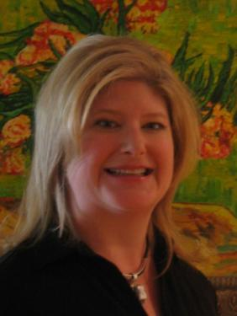
Quick Wins for COHS and other Smaller Projects
Easy Fundraising for
Public Libraries
A California State Library Webinar
Thursday, March 3, 2016
Stephanie Gerding
Notes:
We'll talk about even more easy fundraising ideas and you'll have an opportunity to ask questions, share your ideas and experiences, and interact in real time.

Slide 2
You’ll be ready to:
Focus library fundraising efforts with a clear path to success
Use quick and easy fundraising ideas immediately
Identify resources, methods, and models for easy fundraising
Make the “ask” to the right audience
Gain community support and promote the library through fundraising efforts

Slide 3
Plan Your Fundraising
Friend-raise and Build Partnerships
Implement Easy Activities
It’s about
the people.

Slide 4
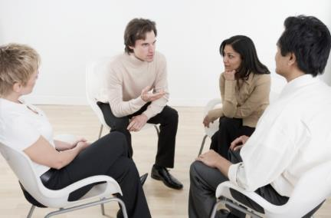
If You Don't Ask, You Won't Get
Does your community know that your roof leaks? Or that your book budget is only 10 cents per person? They can't help if they don't know that help is needed.

Slide 5
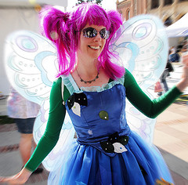
And…you might get more than you ask for!

Slide 6
Plan Your Fundraising
Determine your top library and community needs
Focus on success, not survival!
Notes:
Focus on how the fundraising will help people, and their needs, not the money or the “stuff.” Your project should not just be a good idea, but meet a true need in your community.
Fundraising work should always begin with planning, using your library’s mission, strategic plan, and needs assessments as a foundation.
What should you ask for?

Slide 7
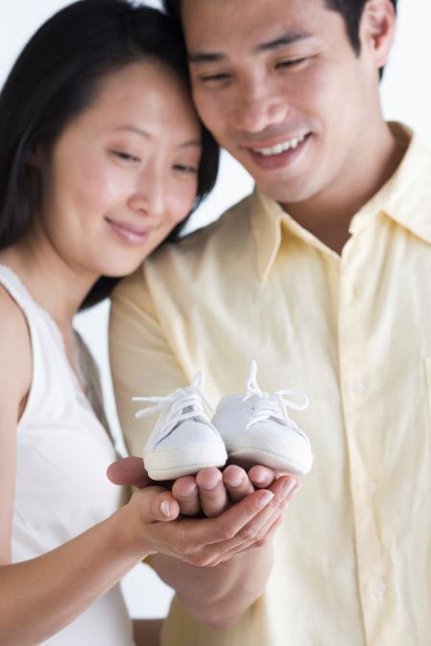
Community Priorities

Slide 8
Plan Your Fundraising
Determine your top library and community needs
Set your goals/wishes and share why you selected them! Make a wish list!

Slide 9


Slide 10
Plan Your Fundraising
Determine your top library and community needs
Set your goals/wishes and share why you selected them!
Verify your fundraising assets

Slide 11

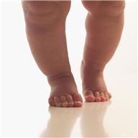
Baby Steps are OK

Slide 12

Plan Your Fundraising
Determine your top library and community needs
Set your goals/wishes and share why you selected them!
Verify your fundraising assets
Determine your baby steps and set deadlines

Slide 13
Friend-raise & Build Partners
Begin by identifying any current or recent private funders.
Consider how you will find new donors.
Make your fundraising efforts highly visible.
Baby step: pick three people to contact

Slide 14
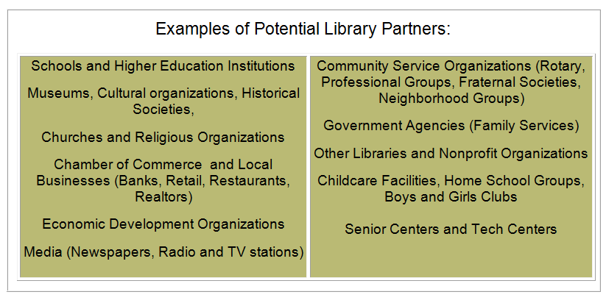
Who is your next new partner?
Notes:
Decide what you bring to the table. Reputation, skills, expertise?
Consider your unique role and connections.
Decide who (people or organizations) you want to partner with.
Use baby steps to build relationships.

Slide 15
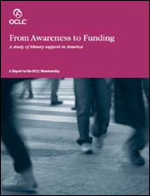
Who to Ask and Why They'll Give
Library funding support is only marginally related to library visitation.
Perceptions of librarians are an important predictor of library funding support.
Voters who see the library as a "transformational" force as opposed to an "informational" source are more likely to increase taxes in its support.
Notes:
Findings in the report From Awareness to Funding: A Study of Library Support in America

Slide 16
Individuals Give the Most
Individuals are the biggest donors (73% of total gift giving)
88% of households give to charity
The greatest percentage (80%) of high net income households give to educational organizations.
MAKE IT EASY TO GIVE!
(These statistics were compiled by the National Philanthropic Trust www.nptrust.org/philanthropic-resources/charitable-giving-statistics)

Slide 17

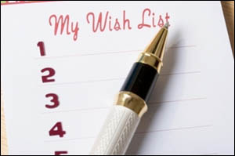
Easy Ways to Ask
Publicize Your Wish List
Talk to probable supporters
Notes:
Although a wish list seems like a simple tool, it is actually a very useful way to prioritize your goals and make the best use of your resources. Wishing helps you to see situations in a positive light and to believe in positive outcomes. Clearly articulate your needs, believe that you can attain them, and then chart a course of action.
When you write your list, express your wishes as specific items or cash requests. Funders love a wish list because it makes it evident what the real needs are and that you have a plan for how to use the items or money. In a small rural library in Arizona, a local business owner noticed the library's recent renovations and approached the director to ask what else was needed. (The timing was good because he needed to make some donations and wanted to get some advertising for his business.) The director showed him the new teen room and told him about the programs offered. He could see that the library needed a big-screen TV, as the children were crowded around a small one. The business owner granted that wish a few days later!

Slide 18
How to Make an “ASK”
Pleasantries (family, work, last time you saw each other)
Make a transition so they know the topic has changed to something more serious.
Make the connection. Remind the person of the connection that you both have with the library.
Appeal to their emotions. Why is the library vital? Use warm fuzzy stories of who has been helped or tap into their personal memories of the library.
Tell them the specific need. This is the background for your ask.
Make the "ask." Remember to make it a question, and ask for something concrete and specific.
Notes:
Libraries have an intellectual and emotional appeal
Adapted from "how to ask anyone for anything" from Joe Garecht’s Fundraising Authority blog.
WHO should ask

Slide 19
Engage Your Super Supporters
Each super supporter makes the commitment to raise a certain amount.
Easy ways to raise $1,000:
They ask 10 people to donate $100.
They donate the entire $1,000 themselves—no added work involved.
They throw dinner parties, and have their guests return the favor. The money multiplies as each guest hosts: For the first party, $25 × 12 guests = $300; three guests have a party, $25 × (12 x 3) = $900; two of their guests have parties, $25 × (12 x 6) = $1,800. Total raised is= $3,000.
Have supporters bring their lunches to work for a week and donate the money saved. They can ask friends to do the same.
The Payson (AZ) Public Library has a Book Wish Tree they keep up all year, adding needed book titles.
Buy-a-Book Fund. Friends and trustees can ask everyone they know to donate the cost of one book, $25. Include a bookplate that donors can fill out themselves.
Notes:
Of course, you could wish bigger and ask for more expensive items than books! In any of these efforts, make sure you include specific items or projects that your library is raising money for, so people know what they are supporting.

Slide 20
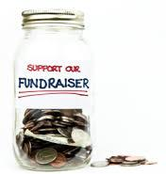
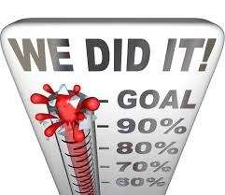
Fundraising Activities
What have you tried?
  Sales, raffles, events, non-events, social media, sponsorships, wish lists
  Annual fund, planned giving
Notes:
There are people ready to make planned gifts to your organization right now

Slide 21

Raffles
Technology Raffles
  Sell enough tickets to cover the cost of the items and make money. For example, sell 250 tickets for $10, purchase an iPad, and you can make a few thousand dollars.
Gift Basket Raffles -fun for trustees and Friends to help out. Themed baskets (cooking, sports, movie time, chocolate lovers, family fun, knitting, etc.) filled with donated items from local stores, restaurants. Display the baskets in the library, and sell tickets to win. This also generates visits to the library as well as excitement when the drawings are held.
Wine Pull. People pay $10 to reach in a box and pull out a number. Each number corresponds to a bottle of wine. If the wine is donated, this is easy money and a quick fundraiser you can do with another event. People are apt to give if they will get some kind of prize. This could be done with items other than wine.

Slide 22

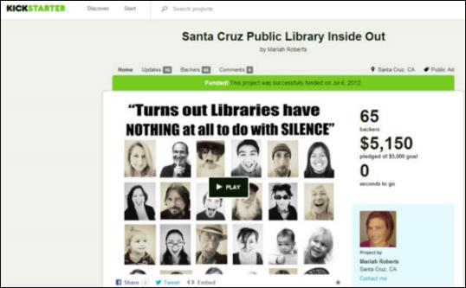
Quick Online Fundraising
eScrip and Gift Cards
Donate Now button
Amazon Wish Lists, Purchases, AmazonSmile
Crowdfunding
  Kickstarter
  Fundly
  Indiegogo
  CauseVox
  DonorsChoose
Notes:
Libraries are also adding direct links for how to give, with "Donate Now" buttons on their websites, with links to PayPal or other secure online payment, or to online forms for donations.
Take a look at how these libraries have developed web pages with multiple ways to donate money or time.
The Boston Public Library Foundation has a Ways to Give page with examples of individual donations and planned giving through wills, memorials, and legacies.
The Winfield (KS) Public Library donation page includes the options of volunteer time, book donations, and giving to the library as "a great way to celebrate a happy occasion or remember someone special. A gift to the library is a lasting gift to the community that will be enjoyed by many again and again."
The Cherry Hill (NJ) Public Library's Support Your Library page highlights many ways to give including a "Friendship Grove" outdoor renovation project, customized art tiles to support the Youth Department, book donations, and volunteer opportunities.

Slide 23
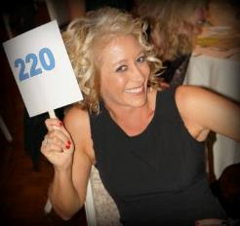

FUNdraising Auctions & Events
"Raise the Paddle“
Walk, Run, or Read-athon
Sales and Theme Parties
Dine Out and "Taste" Events
  Pancake breakfasts from Rotary, Kiwanis, etc. Offer match.
  “Taste of Soup” Mary Stenger, director of the Southern Area Lib. in Lost Creek, WV
Notes:
Midway through the live auction, when the giving spirit has set in, you can have a "Raise the Paddle" to give a cash donation to the library. Have someone talk about a specific need that the library has or share a story of how the library has affected his life. Typically, the auctioneer will have five different giving levels going from the highest to the least amount. Set your levels based on your audience, since you want to be sure to have at least one or two bidders that will meet that challenge. You can even ask a few people in advance to secure those bids. For example, you could begin with $5,000, then drop to $1,000, $500, $100, and $50, depending on your audience. The auctioneer can request the paddles to be held up until they call out the numbers to make sure all bids are counted.
How about creating a library calendar? Jane Somerville, Stanley (ID) Community Library, shared on the ARSL list (January 13, 2014) her process for yearly calendars:
We solicit photographs and sell small advertising squares on each month. The advertisements pay for the printing of the calendar. We sell the calendars for $15.00 each. We have made over $10,000 a year doing this. Every region has its own beauty, so a landscape calendar is pretty easy. There are many other choices, as well. We have our calendars professionally printed. A Friend of the library is a graphic artist and she does the layout for us and sends the proof onto the printer. We do pay her a $500.00 fee. The first time is definitely the most time consuming, getting photos, sponsors, and a logo from each sponsor. We have done this several years running and now have a regular group of sponsors. The back page is updated every year with library information. We sell them at the library, in stores around town, and online.
The Lawrence (KS) Public Library works with local artists to create a series of Banned Book trading cards and then sells them, with proceeds going to both the library and the artists.

Slide 24
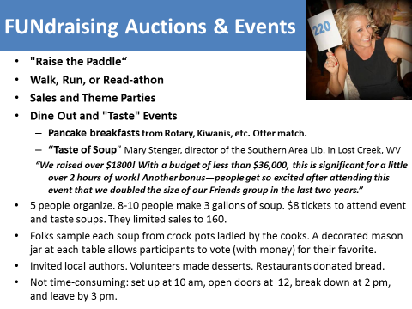

Slide 25

Non-events
Stay home! Invite supporters to stay home and read a book. Mail a tea bag and a card--instead of inviting them to a fundraising dinner, you thought they may like to stay home and read instead. Include an envelope for donations.
End-of-the-year appeal. The majority of money that is given to nonprofits is given at the end of the year. This is when people are thinking about the tax write-offs and are feeling more generous around holidays.
Passive collection efforts. Buy a wishing well, coin funnel, or piggy bank. Children love to put coins in these and will beg their parents for spare change...remember it's for a good cause!
Poetry vending machine! Could be a teen project.
Recycling
Coffee cart
Friends shop
Sponsorships, Naming rights
Notes:
The Payson (AZ) Public Library has a Book Wish Tree. They keep it up all year, adding needed book titles. Library Director Terry Morris decorated the tree with homemade dried fruits. Book titles and fruit are tied onto the tree with raffia.
The Shrewsbury (MA) Library has an ongoing Sunday Sponsorship program to keep the library open on Sundays. The website has a scrolling list of donors, including local businesses, individuals, community groups, and the Firefighters' Association. Approximately 35 Sundays are now funded entirely by donations from these sponsors. The list of sponsors even includes children who have asked for donations to the library instead of birthday presents!

Slide 26
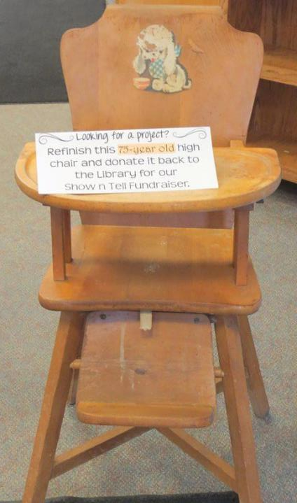

Notes:
Campbellsport, WI
The Library is sponsoring our second annual fun and artistic fundraiser. We are asking community members to donate any unwanted wooden items such as chairs, boxes, benches, small tables, shutters, windows, wooden shelves, as well as metal buckets, watering cans, or any other item that can be turned into a one-of-a-kind piece of art. These items may be dropped off at the Library any time. Starting in June, anyone interested in participating in the fundraiser may stop in and select an item of their liking to decorate however they wish.
This year, we will also be accepting any handmade items for the sale, from hand knit baby blankets to handmade birdhouses, paintings to homemade jams, and woodcrafts to hand strung jewelry.
We are asking that the artists donate their handmade or decorated items back to the Library by September 1st. They will remain on display for 2 weeks so people have a chance to view the items and place bids in an auction.

Slide 27

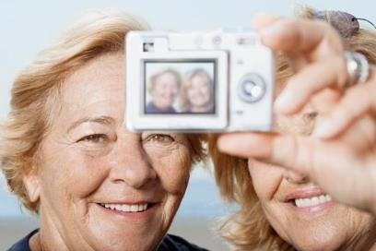

Write the Winning Grant Proposal
1. Follow the Directions
2. Tell the story (PASSION and facts)
3. Keep the audience in mind
4. Seek feedback
5. Ask for everything you need
Notes:
Funders often attest that they get many proposals that are full of great ideas. It's the practical implementation plan with clear goals and objectives that is often missing.
When completing grant proposals or award applications, follow the guidelines explicitly and answer all the questions. Make it easy for the grant reviewer to find the information requested by following the same format and headings as the application. The reviewer may have hundreds of applications to read, so don’t let yours be disqualified due to a technicality such as typos or inaccuracies that could indicate carelessness or lack of dedication. Meet all deadlines on time or ahead of schedule.
Make sure to ask for what you need. Everything your project will require should be listed in your budget. It is better to ask for more and be able to adjust if your proposal is only partially funded.
Grant work is a great way to share your library’s work and recent achievements and success. Tooting your horn when your library succeeds engenders confidence in the library’s leadership, confidence that the library is succeeding at its work and meeting needs in the community, and that the library isn't failing or closing any time soon. No one wants to donate to a library that has big operations, fundraising, or programming problems. Communities support success.
Persevere. Try, try again. No one is ever 100 percent successful, but libraries have a lot of advantages in the grant world, so keep writing those grants!

Slide 28

5 Easy Grants for Beginners
Target Store Grants
Libri Foundation Books for Children
Ezra Jack Keats Foundation Minigrants
Dollar General Grants
Build a Bear Literacy Grants

Slide 29
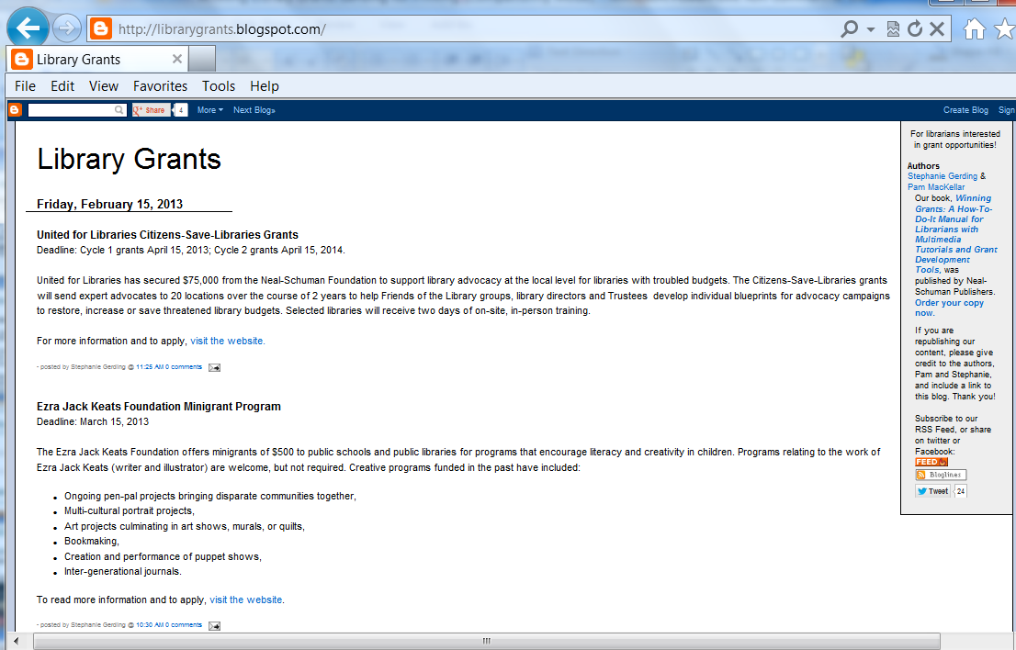
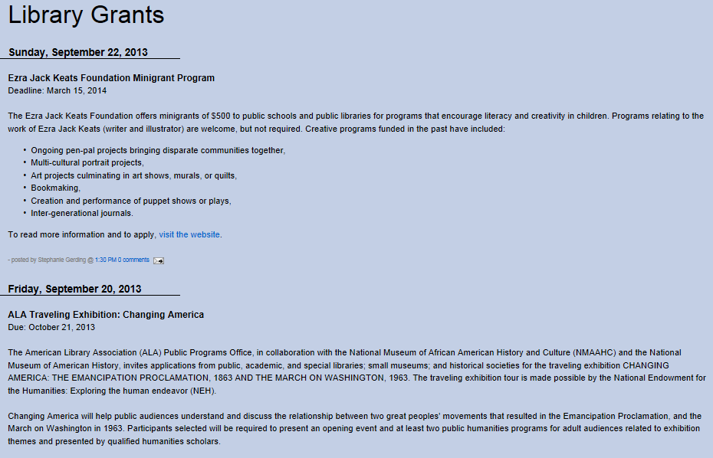
Library Grants Blog
  http://librarygrants.blogspot.com

Slide 30
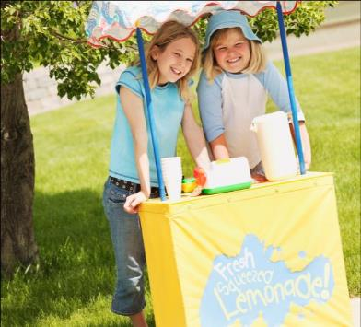





Local Funding Sources
Foundations
Corporations
Clubs and Organizations
Professional Associations
Local government
Local businesses

Slide 31

What easy fundraising ideas and tips do you recommend?

Slide 32

Attitude is important.
Unshakable conviction in the value of your library
  “My library is important and deserving of support!”
Belief that people are willing to give
  “There are people in my community very willing to support my library!”
Belief that, even in bad times, wealth exists in your community
  “We can successfully move our library ahead!”
Willingness to step outside your comfort zone
  “We can do it!”
Notes:
Be positive

Slide 33

Bonus Results
  Visibility
  Community Support
  Easy Advocacy
  New Partnerships

Slide 34
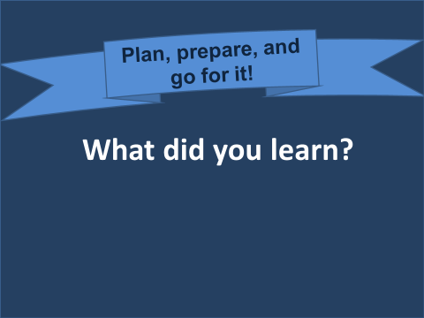
Notes:
ASK, believe and work at it. Libraries do change lives, and we need to make sure that funders and supporters know that we are not just informational, but transformational. There is a saying that luck—and success—is what occurs when preparation meets opportunity. Plan, prepare, and then go after those fundraising opportunities!

Slide 35
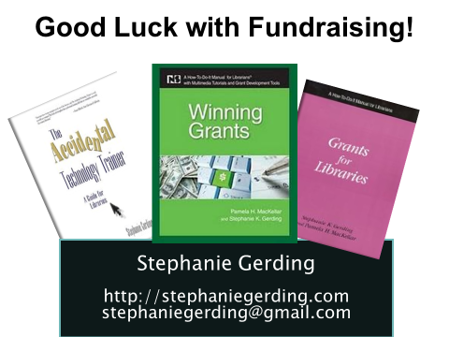

Slide 36



Great to meet you all!
David Baker, JD
LA Based Fundraising Consultant
13+ years engaged in library fundraising & library foundation development
At Your Service

Slide 37
Everything Stephanie said . . .
Focus on the Folks (72% + 8% = 80%)
Leverage your Friends and Foundation
  Prospect identification
  Matching gift opportunity
  Challenge your Foundation to own the scholarships
  Don’t forget IRA Rollovers
Stories win (outputs vs. outcomes)

Slide 38
Let’s chat!
david.baker@givingdesign.com
818-533-8316

Slide 39
Infopeople, a grant project of the Califa Group, is supported in part by the U.S. Institute of Museum and Library Services under the provisions of the Library Services and Technology Act, administered in California by the State Librarian.

