Slide 1

Future-Proofing Library Spaces
Learn the essentials of making your library environment future-friendly
An Infopeople Webinar Wednesday May 11, 2016
http://www.carsonblock.com
librarylandtech@gmail.com
@CarsonBlock

Slide 2
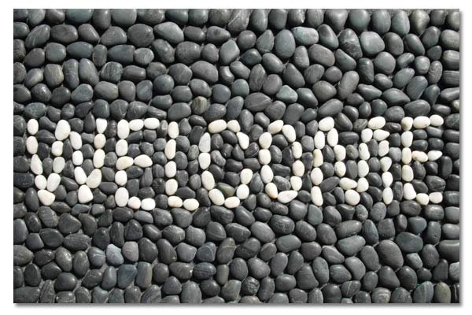
Our Purpose
There's no question of whether technology impacts your library—the question is, how does it impact your library now, and how will it change in the future? What can you do at your library to keep up?

Slide 3
How will we do this?
Learn approaches to retrofitting – including “Design Thinking” and Project Management

Slide 4
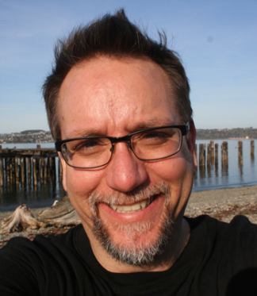
Hello!
Who I am
What I believe
What I do

Slide 5
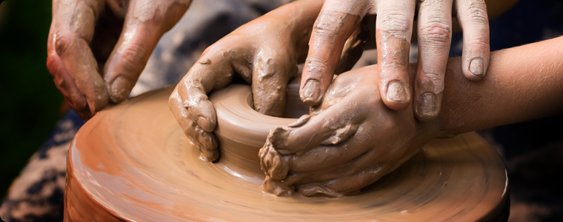
Get ready to engage
Interactive (as possible)!
Collaborative
Conversational
Safe to explore
Type questions in chat box; we will discuss at the end of the presentation
Notes:
external image show-and-tell.jpg284 x 320 · 20 kB · jpeg http://english-pia-moia.wikispaces.com
Filed under: Exhibitions , Interactive , Motion , Works451 x 338 · 131 kB · jpeg tomtor.com

Slide 6

Your Thought Collector
(And you can use your worksheet too!)

Slide 7

Poll: who is here?
Public Librarians
School Librarians
Special Librarians
Academic Librarians

Slide 8
Poll: who is here?
Tiny Libraries
Small Libraries
Medium Libraries
Large Libraries

Slide 9
Handout: Session Worksheet

Slide 10
Introducing Mobile Devices and Design Thinking

Slide 11
Let’s start with a buzz-killing acronym…

Slide 12
BYOD

Slide 13
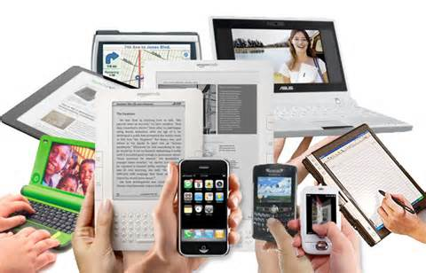
What are mobile devices?
Some Images Courtesy of Demco Interiors

Slide 14
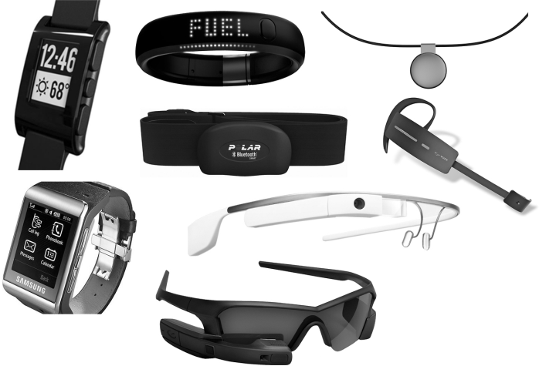
What about wearables?
Notes:
http://blog.ketchum.com/wp-content/uploads/2014/05/tumblr_mu4xnwuglm1qij315o1_1280-300x204.jpg

Slide 15
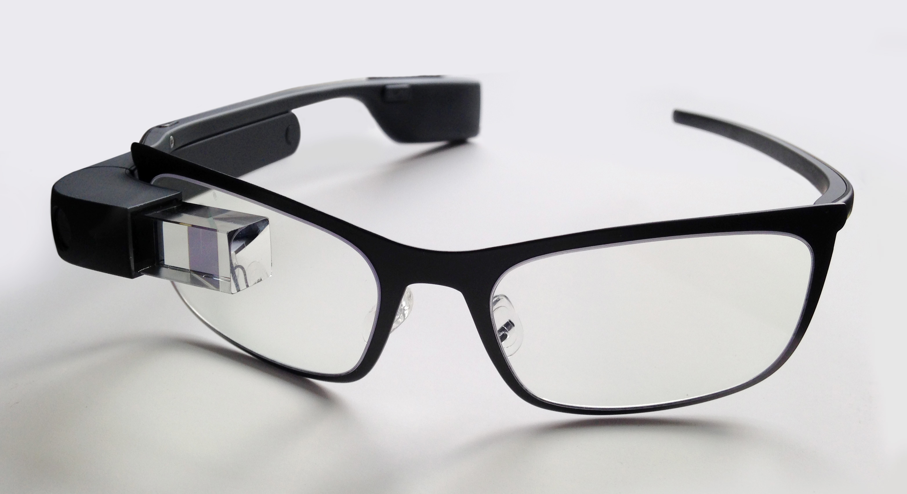
This one talks directly to the Internet

Slide 16
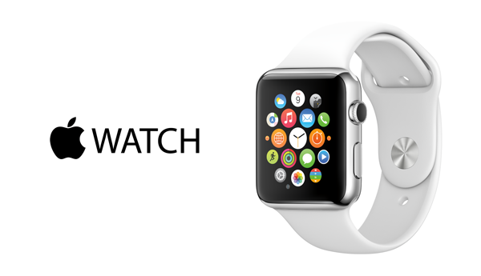
So does this one…

Slide 17
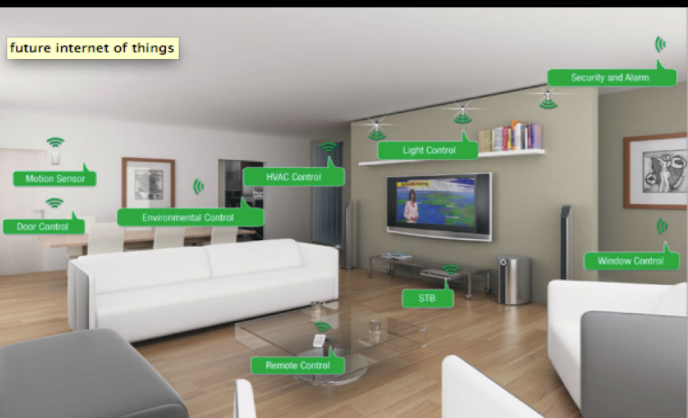
The Internet of Things is here now!

Slide 18
While there are several key things we can do to make our libraries mobile friendly….

Slide 19
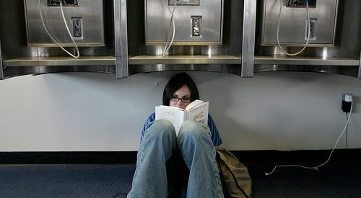
This is what we want to avoid:
Photo credit: https://www.flickr.com/photos/ishane/1082814771/sizes/m/in/photostream/

Slide 20

We can do better!

Slide 21
How do we do better?
Let’s consider what a library is today…

Slide 22
Inside
Outside
Online

Slide 23
Inside
Online
Outside

Slide 24
Form follows
Function*
*ideally :0)

Slide 25
Design
Thinking

Slide 26
Design Thinking
A way to “tackle the unknown” by:
Learn from People
Find patterns
Design Principles
Make Tangible
Iterate Relentlessly
http://upload.wikimedia.org/wikipedia/commons/f/fd/DesignThinking.ogv

Slide 27
Design Thinking is a tool to help us keep pace with an ever-changing world!

Slide 28

Discussion
(feel free to share in chat box)
How is your library like the “inside/outside/online” diagram?
How might you already be incorporating design thinking into what you do every day?

Slide 29
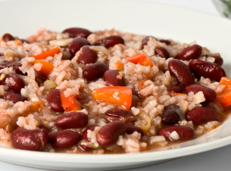
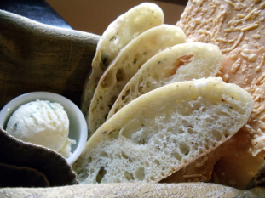
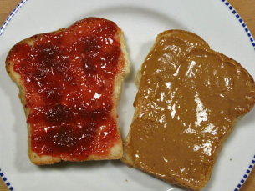
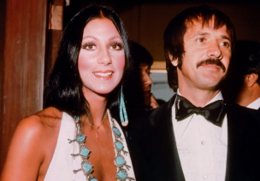
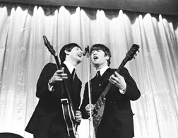
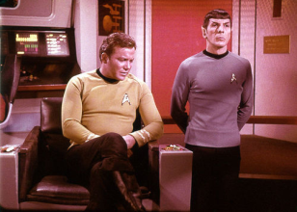
Inspiration and Assessment
Like beans and rice, bread and butter…

Slide 30
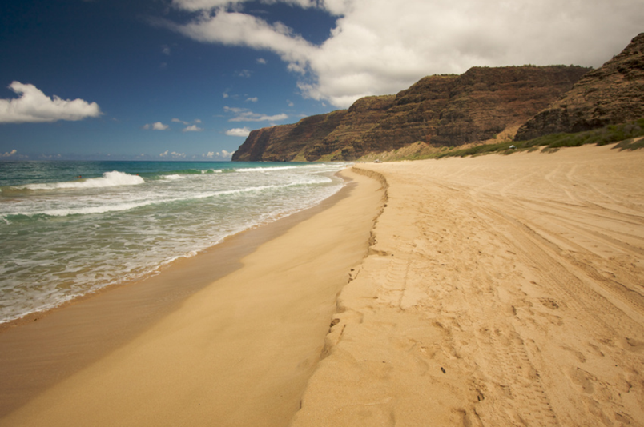
Inspiration: what’s possible today & tomorrow?

Slide 31
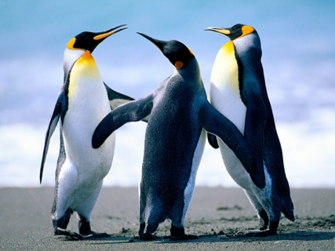
Inspiration: your friends and colleagues

Slide 32
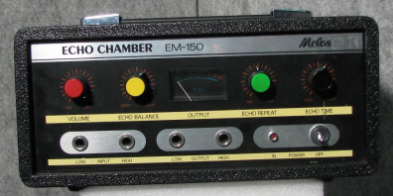
Inspiration: everywhere!
Hint: get outside of the echo chamber…

Slide 33
Activity: Don’t forget to use your worksheet to grab inspiration!

Slide 34
Serving Mobile Users: First Things First

Slide 35
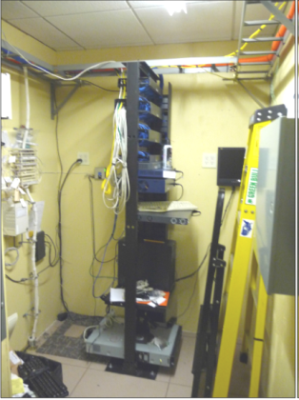
Assessing IT Infrastructure
Having a clear idea of the library’s current capacity and capabilities also creates the perfect place to build from if improvements are needed.

Slide 36
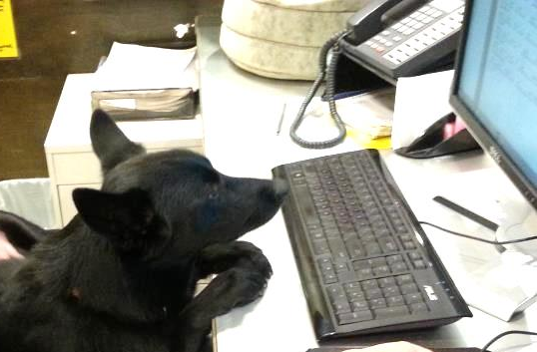
IT Considerations
Capacity of building power
Internet connections
Local area networks
Future needs

Slide 37
The power circuits serving the building are one of the first things to look at, especially for older libraries.

Slide 38
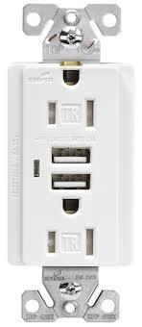
Power Circuits
Is power properly grounded?
Are current circuits adequate or overloaded?
Are there enough outlets (inside and outside the building)?
Are there any power issues such as fluctuations or dimming lights?

Slide 39
Although mobile devices do not require large amounts of power to recharge, having good power available is a prime consideration when serving the needs of mobile users.

Slide 40
For later, after activity: Assess your power!
This is mostly homework – but do you have any obvious power problems?

Slide 41
Mobile devices need more than power.
How is your Internet Connection?

Slide 42

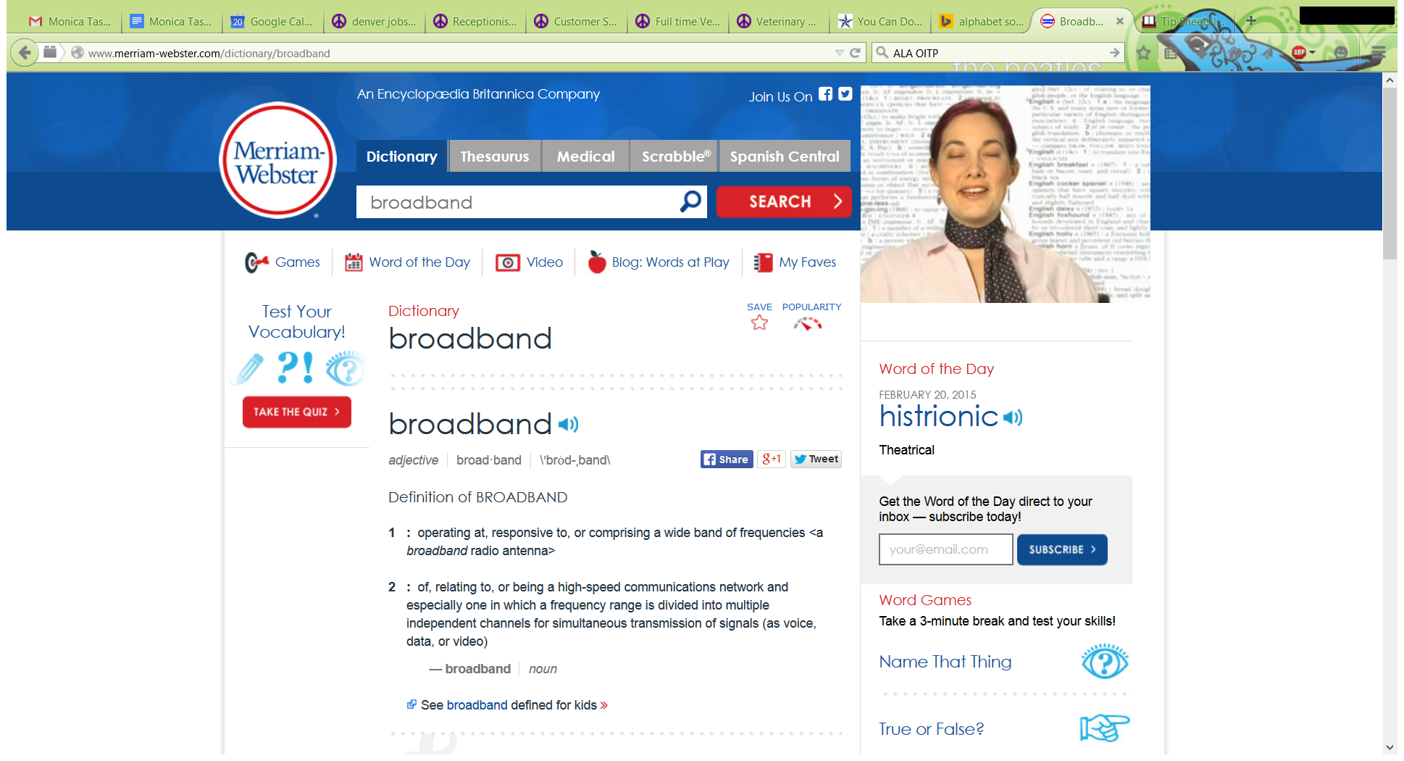
What is “Broadband?”
It’s Fast!
Notes:
Source: ALA’s OITP’s and Merriam-Webster
http://www.ala.org/offices/oitp/publications

Slide 43
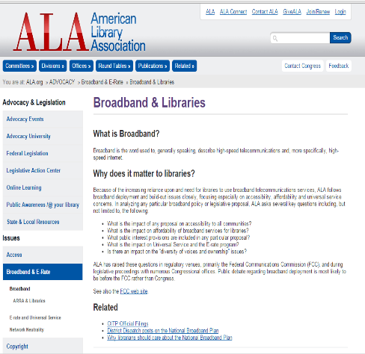
What is “Broadband?”
It’s Fast!
Broadband is the word used to, generally speaking, describe high-speed telecommunications and, more specifically, high-speed internet.
In January the FCC determined that a broadband connection is at least 25 Mb/sec
Notes:
Source: ALA: http://www.ala.org/advocacy/telecom/broadband

Slide 44
Why is broadband desirable?
All those devices are hungry for a network connection – and there are more and more devices every day…

Slide 45
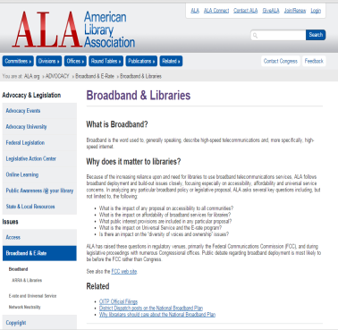
How can I choose the broadband speed for my library?
Two Key Factors:
What is available in your area? (more on that in a bit)
What can you afford? (and don’t forget E-Rate!)
EDGE Formula Calculator: http://impact.ischool.uw.edu/calc.html
Notes:
Source: ALA: http://www.ala.org/advocacy/telecom/broadband
http://impact.ischool.washington.edu/documents/edge_bandwidth.pdf
http://impact.ischool.uw.edu/calc.html

Slide 46
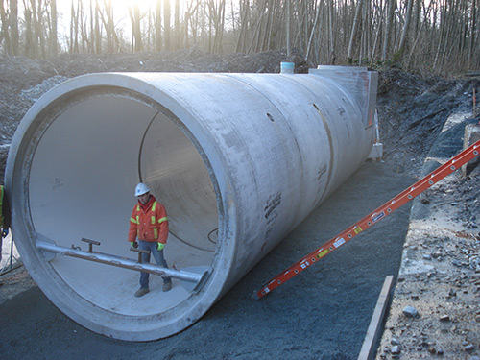
How is speed measured? (And what do you mean by “big pipe” Internet?)
Bits per second (bps) - sloooooow
Kilobits per second (kbps) – dial up modem speed
Megabits per second (Mbps) – “Broadband”
Gigabits per second (Gbps) – Fast (think the Google Fiber projects in KC, Provo and Austin).
Notes:
Source: ALA: http://www.langleyconcretegroup.com/index.php?mact=Gallery,m6e73e,default,1&m6e73edir=South%2520Surrey%2520Interceptor%2520-%2520Metro%25203050mm%2520PVC%2520lined%2520concrete%2520pipe&m6e73ereturnid=19&page=19

Slide 47
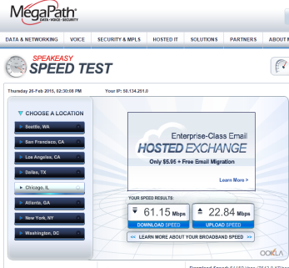
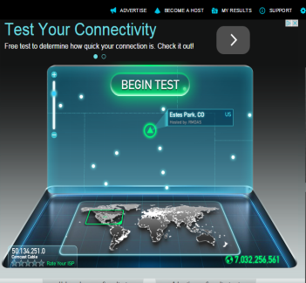
How can I check my speed?
http://www.speakeasy.net/speedtest/
http://www.speedtest.net/
Notes:
Monica: URLS and graphics fortop 2 speed tests (ask me)

Slide 48


How much bandwidth (or speed) do we need?
The answer is always “more.”
Notes:
Playalong para Bateria de “Rebel Yell” - Billy Idol500 x 500 · 45 kB · jpegdanielbatera.com.br

Slide 49
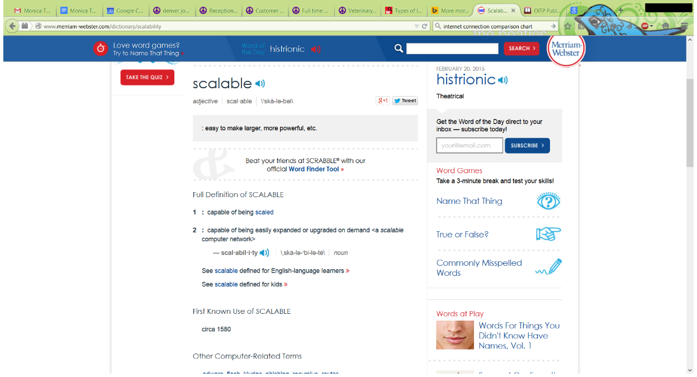
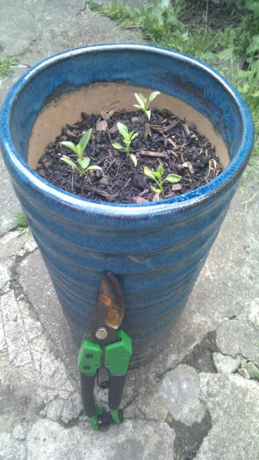
What is “Scalability,” and why does it matter?
Notes:
Spend a little more time explaining scalability - and we will reinforce this later.

Slide 50
What about WiFi?

Slide 51
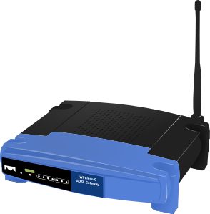
What about WiFi?
WiFi access points serve a limited number of users at one time.

Slide 52
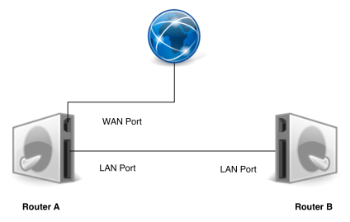
What about WiFi?
Think “scalability” for mobile users--design for a WiFi network that can easily grow by simply adding inexpensive access points as demand increases.

Slide 53
Making User Spaces Mobile Friendly

Slide 54
Pop-Quiz: Which seats are the most popular in your library?

Slide 55
Typically the seats closest to a power outlet!

Slide 56
Remember—we want to avoid this:
https://www.flickr.com/photos/ishane/1082814771/sizes/m/in/photostream/

Slide 57
Making User Spaces Mobile Friendly

Slide 58
Making Spaces “device friendly”

Slide 59
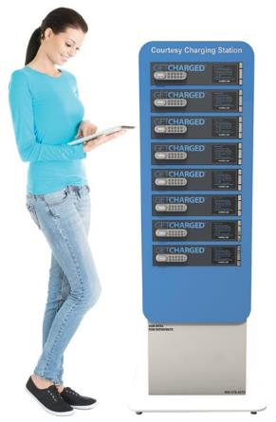
Power to the Patrons!

Slide 60
Carson’s rule for remodels or new construction:
“Any space we provide for a patron to sit, we should also provide safe and convenient access to a power outlet.”

Slide 61
Retrofitting power solutions
Visible surface-mounted power access points built into desks, tables and other furnishings.

Slide 62
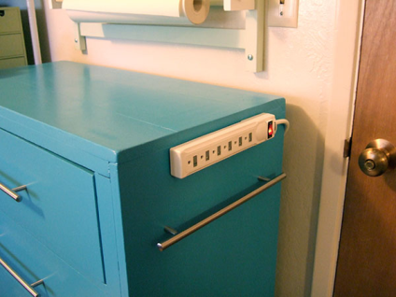
Retrofitting power solutions
The lowly power strip – when selected or modified to match the aesthetics and mounted correctly -- can be an inexpensive approach.

Slide 63
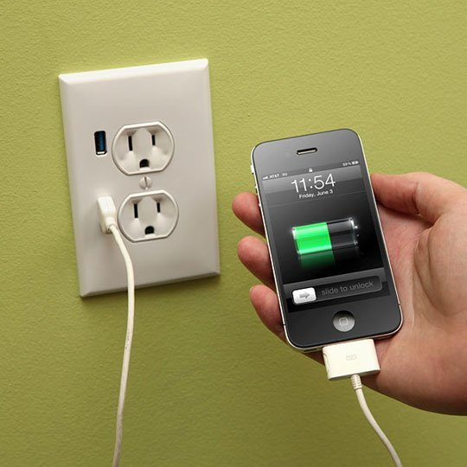
USB Power

Slide 64
Charging Lockers

Slide 65
General Comfort

Slide 66
Design orientation: think like a mobile user.
Are we designing or modifying our spaces with patron comfort and convenience in mind, or just trying to fit the most people in the smallest space possible?

Slide 67
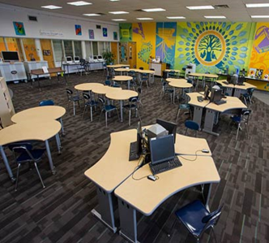
Solo Computing Spaces: places for solitary work
Solo computing spaces – places for patron “stuff”
  Books, purses, backpacks, food and drink (if you allow), etc.
  Patrons have their own mobile devices! (space and power)
Notes:
Monica – please split these into separate slides – perhaps multiple slides for each example?

Slide 68
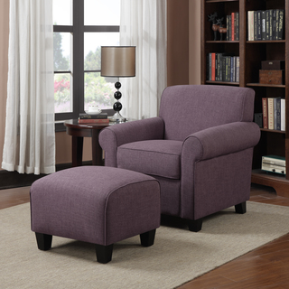
This is also a solo computing area
Notes:
Monica – please split these into separate slides – perhaps multiple slides for each example?

Slide 69
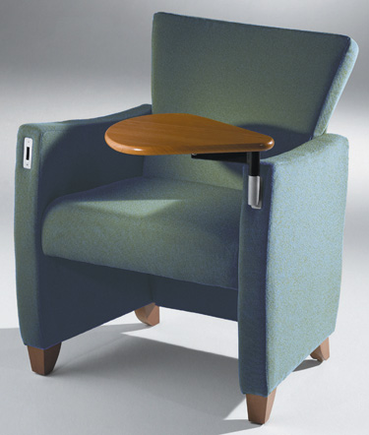
Solo Computing Spaces: Ideas
Lounge chairs with swivel tablet arms or portable pull-up tables are nice options.
Small portable tables are becoming the preferred option since users can adjust the table location to meet their needs, unlike swivel alternatives that attach directly to the chair.
Notes:
Monica – please split these into separate slides – perhaps multiple slides for each example?

Slide 70
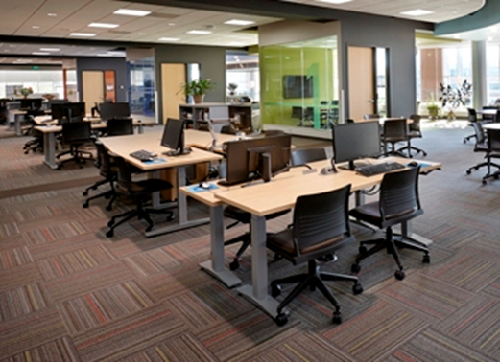
Collaborative Computing Spaces
Notes:
Monica – please split these into separate slides – perhaps multiple slides for each example?

Slide 71
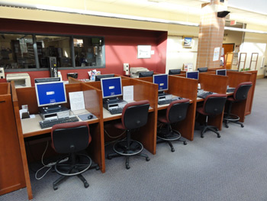
Let’s move away from this when we can:

Slide 72
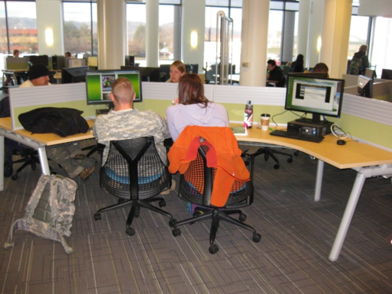
Collaborative Computing Spaces: Ideas
Large surface areas for personal and shared “stuff”
Patrons have their own mobile devices! (space and power)

Slide 73
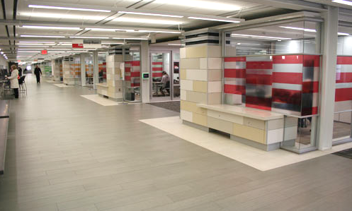
Collaborative Computing Spaces: Meeting Rooms
Private meeting rooms at the University of Iowa library
Notes:
Monica: Please create multiple slides around the paragraph breaks (please see the hard copy_

Slide 74
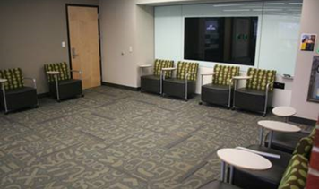
Collaborative Computing Spaces: Meeting Rooms
Notes:
Monica: Please create multiple slides around the paragraph breaks (please see the hard copy_

Slide 75
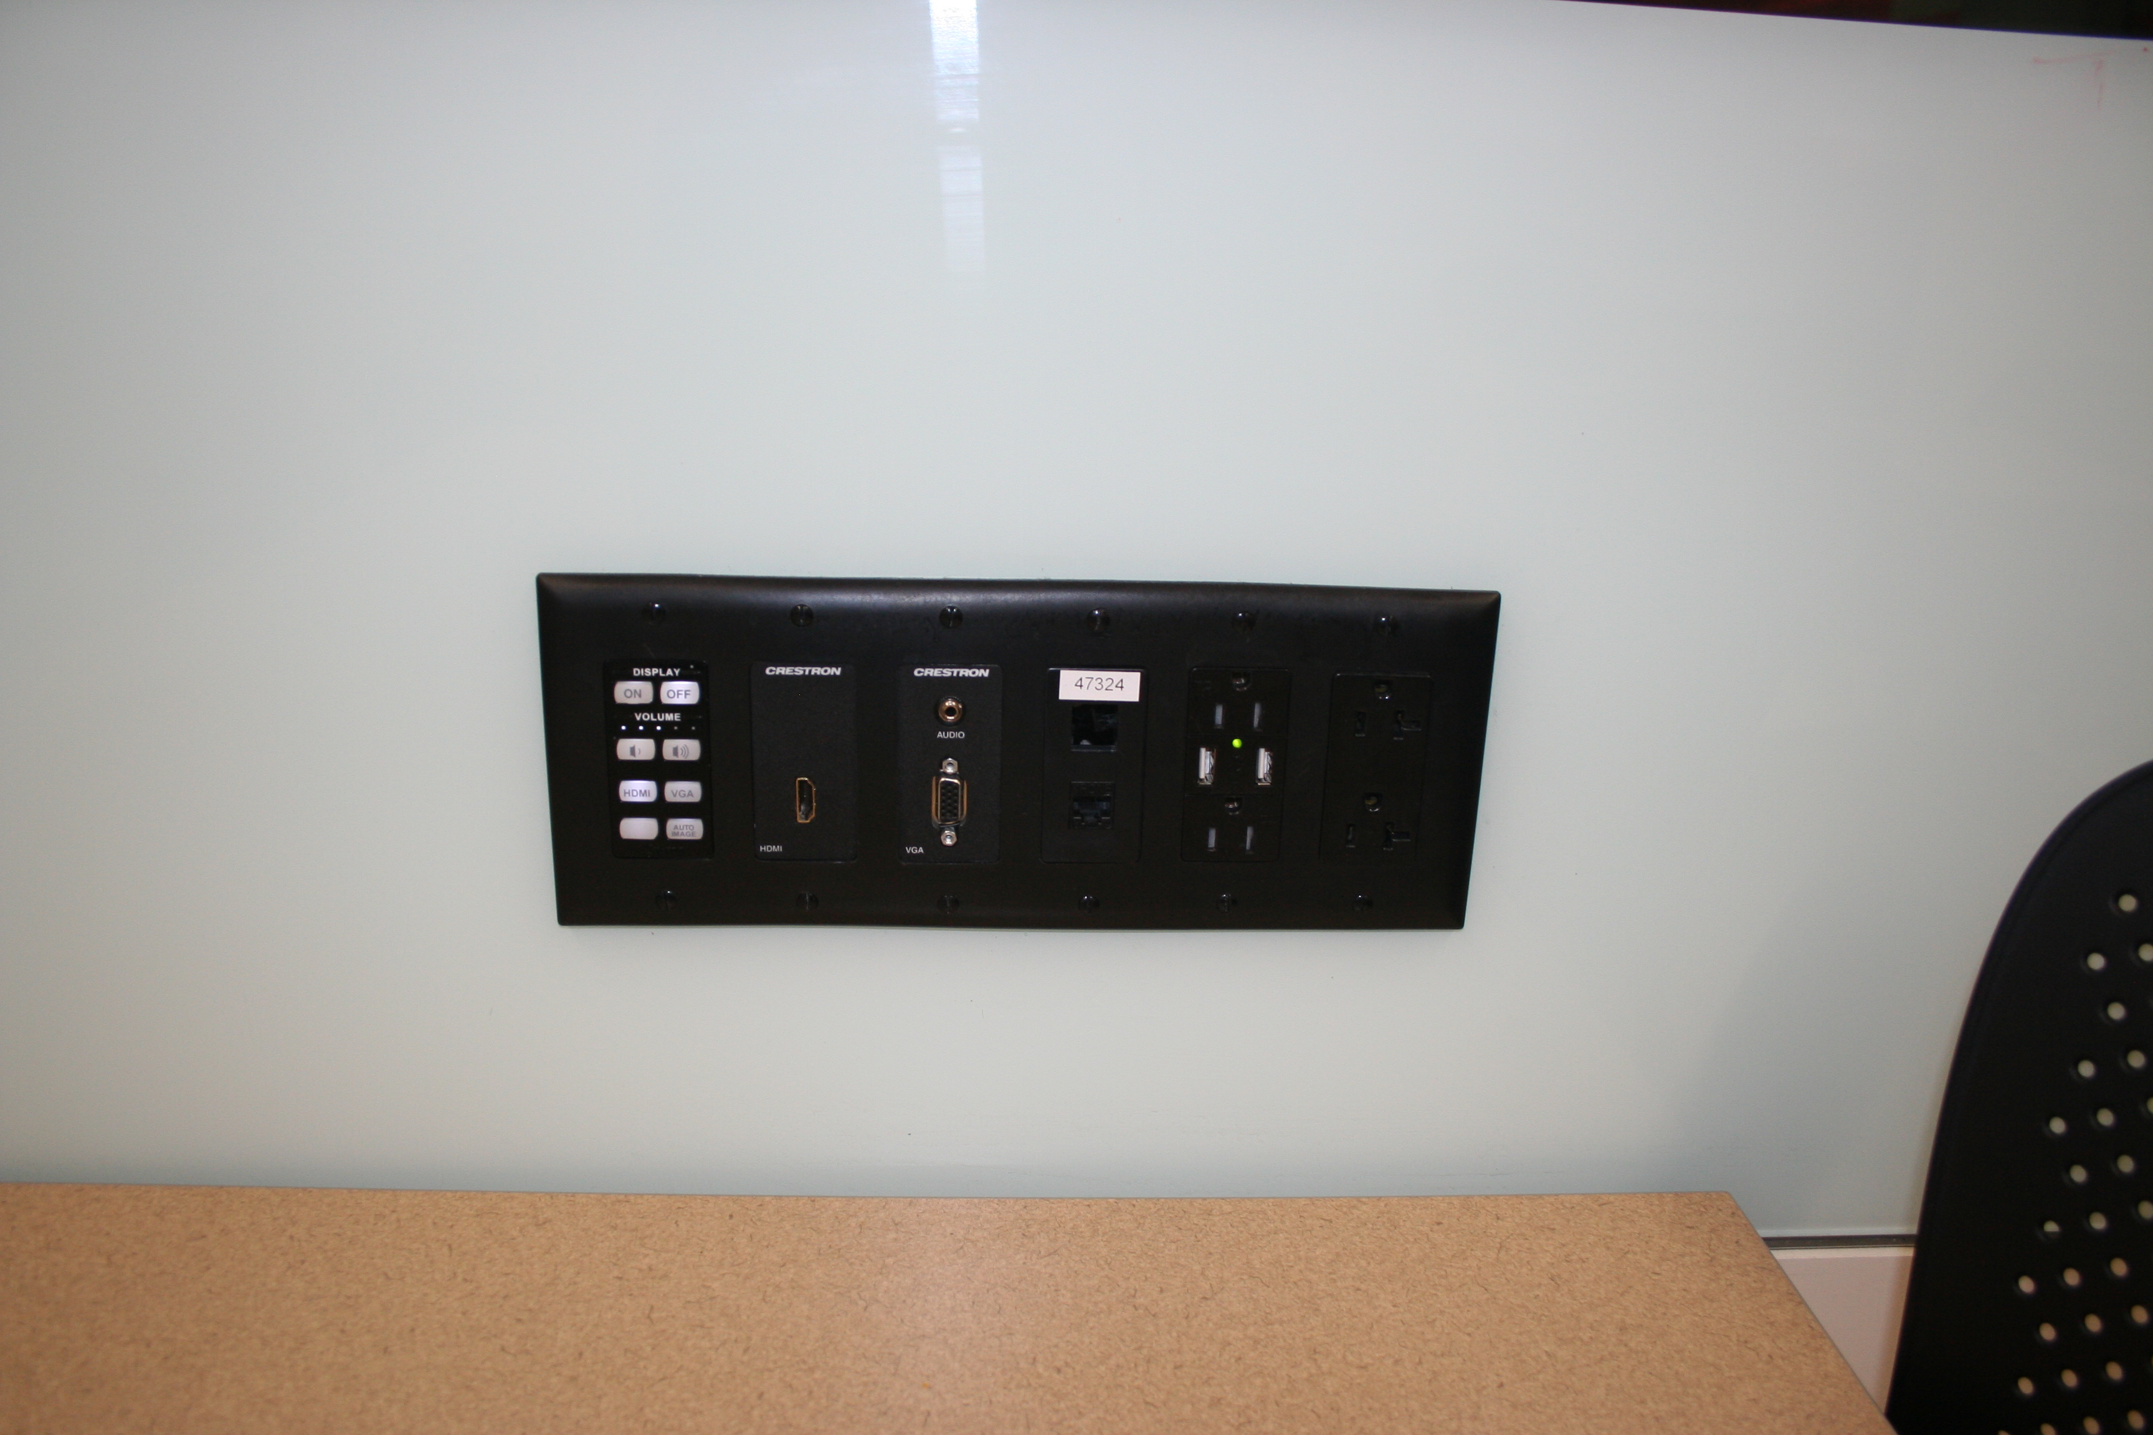
Collaborative Computing Spaces: Meeting Rooms
Meeting rooms at the University of Iowa library—connection plate
Notes:
Monica: Please create multiple slides around the paragraph breaks (please see the hard copy_

Slide 76
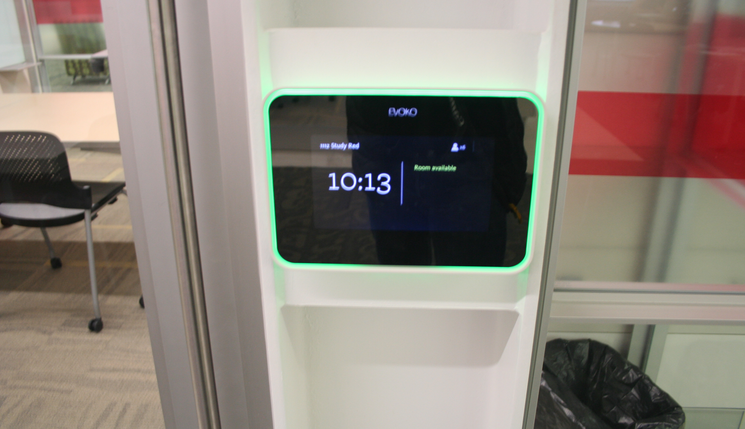
Collaborative Computing Spaces: Meeting Rooms
Meeting rooms at the University of Iowa library—digital room reservation

Slide 77
Homework/comments today: what needs have you observed from users of mobile technology in your library?

Slide 78
Homework/comments for today: How might you address those needs in your library?

Slide 79
What if you’re maxed-out?
What if you can’t build?

Slide 80
Inspiration from Schools: Transition to the Learning Commons

Slide 81

Re-assess and Re-use

Slide 82
Assessment – challenges and opportunities

Slide 83
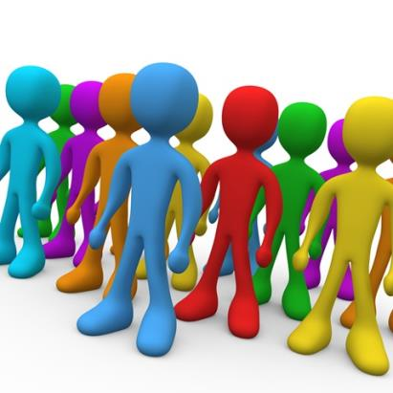
Assessment (different perspectives)
Staff
Patrons/Students
Others
Notes:
Get ready to engage slide from TSLAC

Slide 84

Assess different things
Tech
Power
Physical Spaces
Workflow
Others
Notes:
Get ready to engage slide from TSLAC

Slide 85
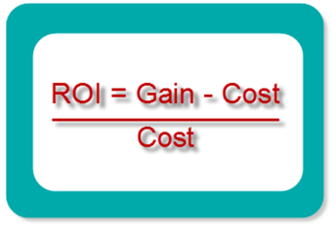
Assessment Criteria
Who does this serve (many or few, well-served already or under-served)?
How is it staffed? (are any trade-offs in staff time/effort worthwhile?)
Is it easy to use or learn for staff and customers?
Advanced: What is the Total Cost of Ownership (TCO)?
Advanced: What is the Return on Investment (ROI)?
Notes:
Get ready to engage slide from TSLAC

Slide 86
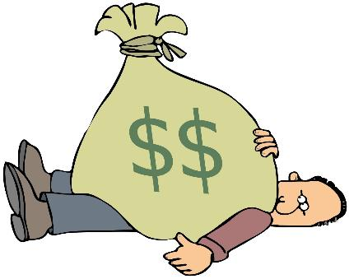
Approaching Funding
Be deliberate
Use a design process
Identify the primary objective

Slide 87

Approaching Staffing
Regular access
Learning
Sharing opportunities

Slide 88
Take Home Activity:
Vision for Your Library

Slide 89
Resources: People, Places, Things

Slide 90
Resources: Energy, Good Will, Stick-to-it-iveness

Slide 91
Activity:
Getting it done! Working through a mini-project plan

Slide 92
Mini-Project Plan
Vision/Impact
A main objective (just one for today)
A set of tasks
A timeline or a deadline
What you need to get the job done
  Time
  Money
  Donations or grants
How do we know we’ve been successful (hint: did we accomplish the objective?

Slide 93
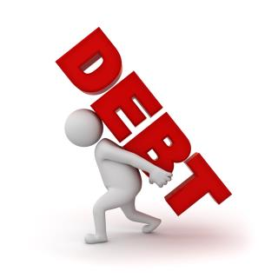
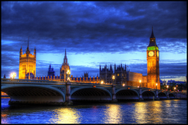
Vision/Impact
What is your big picture?

Slide 94
A main Goal (just for today)
Describe what you intend to accomplish (SMARTly)

Slide 95
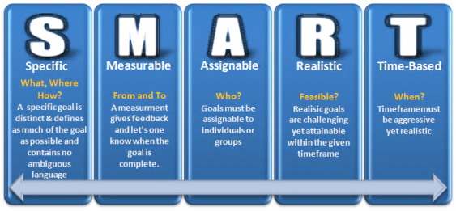
SMART Goals
Notes:
https://thehrcafe.wordpress.com/tag/smart-goals/

Slide 96

A set of tasks:
How will you accomplish your Goal?

Slide 97

A timeline or deadline:
How long with this take – or when should it be completed?

Slide 98
What do you need to get the job done?
Time
Money
Donations or grants
Other

Slide 99
How do we know we’ve been successful?
Hint: did we accomplish the objective?

Slide 100
Are you done?
Hint: You’re never done! :0)

Slide 101
What’s Next?
Going forward, one of the greatest emerging technology needs -- and one that applies to all areas of the library -- is coming from the further evolution of "BYOD" (Bring Your Own Device) where patrons and staff bring their own equipment to use with the library's wireless access. Today, BYOD generally refers to laptop computers, tablets, eReaders and other similar devices. But those are just the beginning.

Slide 102
The Internet of Things is here now!

Slide 103

Questions?
Thank You!
@CarsonBlock
www.carsonblock.com

Slide 104
Infopeople, a grant project of the Califa Group, is supported in part by the U.S. Institute of Museum and Library Services under the provisions of the Library Services and Technology Act, administered in California by the State Librarian. This material is covered by a Creative Commons 4.0 Non-commercial Share Alike license. Any use of this material should credit the funding source.

