Slide 1
Welcome to today’s Infopeople Webinar!
Infopeople is dedicated to bringing you the best in practical library training and improving information access for the public by improving the skills of library workers. Infopeople, a grant project of the Califa Group, is supported in part by the Institute of Museum and Library Services under the provisions of the Library Services and Technology Act administered in California by the State Librarian. This material is covered by Creative Commons 4.0 Non-commercial Share Alike license. Any use of this material should credit the funding source.

Slide 2
TUESDAY JUNE 14, 2016
AN INFOPEOPLE WEBINAR

Slide 10
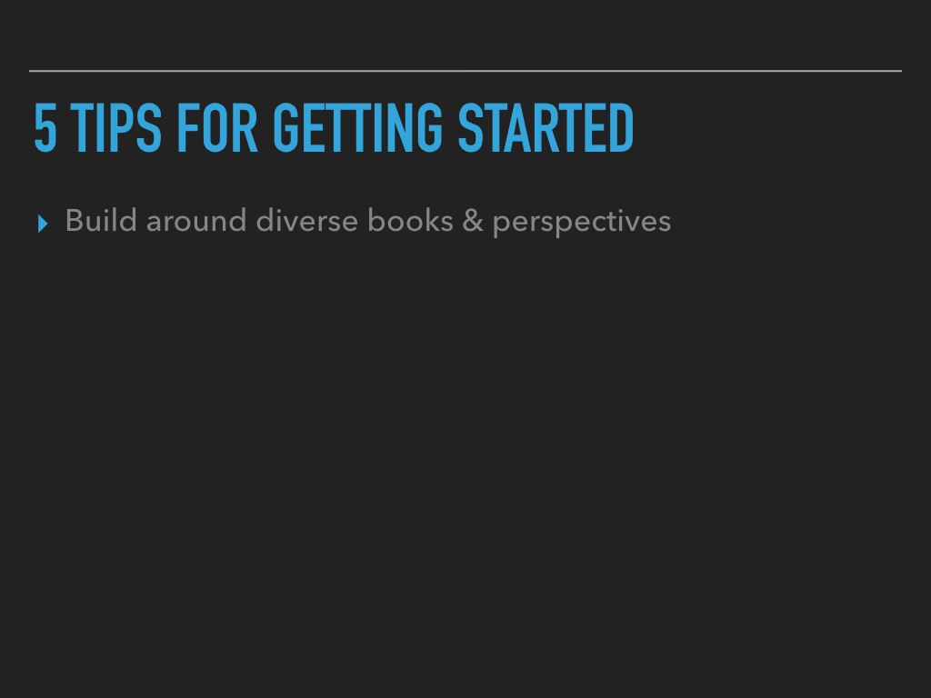

Slide 18
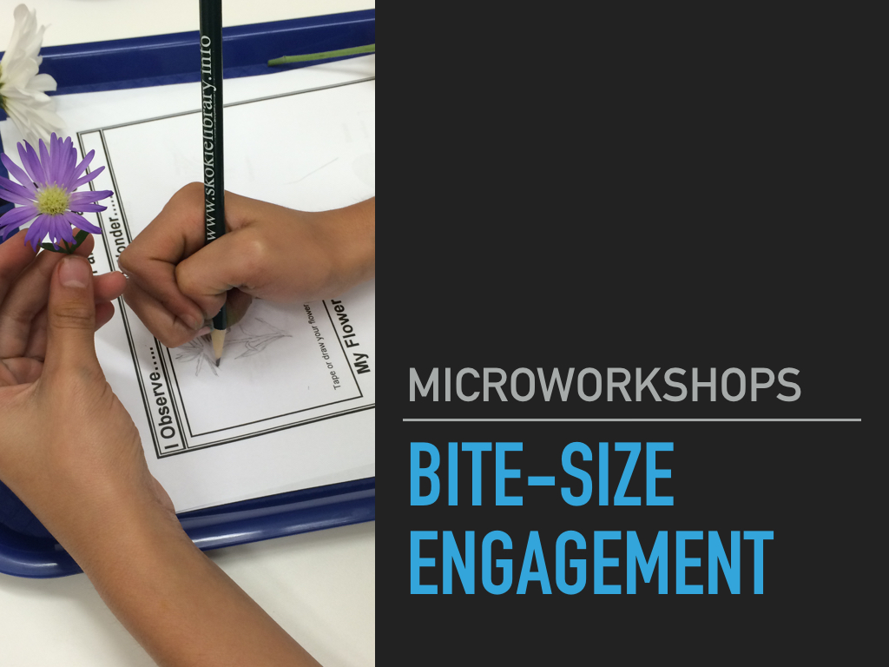

Slide 20
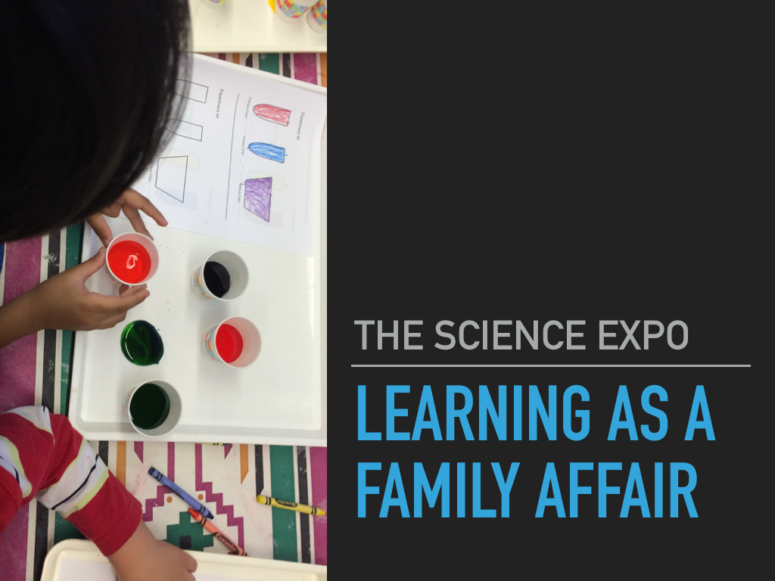

Slide 21
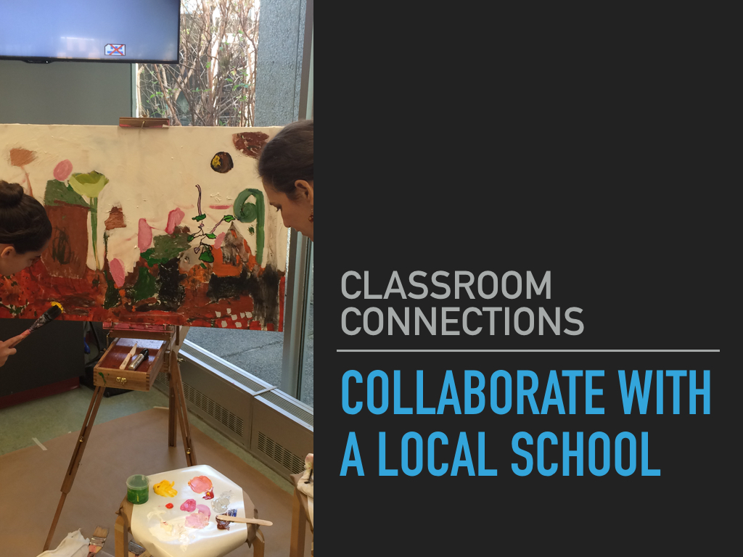

Slide 25
