Slide 1
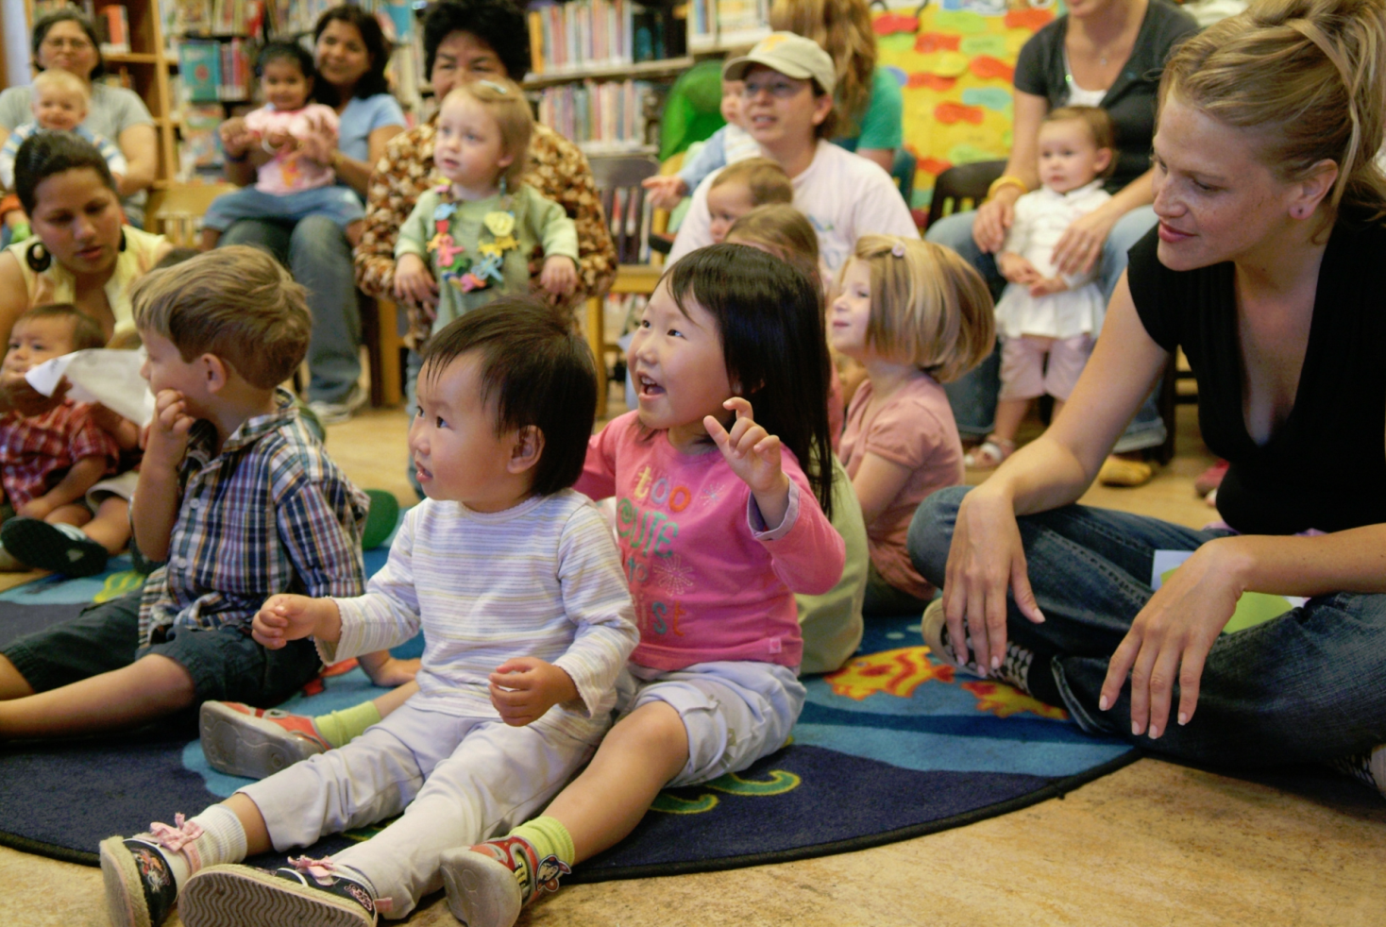
Touchpoints in Libraries

Slide 2
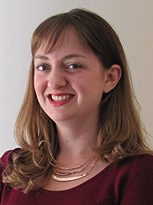
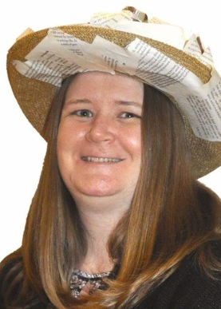
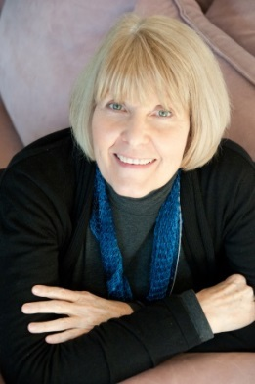
The Presenters
Madeline Walton-Hadlock
Early Education Manager/Senior Librarian
San José Public Library
Susie Serrano
Branch Manager
Butte County Library
Suzanne Flint
Library Programs Consultant
CA State Library

Slide 3
AGENDA
What is Touchpoints?
What does Touchpoints mean for libraries?
How to apply for a Touchpoints training in 2016/17
Questions & Answers

Slide 4
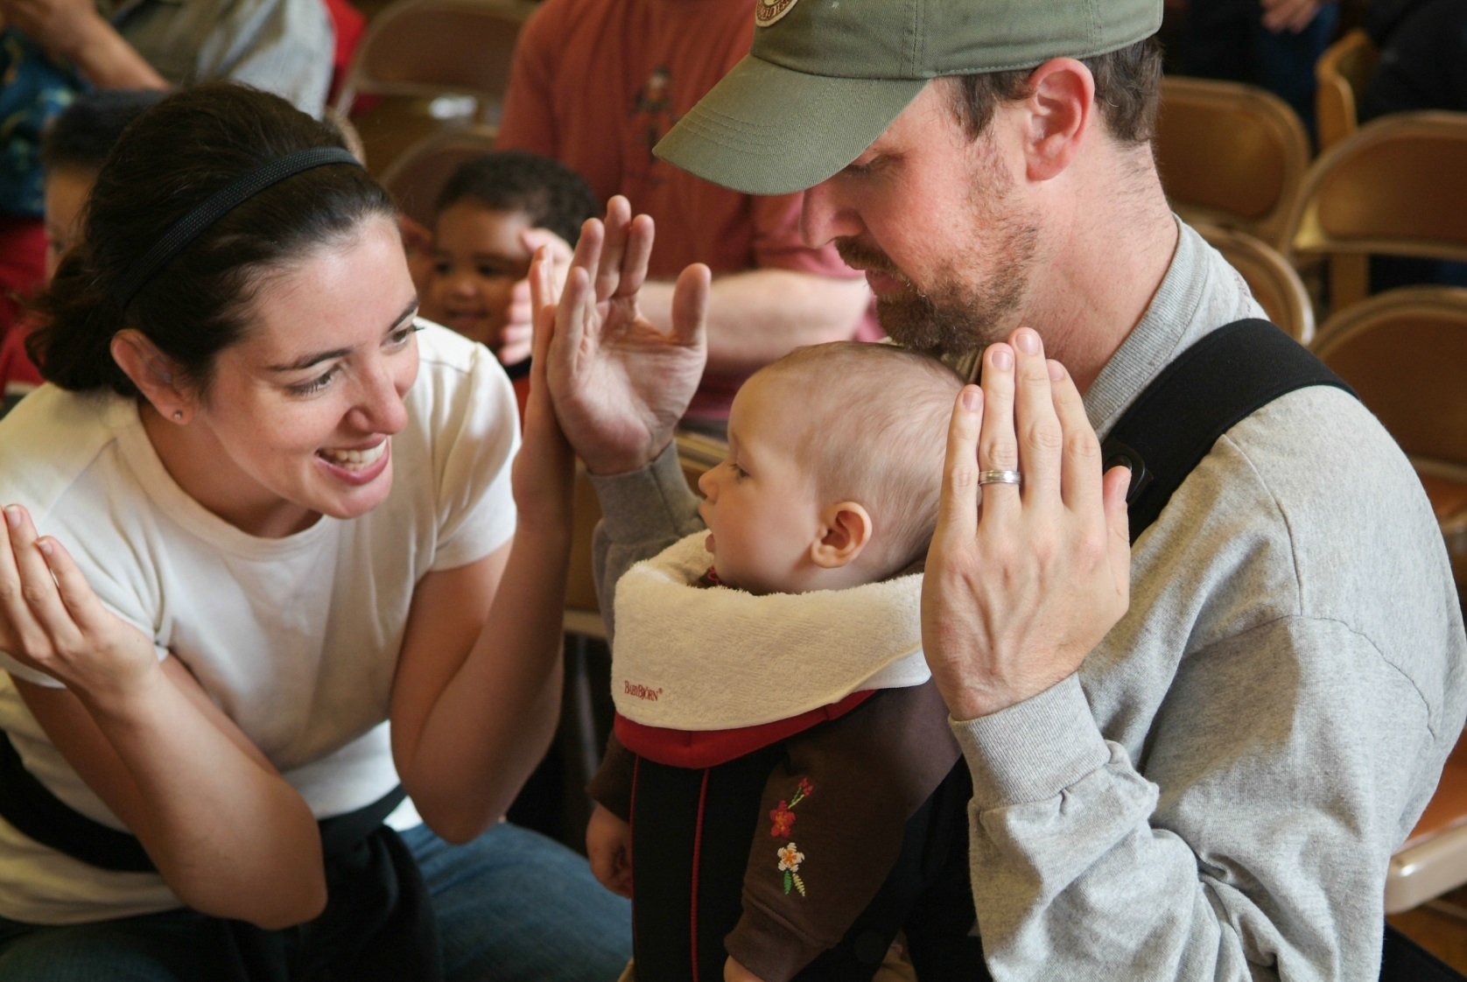
Which statement best describes your library?
All families feel supported by our library, and staff are well prepared for any positive or negative interactions we may have with families.
Families seem happy to use our library, but sometimes we wonder if we could be supporting them (and ourselves) better.
Families aren't well supported by our library, and staff doesn’t feel equipped to interact effectively with them.
Notes:
Audience poll

Slide 5
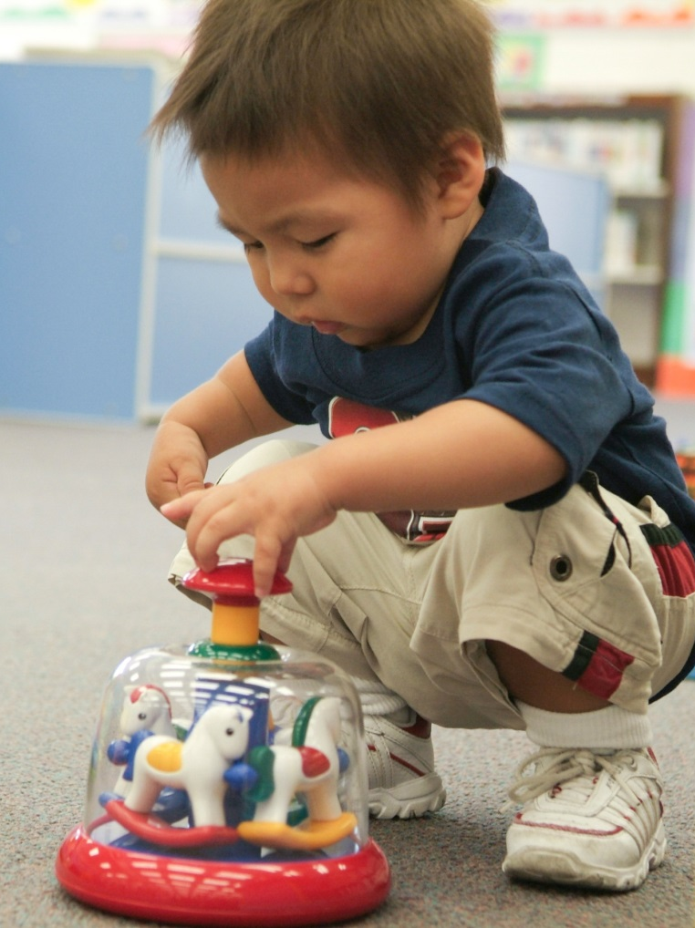
The Touchpoints Approach
Engages families by:
Understanding child development
Supporting relationships
Notes:
Touchpoints were identified by pediatrician, Dr. T. Berry Brazelton and are based on his year’s of studying children and families at Boston Children’s Hospital and Harvard Medical Center. It is an approach for working with families that is being used by various professional groups, and now libraries. The national Brazelton Touchpoints Center is located in Boston.

Slide 6
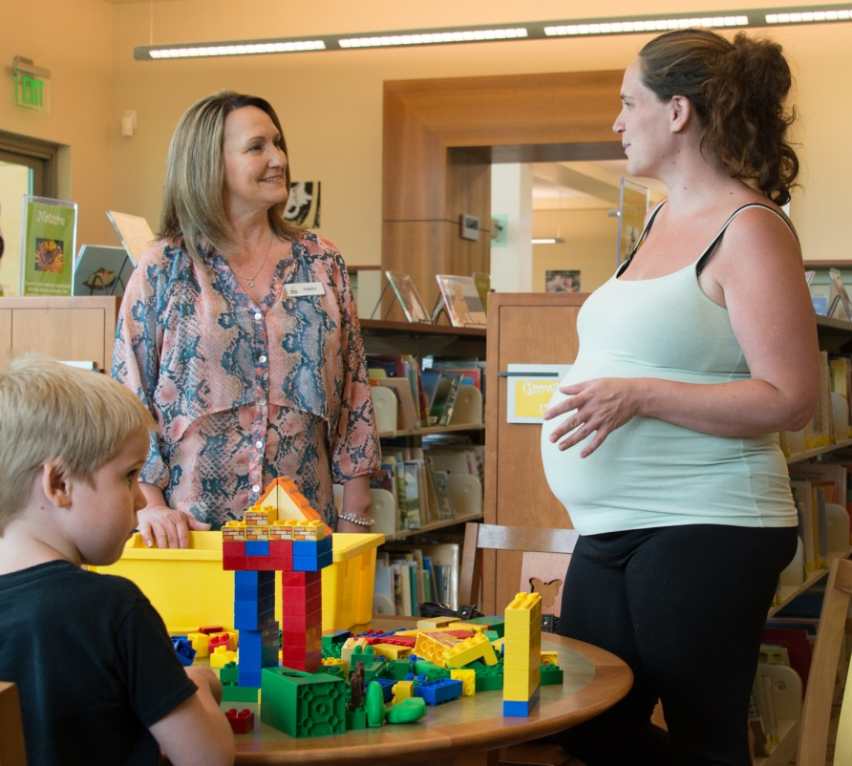
The Touchpoints Approach
Supports staff by:
Increasing knowledge of child development
Expanding awareness of our own thoughts and actions
Providing specific tools to help us make intentional choices

Slide 7
Child Development
Fictional path
Actual path
Notes:
Dr. Brazelton discovered that children actually do NOT develop in a smooth linear progression but that their development is defined by predictable regressions, bursts and pauses, and that these ‘Touchpoints’ periods of regression can cause disorganization for both the child and parents. And because this is an ongoing, repetitive cycle families can often be in a state of disorganization. In addition, the Touchpoints developmental model recognizes that the child’s development is intimately affected by the meaning the child’s caregivers apply to these various developmental events.

Slide 8
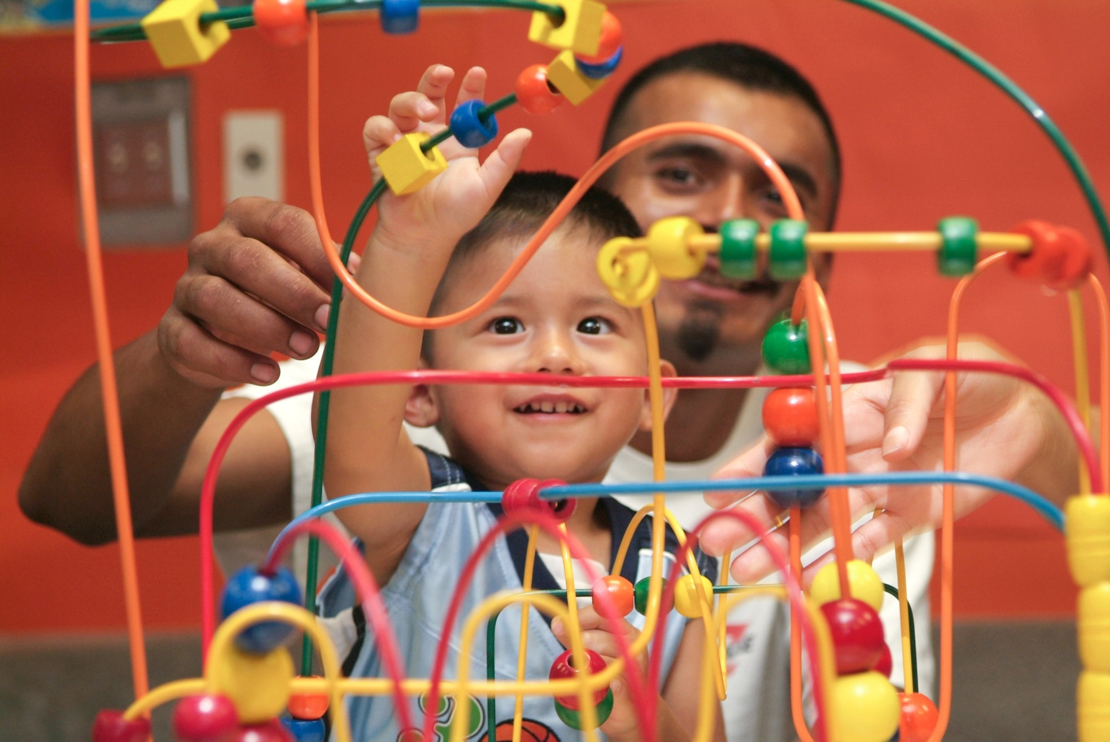
We’re born to develop within caring relationships…
Notes:
Once we understand a bit about how children development, it’s important to understand that ALL early development – cognitive, motor, language, social and emotional development – occurs within a system of caregiving relationships. Babies will not survive without adult caregivers!

Slide 9
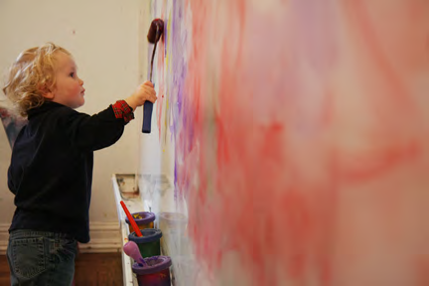
Touchpoints Tools
Assumptions:
strength-based attitudes
Guiding Principles: relational strategies
Notes:
Touchpoints offers us some specific tools and the training provides opportunities to understand and work with these tools so that eventually they can be incorporated into our every day work with children, families and caregivers.

Slide 10
Parent Assumptions
The parent is the expert of his/her child
All parents have strengths
All parents want to do well by their child
All parents have something critical to share at each developmental stage
All parents have ambivalent feelings
Parenting is a process built on trial and error
Notes:
These are attitudinal perspectives we choose to assume…NOT something that parents must display or prove.

Slide 11
Guiding Principles
Recognize what you bring to the interaction
Look for opportunities to support mastery
Use the behavior of the child as your language
Value disorganization
Focus on the parent-child relationship
Value and understand the relationship between you and the parent
Be willing to discuss matters that go beyond your traditional role
Value passion wherever you find it
Notes:
These are strategies for how to stay present, observe, and interact with families and caregivers….both when things are going well in the library and especially when things may not be going smoothly and rules need to be discussed.

Slide 12
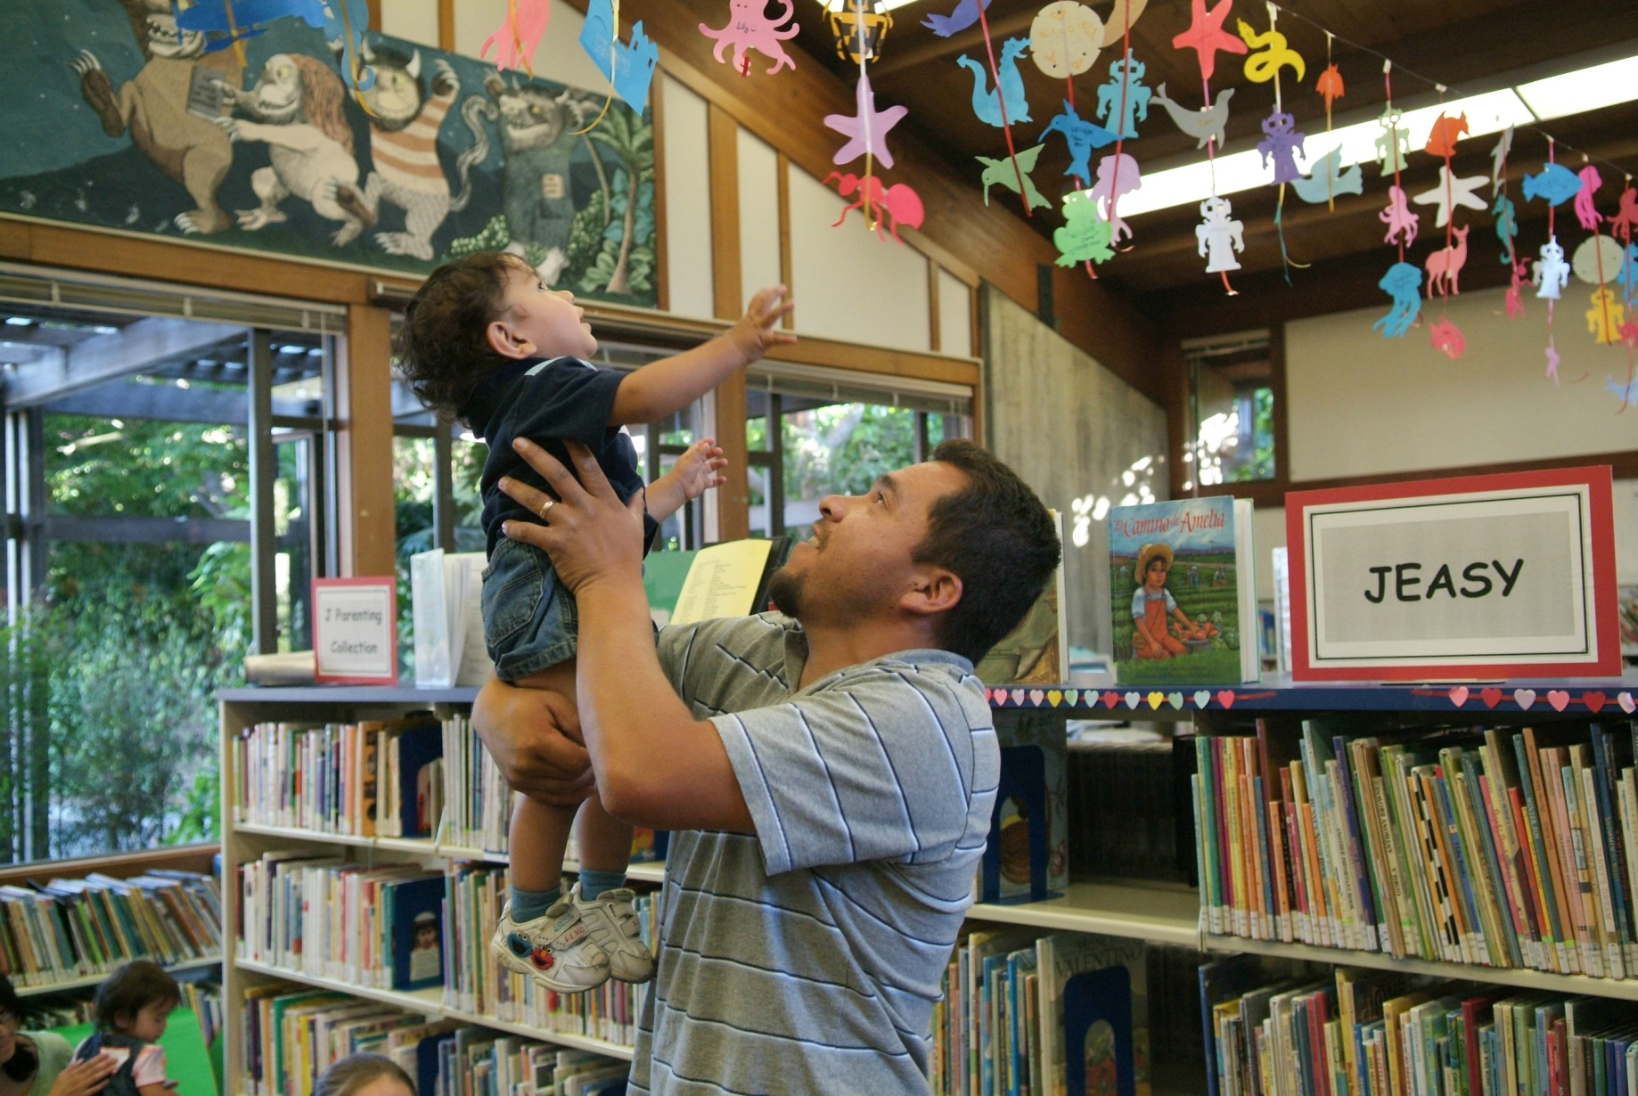
What this Means for Libraries
Notes:
How might we incorporate these tools into our library practice? These tools, although seemingly simple require an iterative and interactive community of practice in which to crystalize them into our daily interactions. Through training and a newly developing statewide Library Touchpoints training and community we are working to do just that.

Slide 13
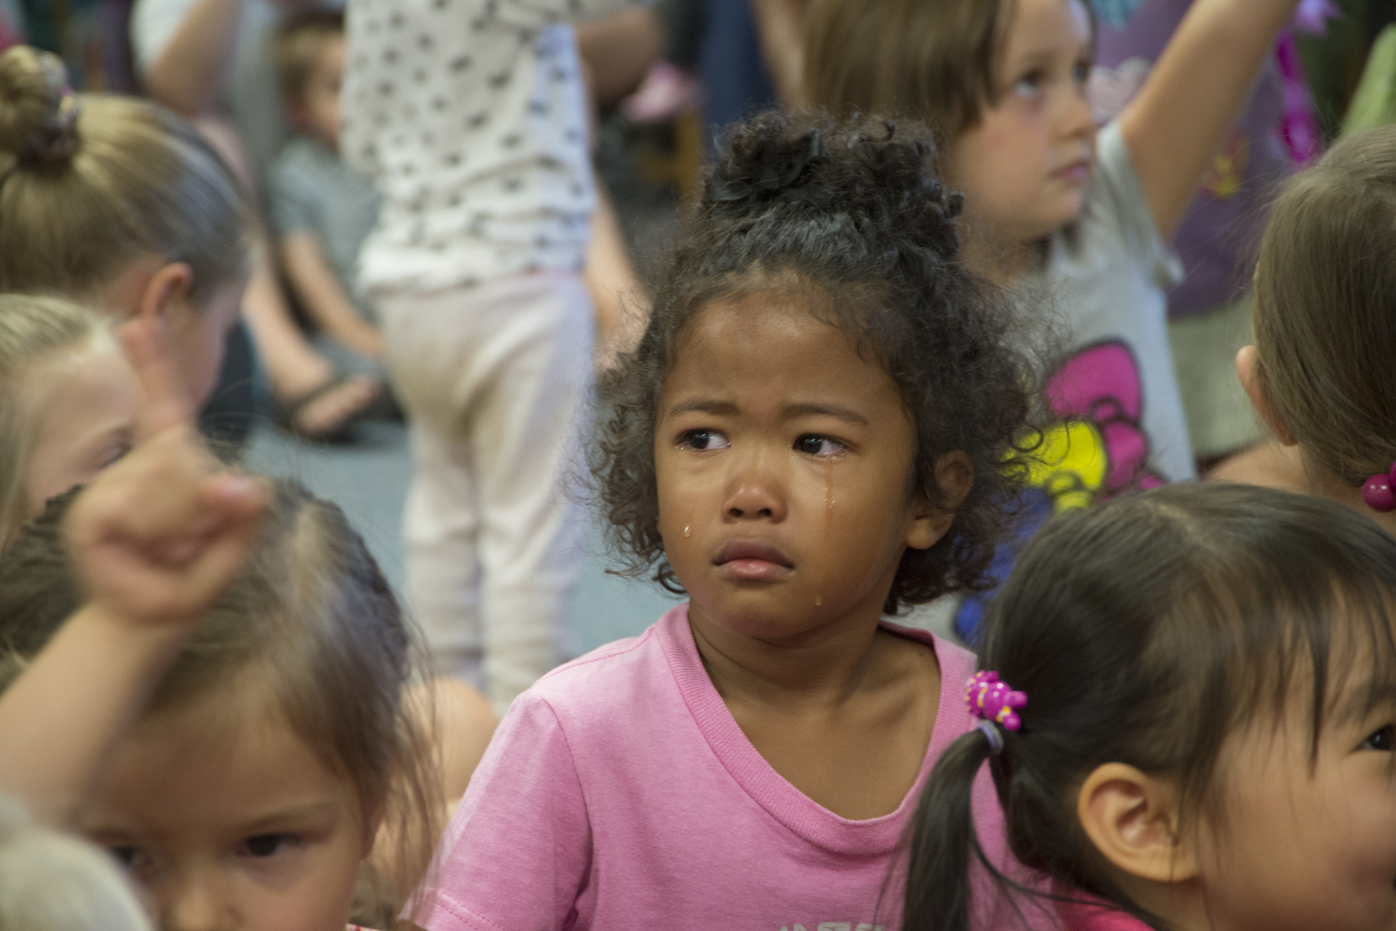
Stories from the Field
Notes:
Give an example of impact either on staff, the library organization or the children and families/caregivers who use your library.

Slide 14
What this Means for Libraries
Staff have more tools for working with and interacting with families.
Staff have a common language and community of practice in which to utilize these tools and strategies.
Young children and their families feel libraries better understand them.

Slide 15
How to Apply for Training
Complete online application: https://www.surveymonkey.com/r/TPLibraries
Additional information available: http://www.library.ca.gov/services/libraries/touchpoints.html
Application deadline: July 29, 2016
Carefully consider training ramifications
Applying libraries notified by September 12, 2016
Specific training dates will be determined after libraries are selected
Trainings held November 2016 through August 2017

Slide 16

Questions & Answers
Notes:
I’m working on the steps and timeline.

Slide 17

Contact:
  Maddy Walton-Hadlock (madeline.walton-hadlock@sjlibrary.org)
  Susie Serrano (sserrano@buttecounty.net)
  Suzanne Flint (suzanne.flint@library.ca.gov)
More information & online application:
http://www.library.ca.gov/services/libraries/touchpoints.html

