Slide 1

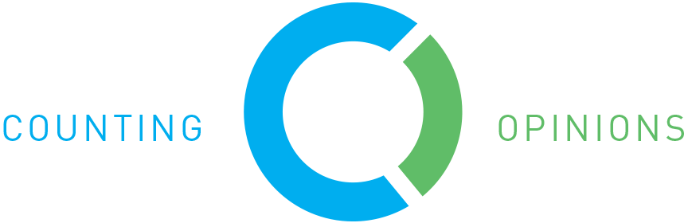
PUBLIC LIBRARY SURVEY
2016
Lisa Dale, California State Library
Lindsay Thompson, Counting Opinions
Hosted by Infopeople
August 24, 2016

Slide 2
Agenda
National Public Libraries Survey
California’s Survey
New Data Elements & Policy
Available Resources
LibPAS Data Input Training
Submitting Survey & Edit Checks
Answers to Your FAQs

Slide 3
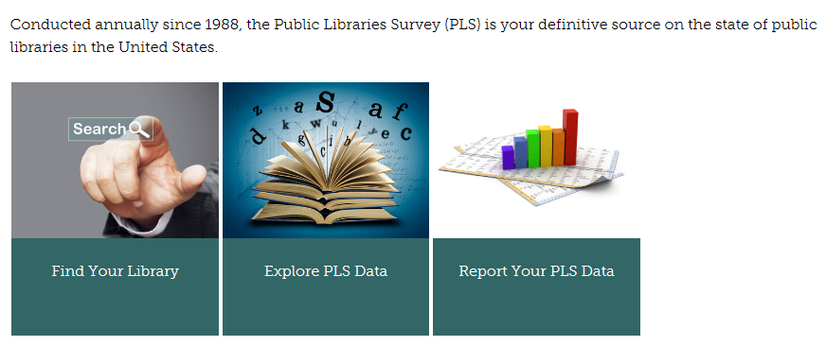
The National Public Libraries Survey
“Current, accurate, and ongoing collection of library data is an essential foundation for quality library services in the United States” -- IMLS
https://www.imls.gov/research-evaluation/data-collection/public-libraries-survey

Slide 4
How is This Data Used?
IMLS
Researchers
Journalists
Local Practitioners
Policy Makers
The Public

Slide 5
California’s Survey
Includes state and IMLS questions
15/16 Survey open Sept 1 - Oct 7
Instructions & Passwords emailed to director by Sept 1

Slide 6
What We Count/The Categories
Directory Update
Population
Outlets
Library Staff
Income
Expenditures
Collections
Library Service
Salary Survey
Electronic Services
Referenda
Mobile Libraries
Outlets

Slide 7
Directory Update
Library Administrative information
Some “CSL Only” elements
NEW: System Membership

Slide 8
Population
Population obtained from CA Dept of Finance
UPDATE: Children Borrowers definition

Slide 9
Income/Expenditures
Revenue, State Funds
  California Library Literacy Services
  Broadband
Expenditures – Actuals spent

Slide 10

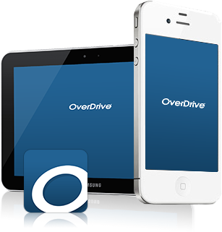

Collections
Electronic Books
Audio
Video
Electronic
Collections
vs

Slide 11
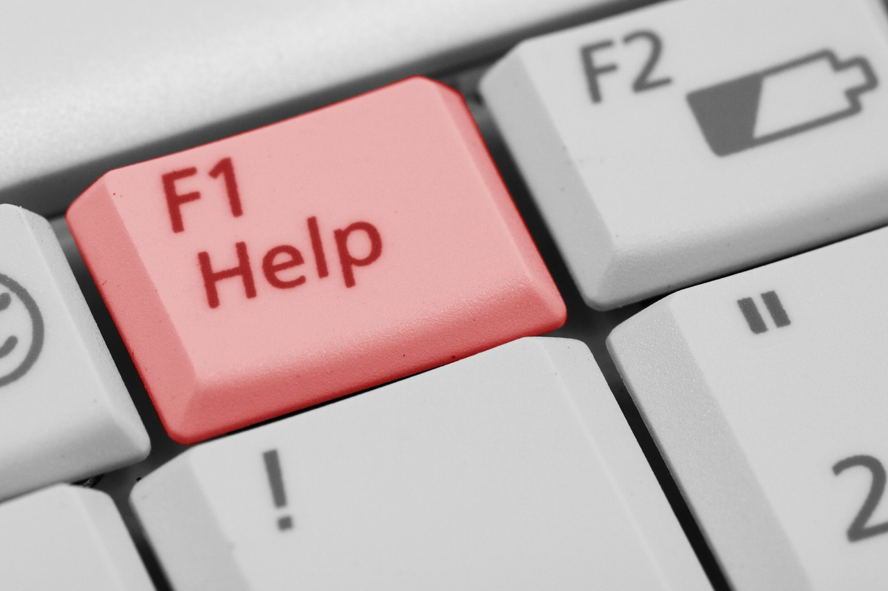
Library Service, Annual
Technology Assistance
Programs
New: Physical Item Circ
Successful Retrieval of Electronic Info
Electronic Content Use (Total field)
Total Collection Use (Total field)

Slide 12
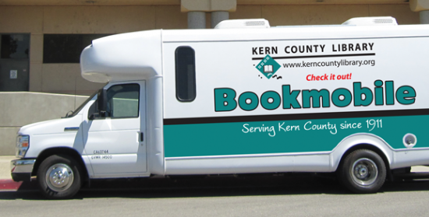
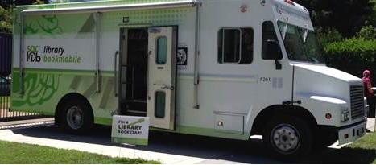
Mobile Libraries
Truck or van with circulating collection
Regularly scheduled hours
Paid staff

Slide 13
New Policy
Any library that doesn’t complete the survey beginning with the fiscal year starting July 1 will not be awarded additional LSTA grants.

Slide 14
Resources
15/16 Survey Updates
Counting Electronic Items Handout
Past Infopeople Webinars:
Public Library Statistics: Collecting, Finding, Using
Making it Count: California Library Statistics Online
Find past data =
californialibrarystatistics.com

Slide 15
LibPAS Data Input Training
Logging in – who to contact for help
Navigating the survey tool LibPAS – functionality, layout, and structure
Completing the survey - required information, repeating fields, and notes
Printing and saving your survey
Submitting the survey and dealing with edit checks

Slide 16
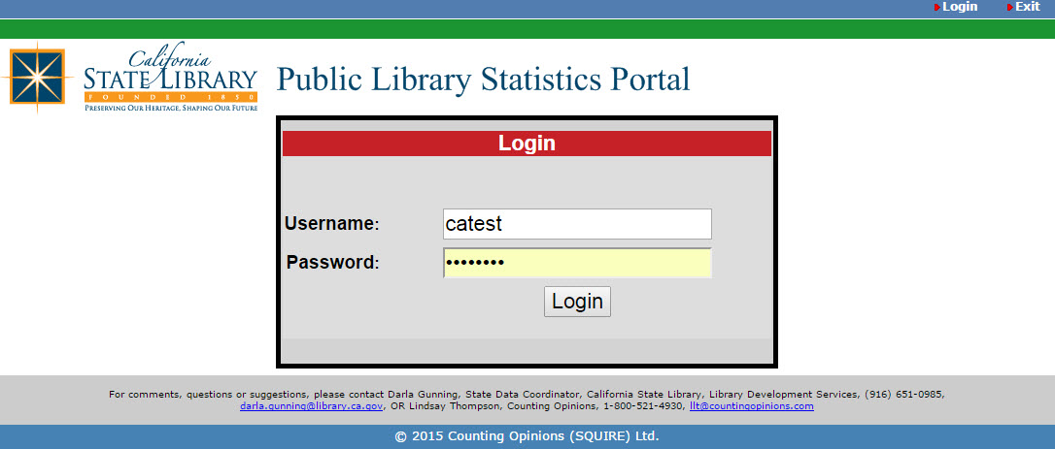
Login / Access
Web Address: http://ca.countingopinions.com/
System Requirements
  Operating Systems: Mac and Windows supported
  All major browsers are OK; newest versions recommended

Slide 17
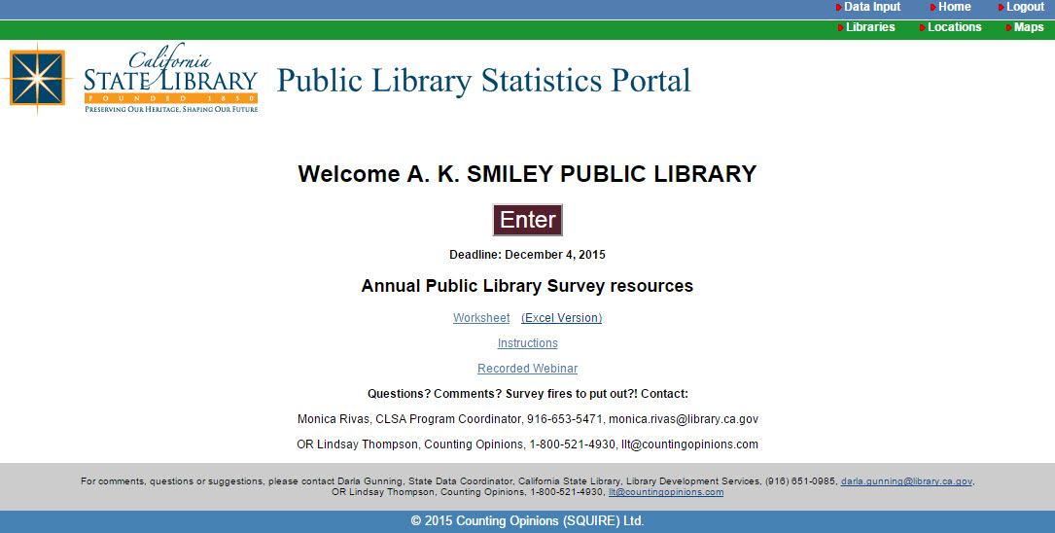
Navigating through LibPAS

Slide 18
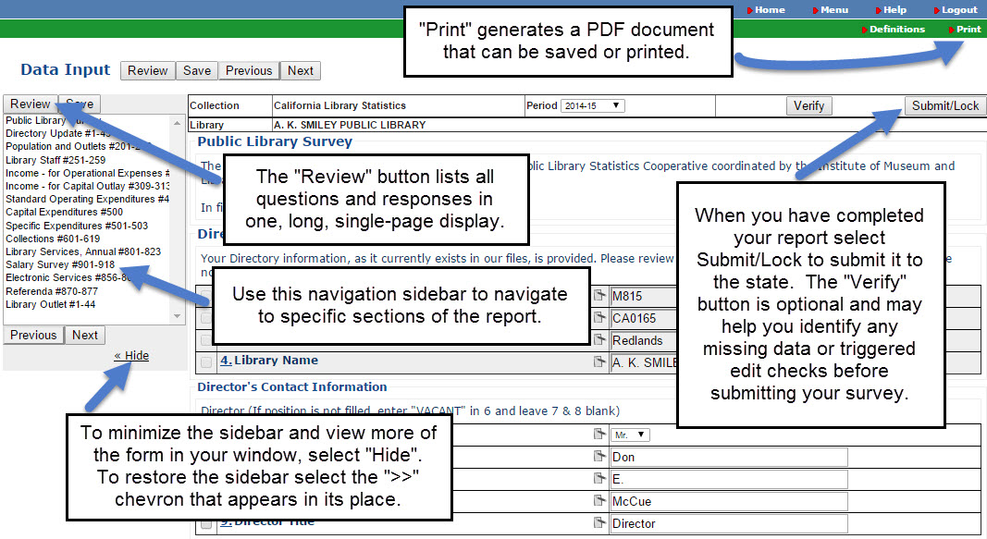
Navigating the Survey Form

Slide 19
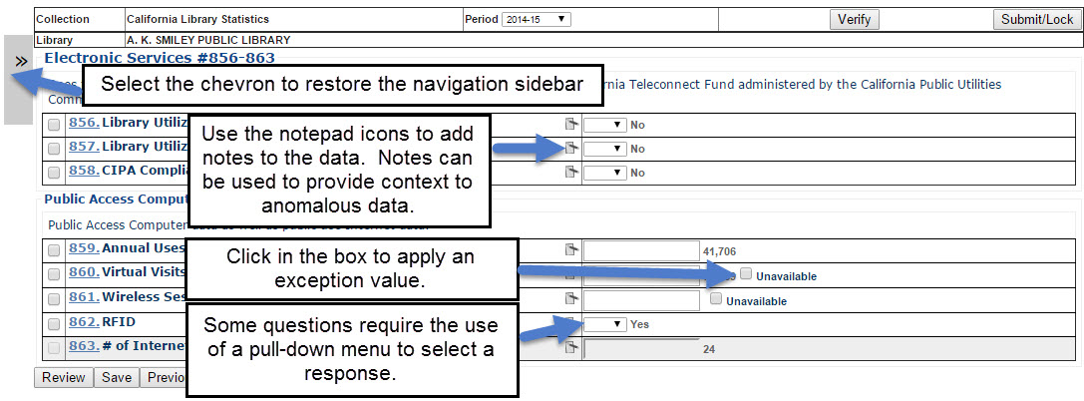
Completing the Survey

Slide 20
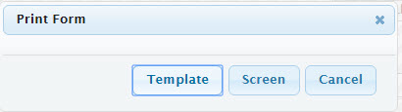
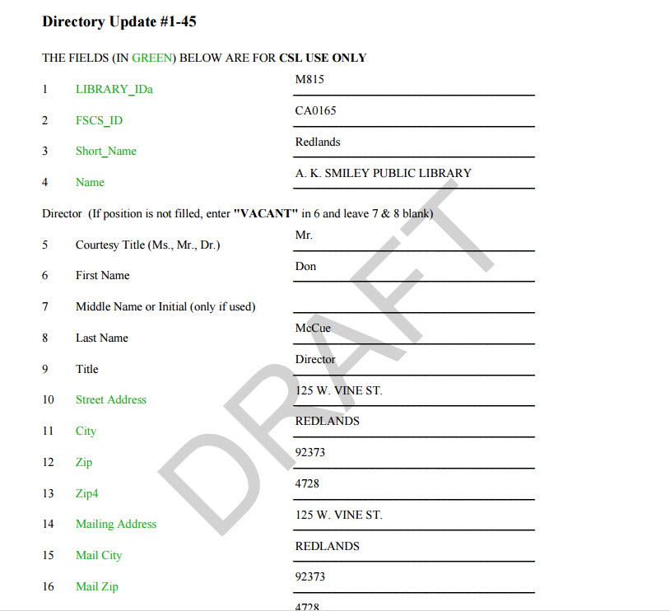
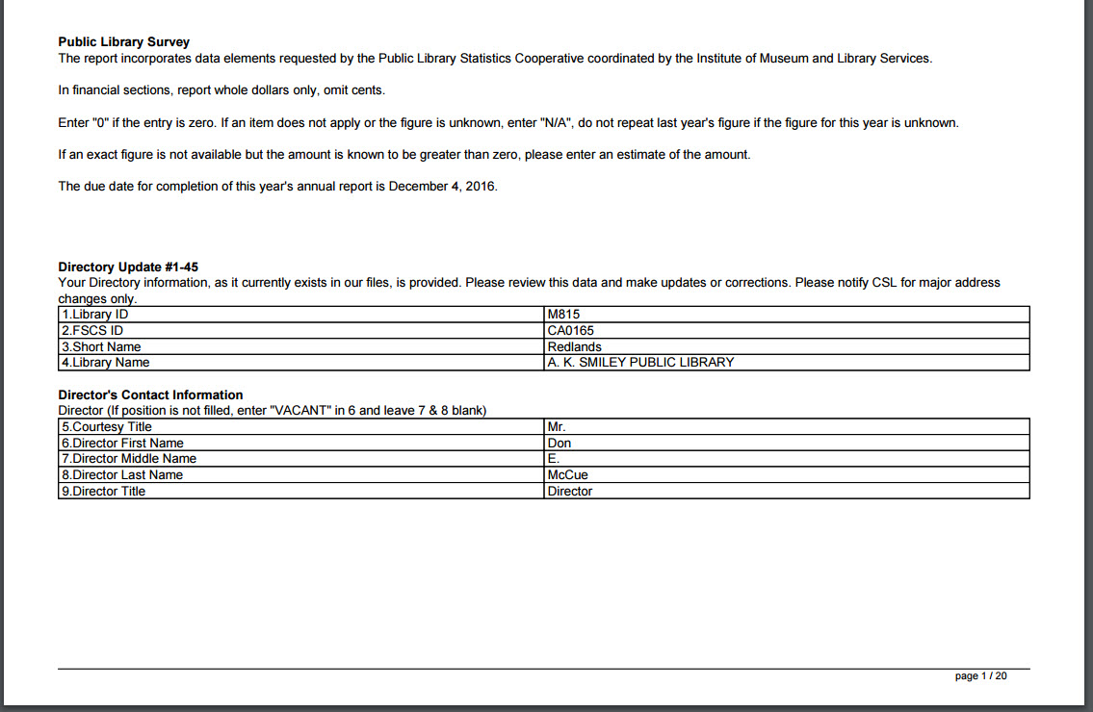
Printing Survey

Slide 21
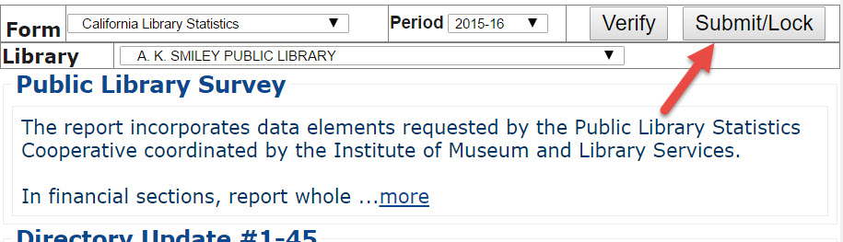
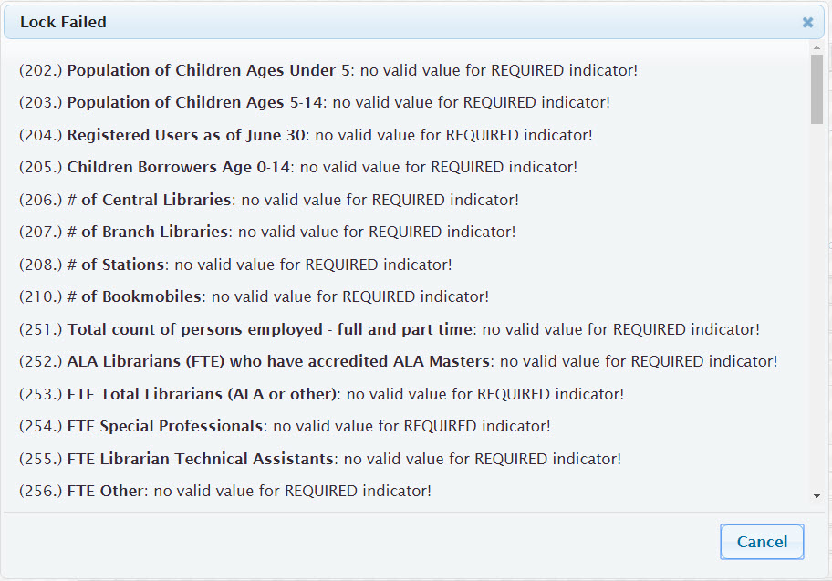

Submitting Survey
If, after selecting the “Submit/Lock” button the buttons disappear and are replaced by the Locked image below, then your survey has been submitted successfully!
If, after selecting the “Submit/Lock” button you see a pop-up that reads “Lock Failed” and provides a list of required fields or edits that require an explanation, you’re not quite done. Please address the fields and try again.

Slide 22
Thank You!
Lisa Dale
lisa.dale@library.ca.gov
916-653-7743
Lindsay Thompson
llt@countingopinions.com
800-521-4930
This webinar was supported in whole or in part by the U.S. Institute of Museum and Library Services under the provisions of the Library Services and Technology Act, administered in California by the State Librarian.

