Slide 1
Welcome to today’s Infopeople Webinar!
Infopeople is dedicated to bringing you the best in practical library training and improving information access for the public by improving the skills of library workers. Infopeople, a grant project of the Califa Group, is supported in part by the Institute of Museum and Library Services under the provisions of the Library Services and Technology Act administered in California by the State Librarian. This material is covered by Creative Commons 4.0 Non-commercial Share Alike license. Any use of this material should credit the funding source.

Slide 2
Brenda Hough and Stephanie Gerding
FOSTERING
INNOVATION
and CREATIVITY
An Infopeople Webinar
September 8, 2016

Slide 3
today:
barriers
examples
techniques
risk
FOSTERING
INNOVATION
and CREATIVITY

Slide 4
today:
potential barriers
examples
techniques
risk
FOSTERING
INNOVATION
and CREATIVITY

Slide 5
today:
barriers
examples of innovation
techniques
risk
FOSTERING
INNOVATION
and CREATIVITY

Slide 6
today:
barriers
examples
innovation techniques
risk
FOSTERING
INNOVATION
and CREATIVITY

Slide 7
today:
barriers
examples
techniques
balancing risk
FOSTERING
INNOVATION
and CREATIVITY

Slide 8
today:
potential barriers
FOSTERING
INNOVATION
and CREATIVITY

Slide 9
What gets IN THE WAY of innovation?
I just don’t have time to innovate.
We don’t have the money to innovate.

Slide 10
What gets IN THE WAY of innovation?
I don’t think that’s my role…

Slide 11
What gets IN THE WAY of innovation?
I’m not innovative…
?
?
?

Slide 12
What gets IN THE WAY of innovation?
I don’t know what kind of innovation libraries need.
The way we do things today is OK/fine/good enough.
?
!

Slide 13
What is innovation??
Source: Merriam-Webster
FOSTERING
INNOVATION
and CREATIVITY

Slide 14
What is innovation?
Noun.
in·no·va·tion \ˌi-nə-ˈvā-shən\
The act or process of introducing new ideas, devices, or methods.
Source: Merriam-Webster
FOSTERING
INNOVATION
and CREATIVITY

Slide 15
What is innovation?
“Creativity is thinking up
new things.
Innovation is doing
new things.”
Source: Merriam-Webster
Theodore Levitt

Slide 16
What does innovation in libraries look like?
I don’t know what kind of innovation libraries need.
?

Slide 17
Libraries…
Libraries…

Slide 18
Libraries…
New
Remodeled
Redefined

Slide 19
Libraries…
New
…to better meet the needs of your community
Remodeled
Redefined

Slide 20
Libraries…
New
…to better meet the needs of your community
“Library now offers seeds for ‘checkout’..”
Remodeled
Redefined

Slide 21
Libraries…
New
…to better meet the needs of your community
“Library users can now checkout a bike”
Remodeled
Redefined

Slide 22
Libraries…
New
…to better meet the needs of your community
“Airport libraries cater to readers on the go”
Remodeled
Redefined

Slide 23
Libraries…
New
…to better meet the needs of your community
“Pop-up library appears throughout community”
Remodeled
Redefined

Slide 24
Libraries…
New
…to better meet the needs of your community
“Bookmobile delivers computers and wifi”
Remodeled
Redefined

Slide 25
Libraries…
New
…to better meet the needs of your community
“Library used its 3d printer to make a prosthetic hand for girl”
Remodeled
Redefined

Slide 26
Libraries…
New
…to better meet the needs of your community
“Library social worker connects homeless with meals”
Remodeled
Redefined

Slide 27
Libraries…
New
…to better meet the needs of your community
“Library nurses look after those in need.”
Remodeled
Redefined

Slide 28
Libraries…
What recent examples of library innovation can you think of? Please share in the chat.
New
…to better meet the needs of your community
Remodeled
Redefined

Slide 29
Why do we need to innovate?
The way we do things today is OK/fine/good enough.
!

Slide 30
“
What is innovation?
As a leader you may have specific goals about where you are going, but you also should be open to new possibilities. Why? Because we need new answers for our changing world. Let's face it, our world today is different from what it was 50, 20, and even 10 years ago. Our technology, culture, economics, and community life are significantly different than they used to be. And the changes are only accelerating. Those changes present new challenges and often demand new solutions. If we know something that has worked before is likely to work again, we don't have to reinvent the wheel. But in order to find workable solutions to some new problems, we need to be open to possibilities that might not have been tried before.
Source: Merriam-Webster
Marya Axner The Community Tool Box, Kansas University

Slide 31
“
What is innovation?
Expanding access to education, learning opportunities and social connections for all is one of the great challenges of our time. It is a challenge make more urgent by the rapid transition from old industrial and service-based economic models to a new economy in which knowledge and creativity are the drivers of productivity and economic growth, and information, technology and learning are central to economic performance and prosperity. It is not only the economy but all of society that is being reshaped by these trends. Amid these changes, there are divides in wealth, digital inclusion and participation that threaten to widen if we as a nation do not commit to new thinking and aggressive action to provide these opportunities for all. This is a time of great opportunity for communities, institutions and individuals who are willing to champion new thinking and nurture new relationships.
Source: Merriam-Webster
Rising to the Challenge The Aspen Institute

Slide 32
Where you WANT and NEED to be
Where you ARE
how do you get from where you are
to where you want and need to be?
?
?
FOSTERING
INNOVATION
and CREATIVITY

Slide 33
10 WAYS TO FOSTER A CULTURE OF INNOVATION:
Include innovation in planning documents.
Hire people who are innovators.
Include innovation goals and actions in new employee orientation.
Include innovation goals and actions in performance evaluations.
Provide creativity and innovation training.
Invest in hands-on learning.
Find ways to support collaboration.
Engage in ongoing conversations with library users and others.
Encourage play, experimentation, and risk taking.
Encourage and capture innovative ideas.
FOSTERING
INNOVATION
and CREATIVITY

Slide 34
Where you WANT and NEED to be
Where you ARE
Strategy and Planning (essential for innovation)
FOSTERING
INNOVATION
and CREATIVITY

Slide 35
today:
barriers
examples
innovation techniques
risk
FOSTERING
INNOVATION
and CREATIVITY

Slide 36
practicing innovation:
inspiration
ideation
iteration
FOSTERING
INNOVATION
and CREATIVITY

Slide 37
practicing innovation:
inspiration
ideation
iteration
designthinkingforlibraries.com

Slide 38
i. inspiration
Start with a clear challenge or need or purpose.

Slide 39
i. inspiration
Start with a clear challenge or need or purpose.
USER GROUP + USER NEED/PROBLEM

Slide 40
i. inspiration
Start with a clear challenge or need or purpose.
USER GROUP + USER NEED/PROBLEM
older adults in our town
social isolation

Slide 41
i. inspiration
Start with a clear challenge or need or purpose.
explore and learn about the challenge

Slide 42
i. inspiration
Start with a clear challenge or need or purpose.
USER GROUP + USER NEED/PROBLEM
older adults in our town
social isolation

Slide 43
i. inspiration
Start with a clear challenge or need or purpose.
USER GROUP + USER NEED/PROBLEM
older adults in our town
social isolation
listen
observe
explore
learn
interview

Slide 44
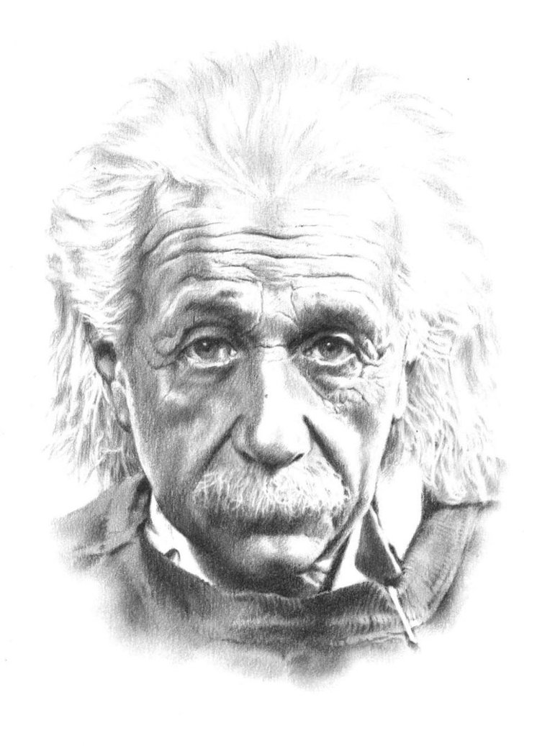
When Albert Einstein was asked,
“Given one hour to solve a problem, how would you approach it?”
He replied, “Spend 55 minutes understanding the question, then 5 minutes finding the answer.”

Slide 45
ii. ideation
brainstorm
select an idea
create a prototype

Slide 46
ii. ideation
brainstorm
select an idea
create a prototype
“How might we…?”

Slide 47
“Really great ideas are very rare and very valuable. More ideas increase chances of getting a good one. Volume matters.”
Source: Adobe Kickbox Workshop Guide. Kickbox.adobe.com

Slide 48
successful brainstorms:
pay attention to:
the time of day
the location
the tools
reflection time
time limits
the “rules”
“rules”:
defer judgment
encourage wild ideas
build on ideas of others (“yes and…”)
stay focused
one voice at a time
be visual
go for quantity
Source: Design Thinking in a Day

Slide 49
idea generation exercises:
leaves technique
idea chain
brain walking
brain writing

Slide 50
ii. ideation
brainstorm
select an idea
create a prototype

Slide 51
ii. ideation
brainstorm
select an idea
create a prototype
Disney method
fist of five technique

Slide 52
Critic
Realist
Dreamer
Disney method

Slide 53
ii. ideation
brainstorm
select an idea
create a prototype

Slide 54
prototypes
bring your idea to life!
get the idea out of your head and into the world

Slide 55
prototypes
bring your idea to life!
get the idea out of your head and into the world
a model
a role play
an advertisement

Slide 56
practicing innovation:
inspiration
ideation
iteration
FOSTERING
INNOVATION
and CREATIVITY

Slide 57
iii. iteration
put your prototype in front of your users and get feedback
potential questions to ask:
What excites you about this idea and why?
If you could change one thing about this prototype, what would it be?
What else would you like to improve about this idea?
What do you NOT like about this idea?
What do you need to hear or learn more about in order to understand this idea?
Source: Design Thinking in a Day

Slide 58
“Go ahead and make mistakes. That is an essential step in the process of creativity. The more things you try, the more likely you will eventually hit upon something that works.”
Fail
HAPPILY
Marya Axner The Community Tool Box Kansas University

Slide 59
What is innovation?
Assessing RISK
Source: Merriam-Webster

Slide 60
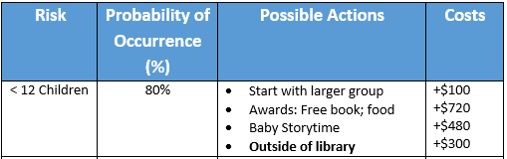
crisis avoidance tool
potential risk:
Kindergarten Readiness Program has
low enrollment

Slide 61
review:
foster the culture
practice the techniques (identify a need/problem, explore the problem, ideate and iterate)
assess risks
FOSTERING
INNOVATION
and CREATIVITY

Slide 62
what next?
what actions will you take in the next 3 months to foster a culture of innovation?
with whom will you share resources and ideas from today?
FOSTERING
INNOVATION
and CREATIVITY

Slide 63
Additional Resources
This webinar includes material from the Nexus Leadership Curriculum, Fostering Innovation and Creativity, made possible in part by the Institute of Museum and Library Services [AWARD NUMBER: RE-00-14-0095-14], and made available through Educopia under a Creative Commons Attribution 4.0 International license (CC BY 4.0). educopia.org/research/grants/nexus-lab-leading-across-boundaries
Discovering and Creating Possibilities. The Community Tool Box, University of Kansas. ctb.ku.edu/en/table-of-contents/leadership/leadership-functions/discover-possibilites/main
Design Thinking for Libraries, “Design Thinking in a Day” (the At-a-Glance Guide) - designthinkingforlibraries.com
Design Kit by IDEO – for case studies and design-thinking methods - www.designkit.org
Adobe Kickbox Innovation toolkit & free workshop - kickbox.adobe.com/workshop/kickbox
How Conservative Organizations Can Innovate Successfully by the Center for Creative Leadership - insights.ccl.org/articles/leading-effectively-articles/how-conservative-organizations-can-innovate-successfully/
Stop Winging It: How Innovation Works and How to Lead It by the Center for Creative Leadership - insights.ccl.org/articles/leading-effectively-articles/stop-winging-it-how-innovation-works-and-how-to-lead-it/
How to Lead Better Brainstorming Sessions - hbr.org/2009/05/how-to-lead-better-brainstormi&cm_sp=Article-_-Links-_-End%20of%20Page%20Recirculation
Innovation Spaces. The Harwood Institute, as part of Libraries Transforming Communities. In partnership with PLA. ala.org/transforminglibraries/sites/ala.org.transforminglibraries/files/content/Innovation%20Spaces.pdf
The Aspen Institute’s report Rising to the Challenge: Re-Envisioning Public Libraries and Action Guide for Re-Envisioning Your Public Library - www.libraryvision.org
What other resources have you found helpful?

Slide 64
Thank You!
Brenda Hough bckhough@gmail.com
Stephanie Gerding stephaniegerding@gmail.com

