Slide 1
Welcome to today’s Infopeople Webinar!
Infopeople is dedicated to bringing you the best in practical library training and improving information access for the public by improving the skills of library workers. Infopeople, a grant project of the Califa Group, is supported in part by the Institute of Museum and Library Services under the provisions of the Library Services and Technology Act administered in California by the State Librarian. This material is covered by Creative Commons 4.0 Non-commercial Share Alike license. Any use of this material should credit the funding source.

Slide 2
Building Business Connections with Your Community
An Infopeople Webinar
September 13, 2016
Barbara Alvarez www.barbaralvarez.com

Slide 3
Welcome!
What is Embedded Business Librarianship? Why does it matter?
How does Embedded Business Librarianship differ from outreach?
What are the 5 steps to Embedded Business Librarianship?
How can you bring the business community to the library?
How can you customize this for your library?

Slide 4
Let’s get acquainted!
Business Liaison Librarian
Community Outreach
Library OnConference
Sharing stories and understanding how communities connect

Slide 5
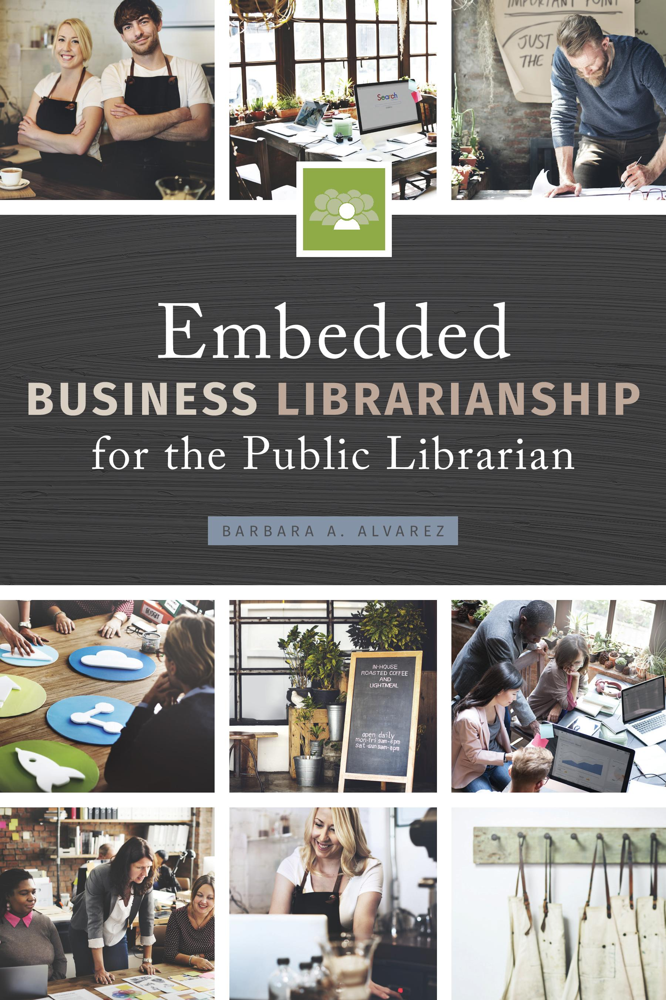
Latest publication!
ALA Editions 2016
Embedded Business Librarianship for the Public Librarian

Slide 6
Embedded Business Librarianship
”Embedded Business Librarianship is a library professional who becomes engrained in their library’s business community.”
Do not function as an outsider, but as a peer, equal, and colleague
The title is not important! It’s the action that matters the most

Slide 7
Why should we care about businesses?
Because they care about us!
Small business owners are 64% of the “new net jobs created between 1993-2011”
18 million solopreneurs and counting
Upwards of 35% of job seekers use the library
How can we build meaningful relationships with these groups?

Slide 8
Pop Quiz!
How often does your library provide outreach?
A: At least once per week
B: Once every few weeks
C: Once per month
D: A few times per year
E: Never

Slide 9
Outreach is not embedded librarianship
The key difference: promotion
Outreach is occasionally going out into the community
Embedded is consistently being integrated in the community

Slide 10
Benefits of being embedded
Get to really know your community- no superficial relationships!
Changes the perspective of public libraries and librarianship
Streamlines your job: programs, collection development, and more
Benefits to them? Countless!

Slide 11
Transform existing relationships
You don’t have to start from scratch
Take your current relationships to the next level
Make new connections from current community partners
Start small and focus on consistency

Slide 12
5 Steps to Embedded Business Librarianship
Create your networking list
Start reaching out
Make your debut: initial presentation
Create a call to action
Network, network, network

Slide 13
Before you get started, remember…
Guiding principle: the public library adds value to the community
You are building meaningful relationships by learning about their needs, worries, strengths, aspirations by becoming part of the community

Slide 14
Step 1: Create your networking list
Chamber of Commerce
Career Centers
Small Business Development Center
Village Hall
Merchant meetings
Community colleges
SCORE (www.score.org)
Rotary Club
Shopping Centers
Religious organizations
Meetup.com
Entrepreneur Forums

Slide 15
Step 2: Start reaching out
Begin with someone you are already connected with- don’t reinvent the wheel!
Email vs. phone
Key words to use: brief, information, learning
Avoid “partnership” words
Start slow!

Slide 16
Step 3: Making your debut
Initial presentation
Make it count
Interactive, engaging, short, sweet
Focus on what you can do and getting to know them

Slide 17
Step 4: Call to Action
The most important part of the process!
Think outside the box
Networking breakfasts
Off-site training sessions
One-on-one consultations
Ask them what you can customize!

Slide 18
Step 5: Network, network, network!
The real work now begins
Practice your elevator speech
Sharing what you can do + learning what they need = crystal clarity
Get out there regularly
Job fairs
Network scrambles
Ribbon cuttings
Open houses

Slide 19
Bringing it back to your library
Networking events
Video/podcast series
Tech Training- apps, video production, Etsy, social media, blog/website design

Slide 20
Coworking spaces
Shared, open workspaces for entrepreneurs and professionals meet, collaborate, and network
Good news: they are looking for public spaces- that’s us!
More good news: It doesn’t have to be expensive or a big commitment- simply rearranging furniture or adjusting library rules
Does your library create a welcoming environment?

Slide 21
Pop Quiz!
How big is your library?
A: Less than 25 employees
B: 26-50 employees
C: 51-80 employees
D: 80-125 employees
E: More than 125 employees

Slide 22
Making it work for your library
Action creates clarity
Relaying the benefits to management/board
Using a hybrid model to work for your library, department, and community

Slide 23
Questions?
Let’s stay in touch!
www.barbaralvarez.com
@alvarez_b3
THANK YOU! ☺

