Slide 1
Welcome to today’s Infopeople Webinar!
Infopeople is dedicated to bringing you the best in practical library training and improving information access for the public by improving the skills of library workers. Infopeople, a grant project of the Califa Group, is supported in part by the Institute of Museum and Library Services under the provisions of the Library Services and Technology Act administered in California by the State Librarian. This material is covered by Creative Commons 4.0 Non-commercial Share Alike license. Any use of this material should credit the funding source.

Slide 2
Asset Based Community Development
(ABCD)
in the Library
An Infopeople Webinar
September 14, 2016
Presented by Tonya Kennon

Slide 3
Presenter
Tonya Kennon
Director
Riverside Public Library

Slide 4
Agenda
What is ABCD?
Asset Mapping vs. Needs Assessments
ABCD in Libraries
Examples
Tools for Community Engagement
Questions & Answers

Slide 5
ABCD
A strategy for sustainable community-driven development.
A belief that everyone has gifts to contribute.
Builds on assets already found in the community and mobilizes individuals, associations, and institutions to come together to build on those assets instead of concentrating on their needs.

Slide 6
Whatever the question, community is the answer. - Margaret Wheatley

Slide 7
Needs Map
Asset-Based Community Development Institute (ABCD), Jody Kretzmann and Brian McKnight

Slide 8
Asset Map
Asset-Based Community Development Institute (ABCD), Jody Kretzmann and Brian McKnight

Slide 9
Why Asset Mapping Matters
Asset Based Approach | Needs Based Approach
Focus on assets | Focus on needs
Builds on opportunities | Responds to problems
Investment oriented | Charity oriented
Emphasis on associations | Emphasis on agencies
Focus on community | Focus on individuals
Goal is empowerment | Goal is service
Power comes from relationships | Power comes from credentials
People are the answer | Programs are the answer
People are citizens | People are clients
http://www.nurturedevelopment.org

Slide 10
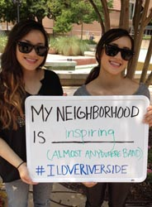
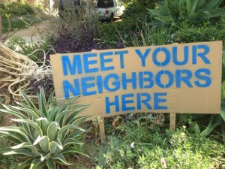
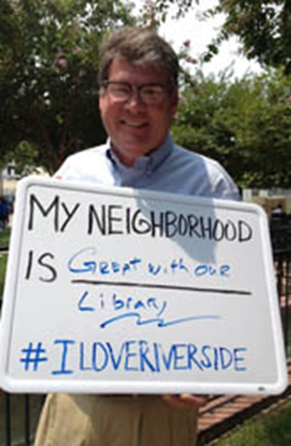
Intentional Bumping

Slide 11
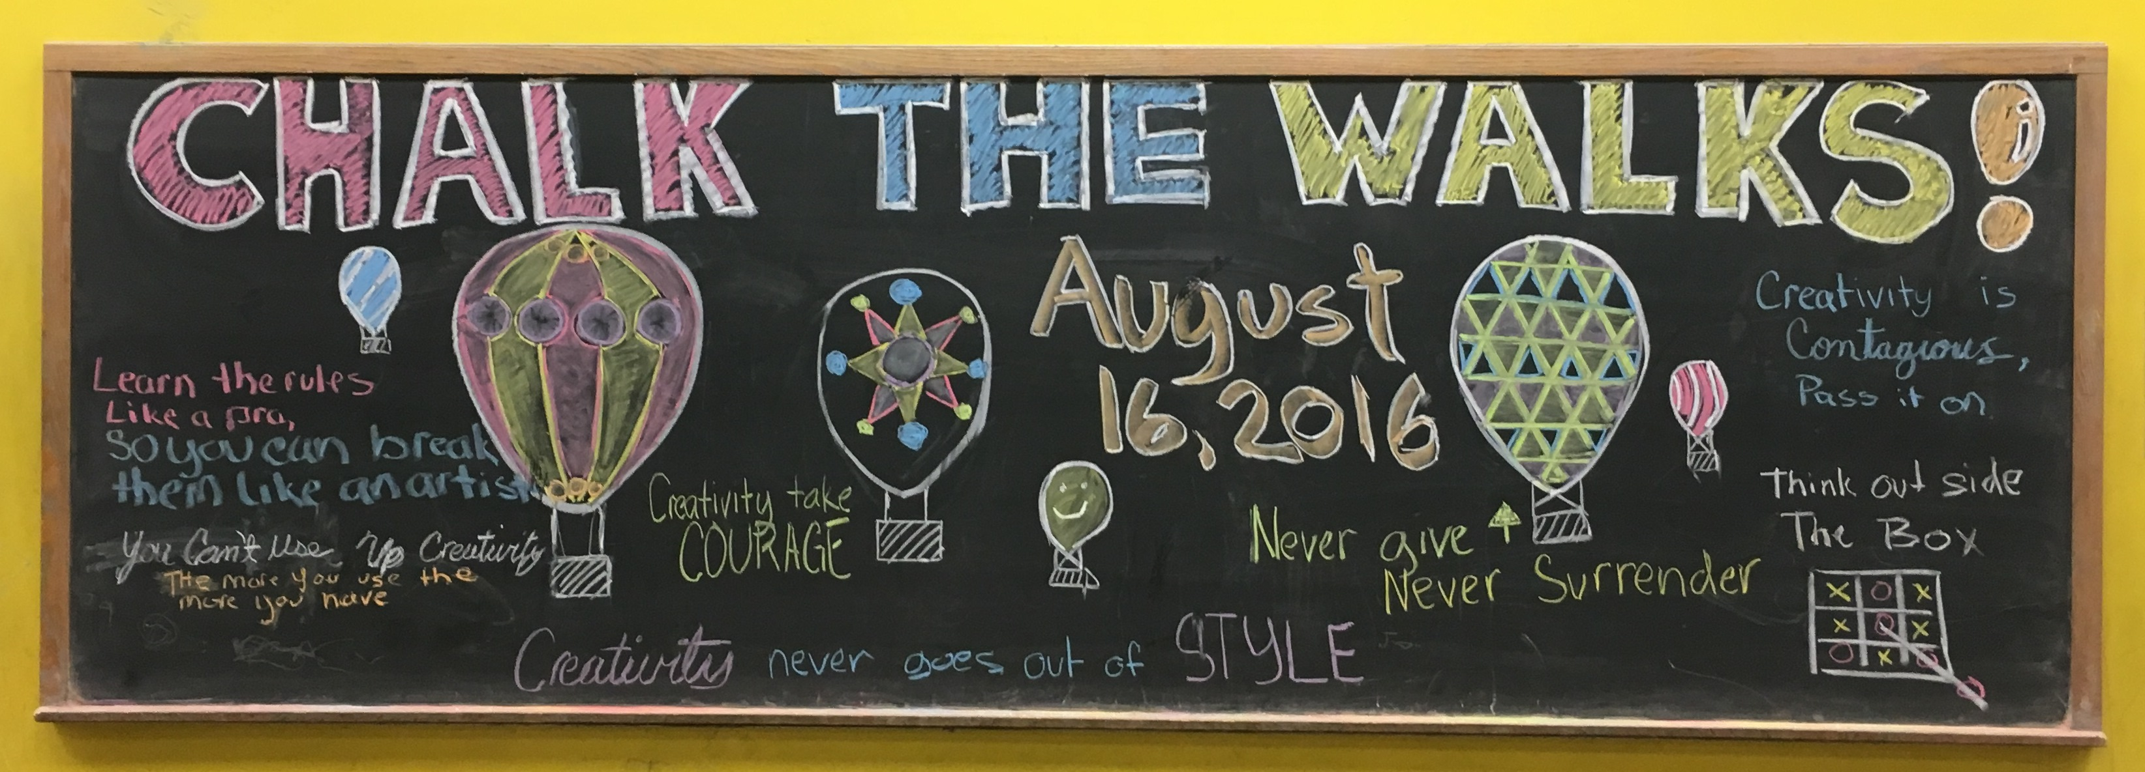
Intentional Bumping

Slide 12
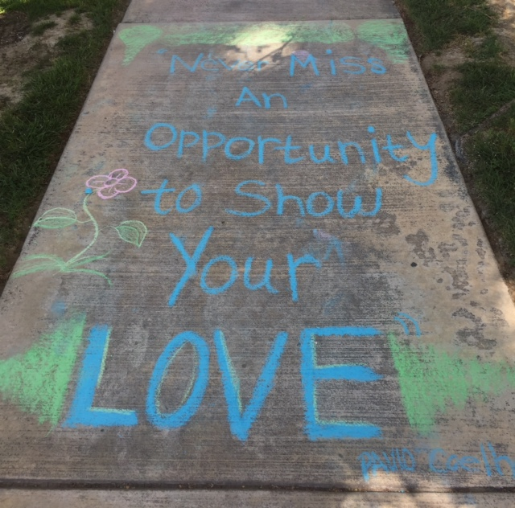
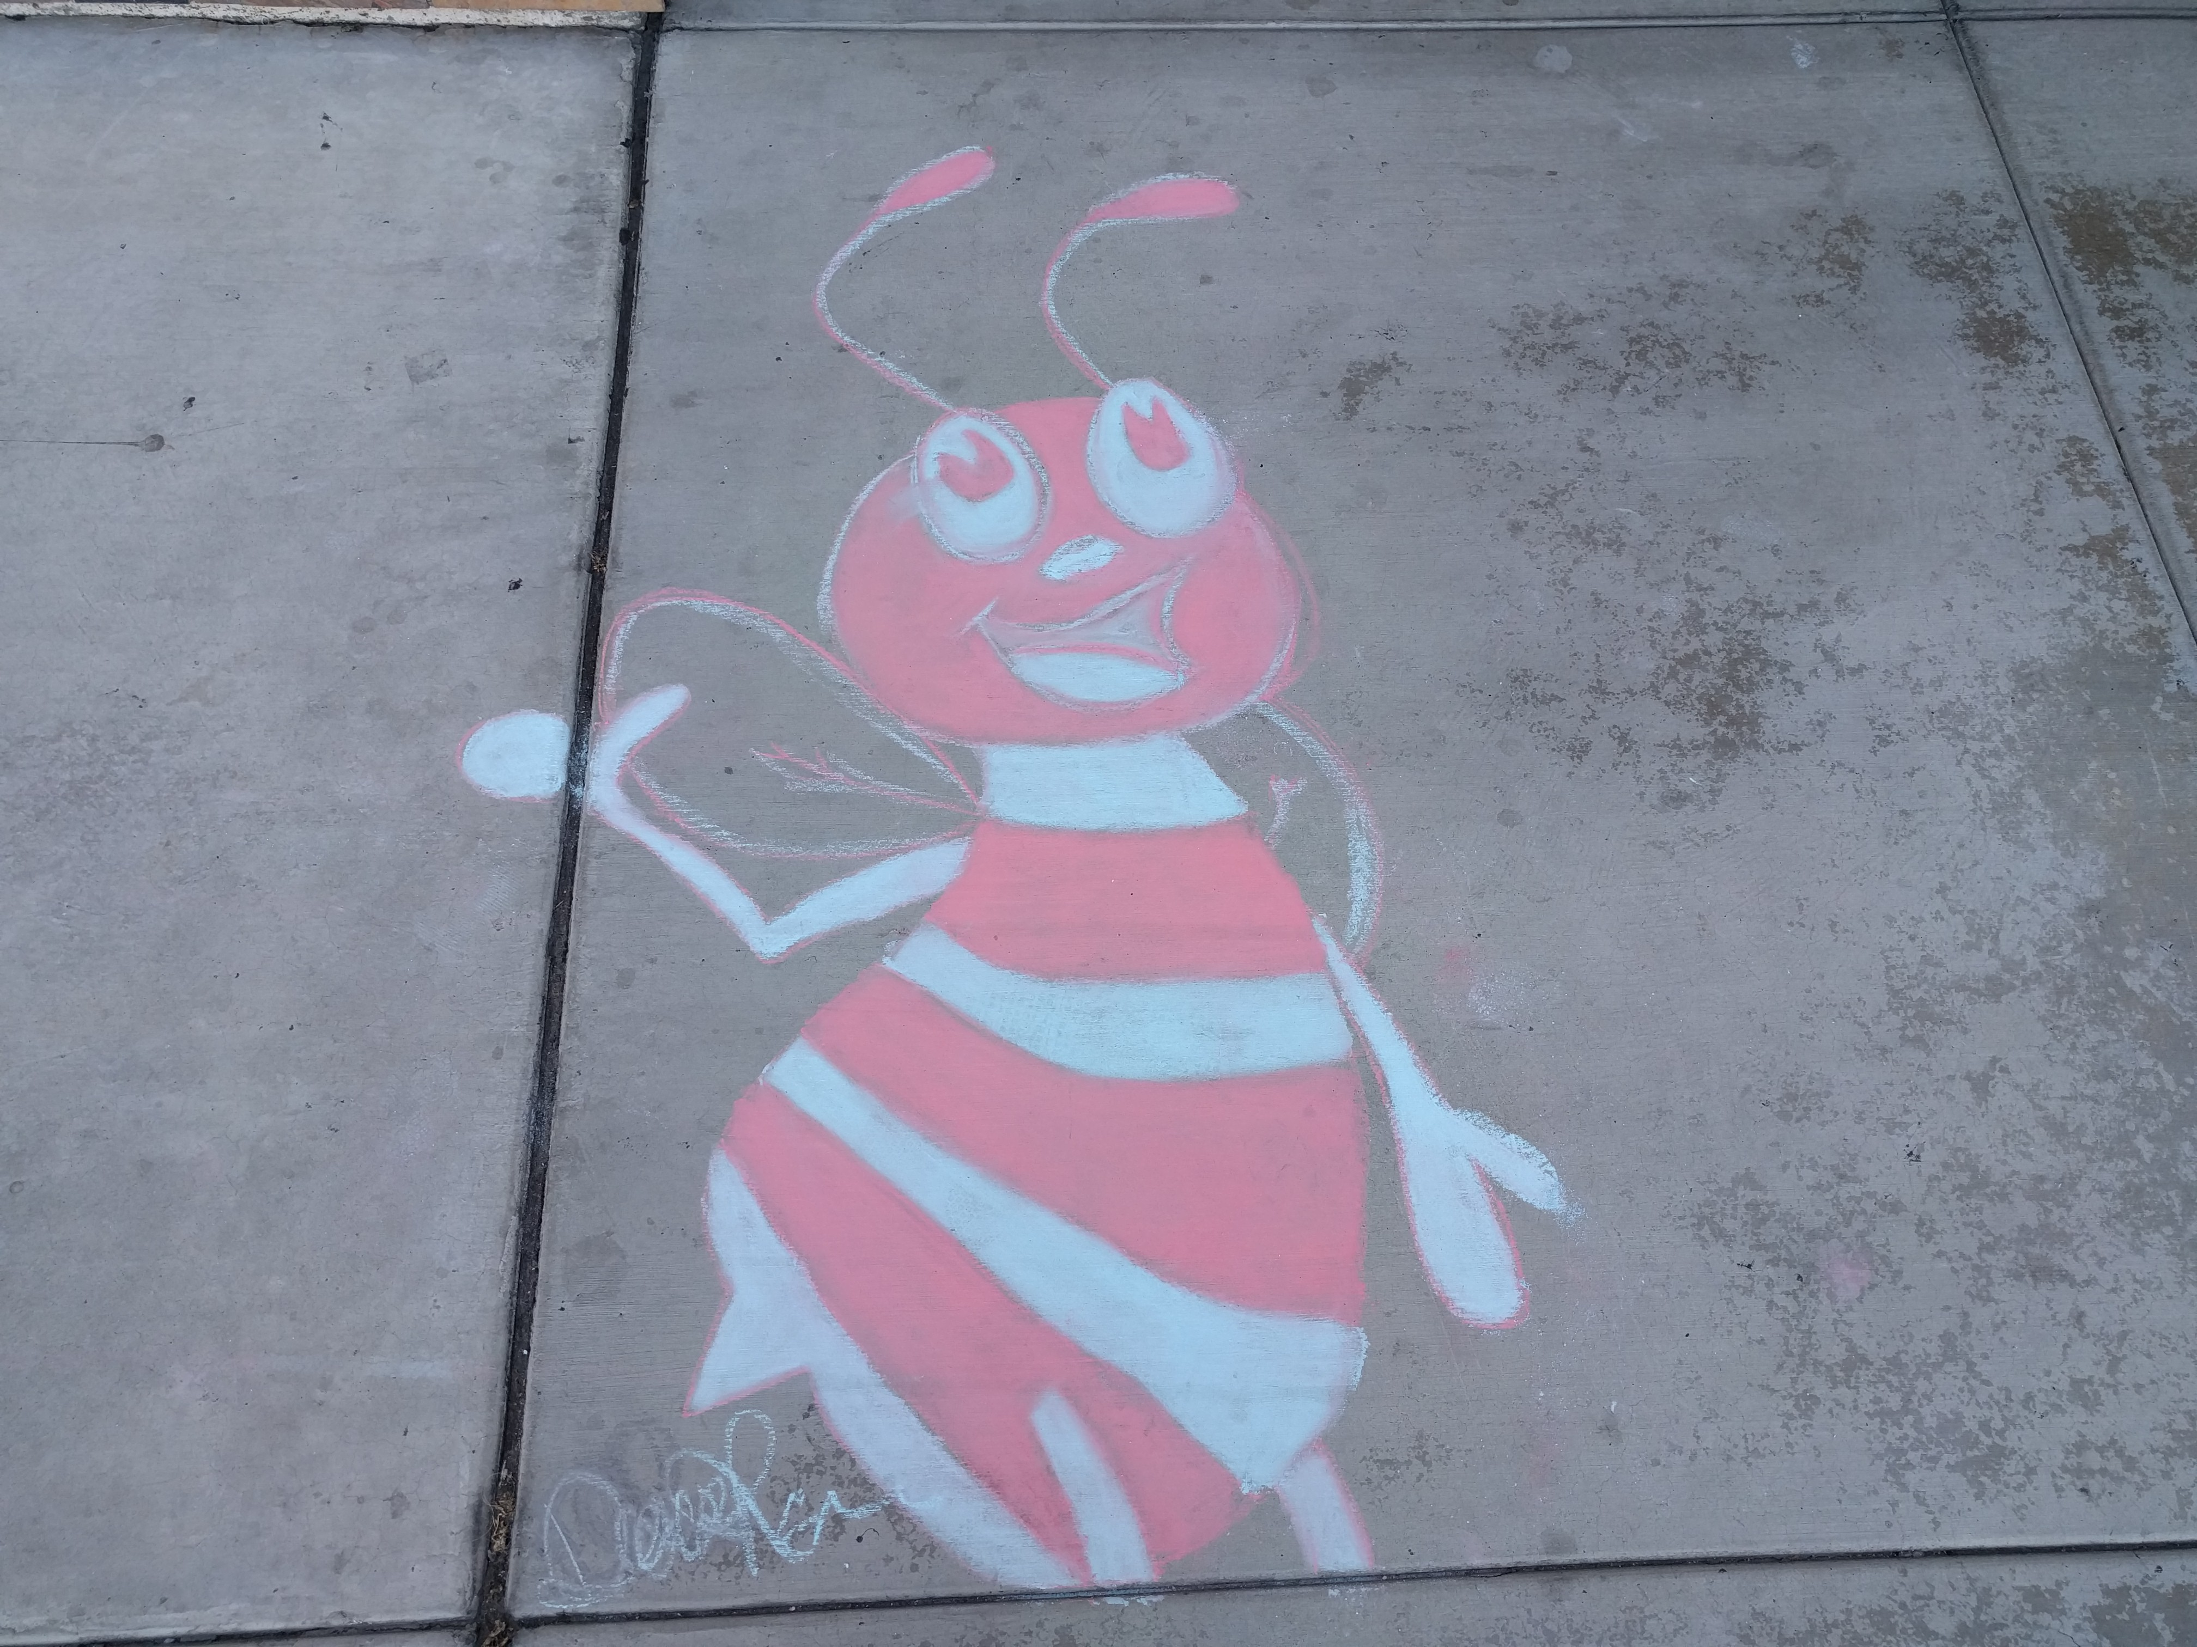
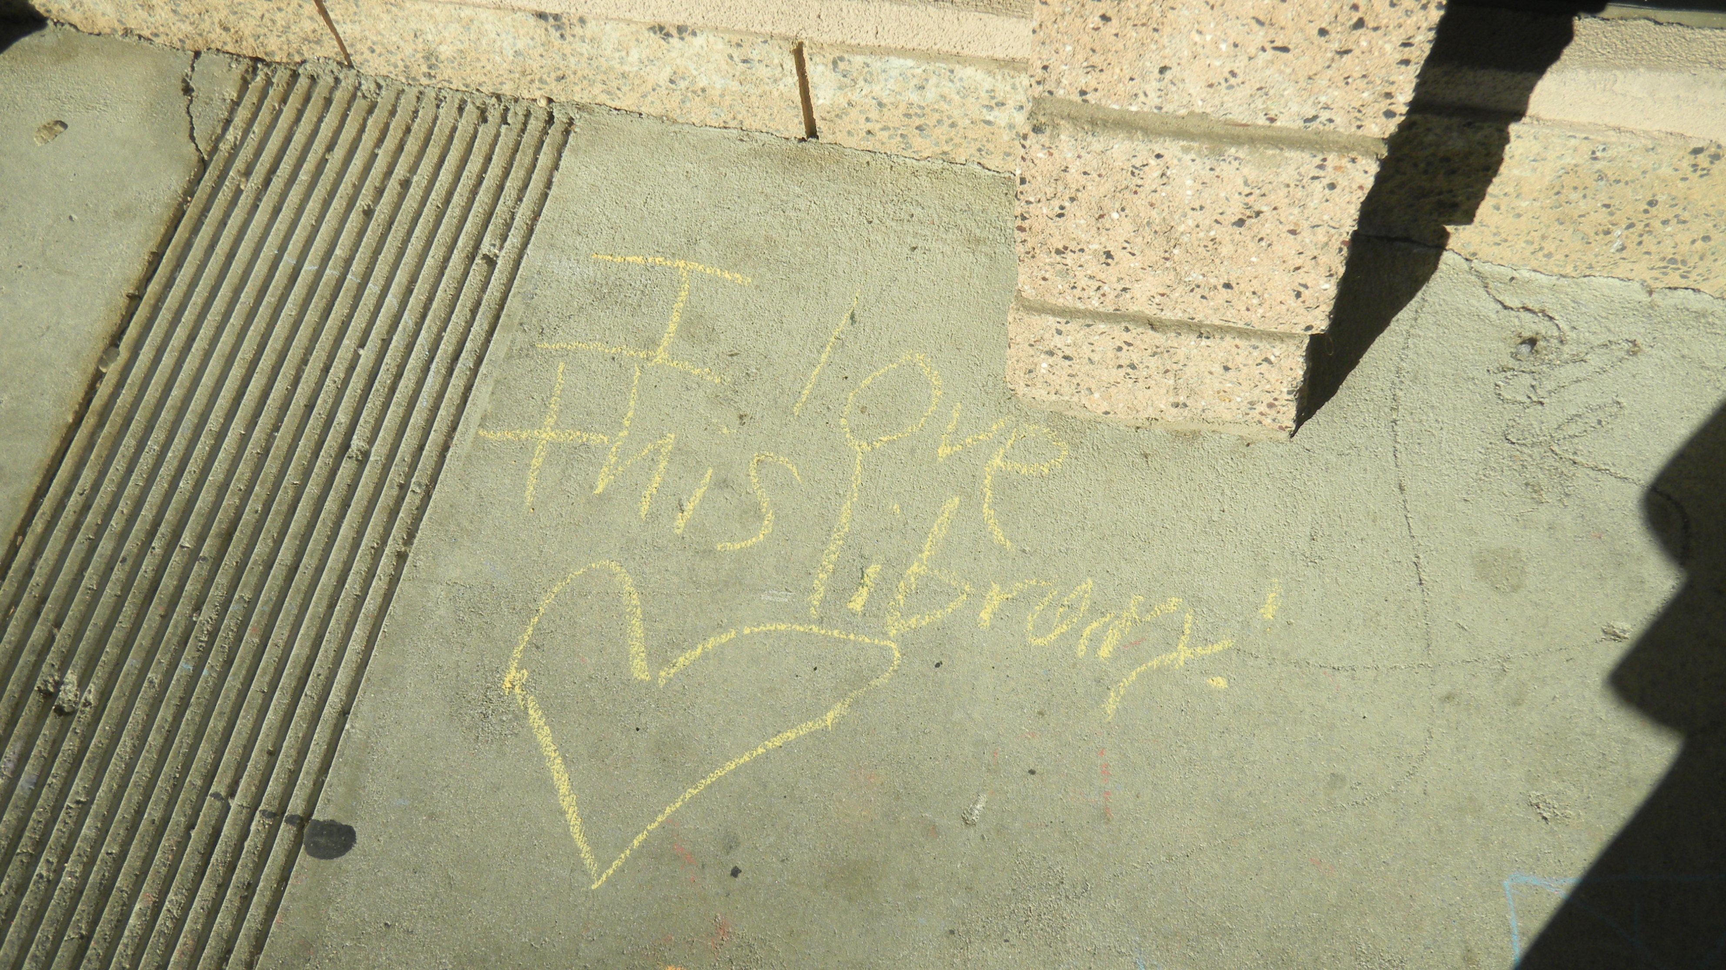
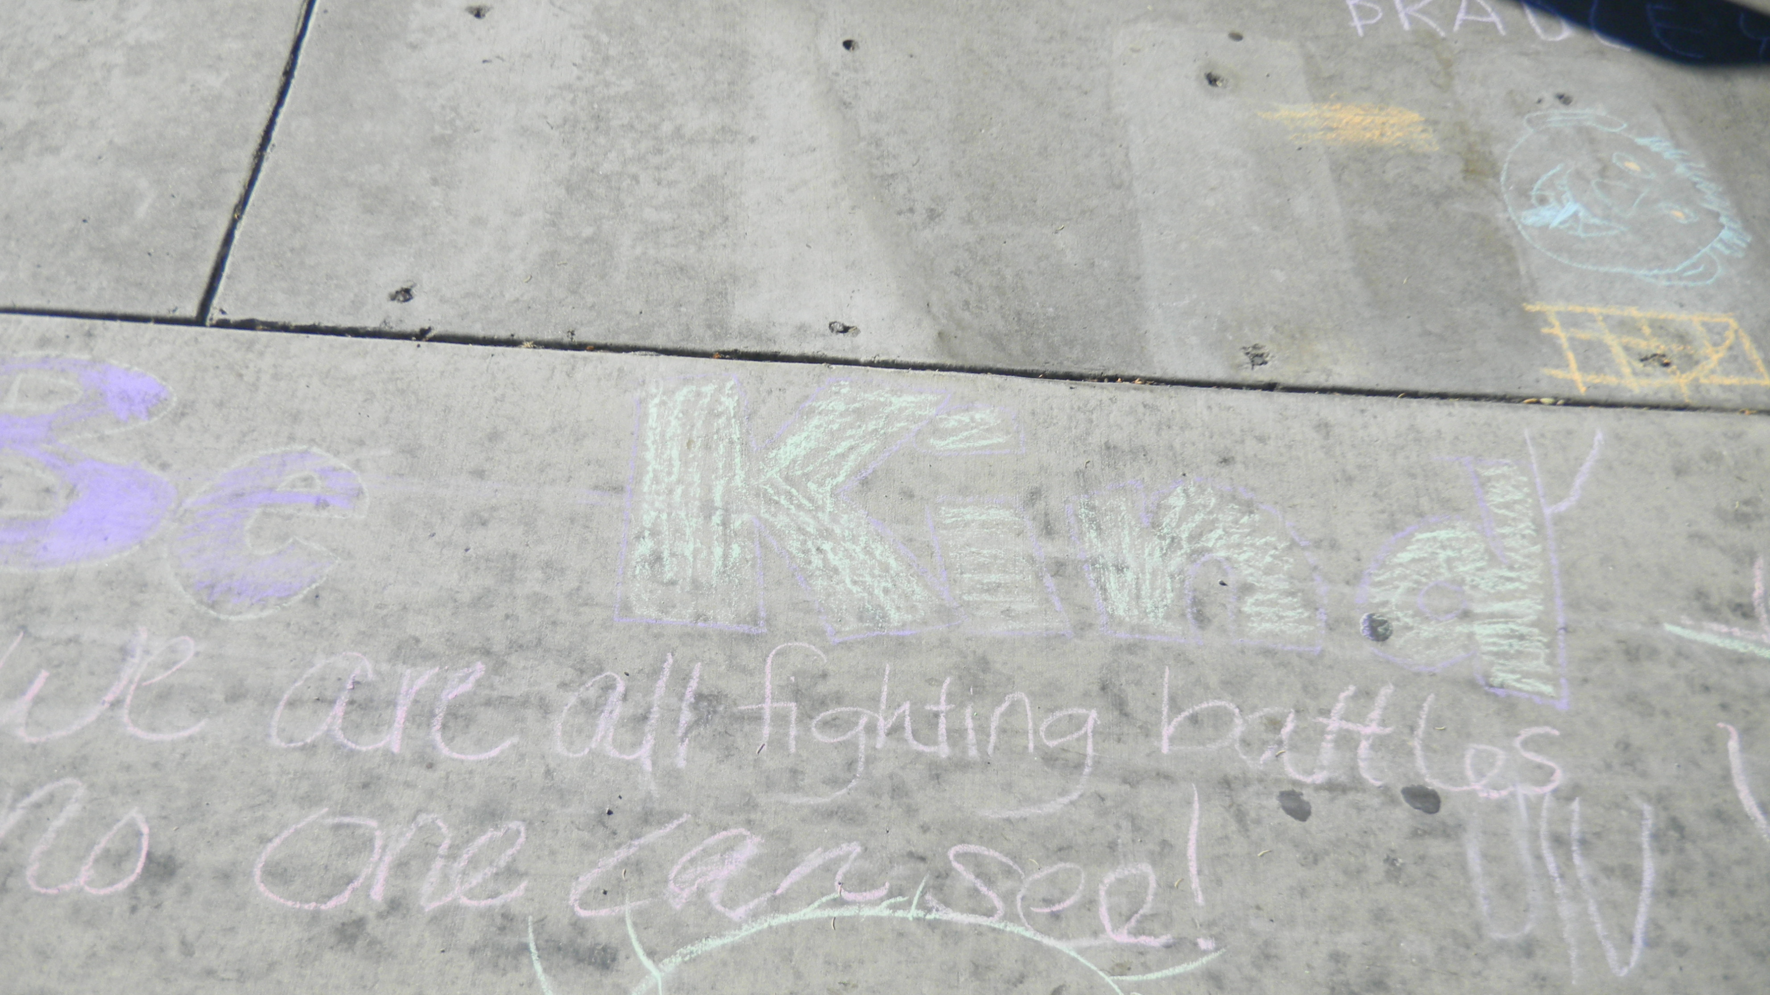
Intentional Bumping

Slide 13
What could your library do to encourage better bumping?

Slide 14
No One Left Behind
Undesirable Labels Designer Labels
Homeless Artistic
Old Wise
Pregnant Teen Mentor
Disabled Advocate

Slide 15
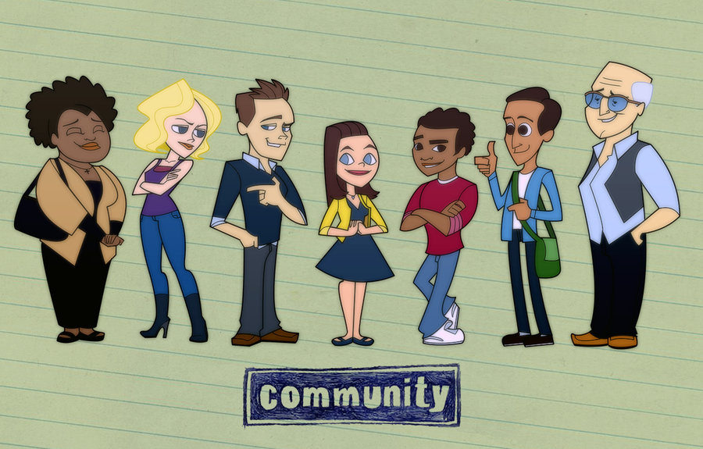
Untapped Resources
Customers or citizens?
Photo Credit: Flickr Creative Commons, http://bit.ly/2bSG4N0

Slide 16
Untapped Resources
Head, heart and hand. Retrieved from http://www.aiga.org/head-heart-and-hand--modern-design-practice/

Slide 17
Are there individuals using your library who you think of more as customers than citizens? What could you do to help them, other individuals and the library to focus more on their gifts?

Slide 18
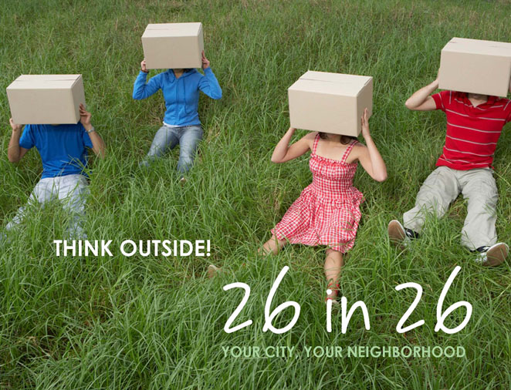
ABCD in Action
Citizen-led visioning to create unique action plans in all 26 neighborhoods in 26 months
Ongoing effort to identify and celebrate neighborhood strengths and empower neighborhoods to reach their full potential

Slide 19
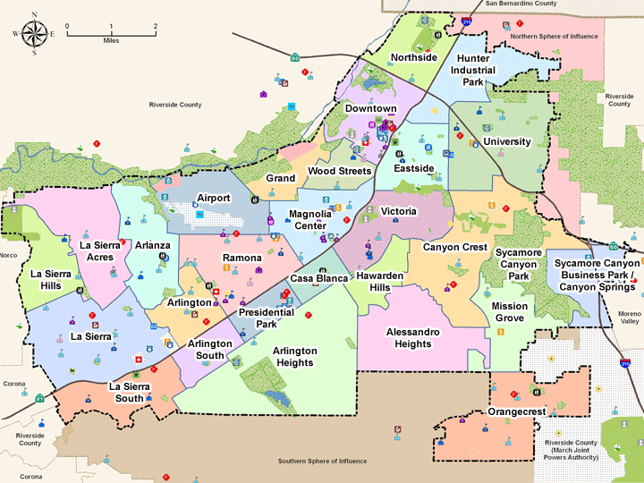
ABCD in Action

Slide 20
ABCD in Action
10 months of engagement
1 day of celebration

Slide 21
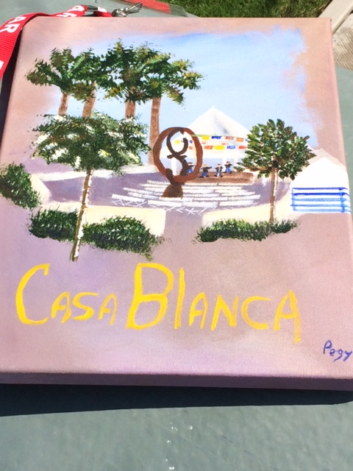
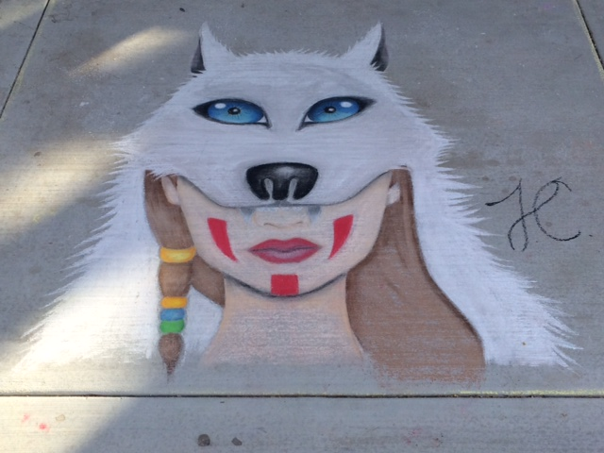
ABCD in Action

Slide 22
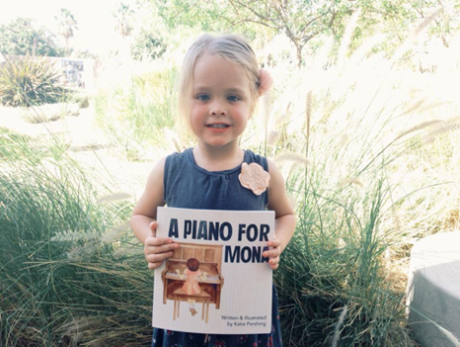
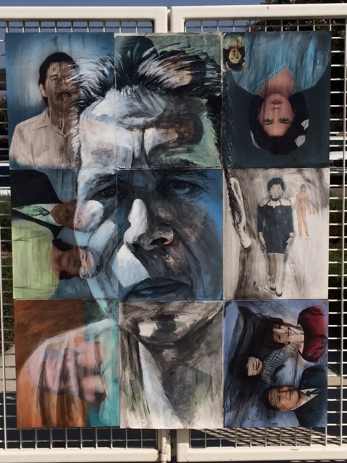
ABCD in Action

Slide 23
How can your library help the community identify and build on its cultural and historical assets?

Slide 24
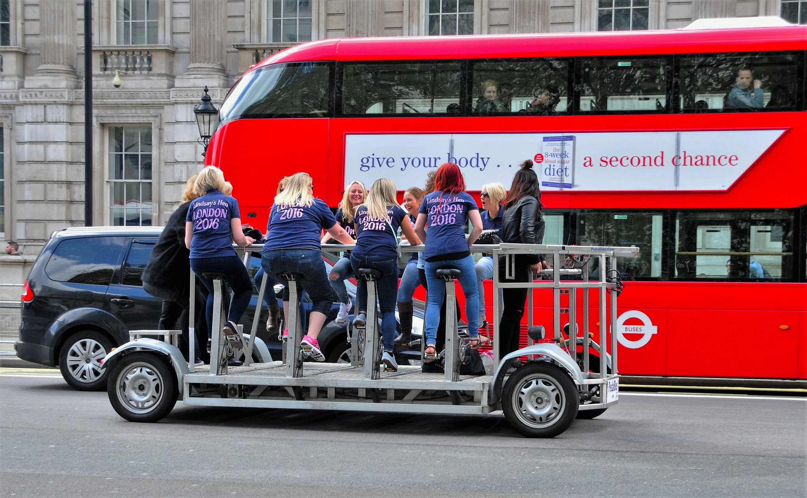
Community-Driven Planning
Photo Credit: Flickr Creative Commons, http://bit.ly/2bSFtv3

Slide 25
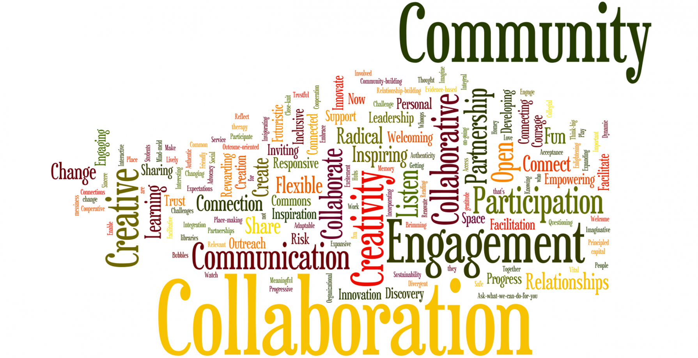
Invite
Engage
Rest
Adapt
Repeat
The Formula

Slide 26
Using these principles, how can your library better utilize your community’s assets?

Slide 27
Questions & Answers
[Questions]. Retrieved from http://bit.ly/2bBLPRH

