Slide 1
Welcome to today’s Webinar!
Infopeople is dedicated to bringing you the best in practical library training and improving information access for the public by improving the skills of library workers. Infopeople, a grant project of the Califa Group, is supported in part by the Institute of Museum and Library Services under the provisions of the Library Services and Technology Act administered in California by the State Librarian. This material is covered by Creative Commons 4.0 Non-commercial Share Alike license. Any use of this material should credit the funding source.

Slide 2
Making Data More Powerful
El Dorado County Library & First 5

Slide 3
Library and data
Traditional Numbers
Grants-Unique Counts
Number of Attendees
Adults
Children
Number of Programs
Type
Number of Checkouts
Unduplicated Count
People
Programs
Program Focus
Culture
Language
Support (ie…Fathers)

Slide 4
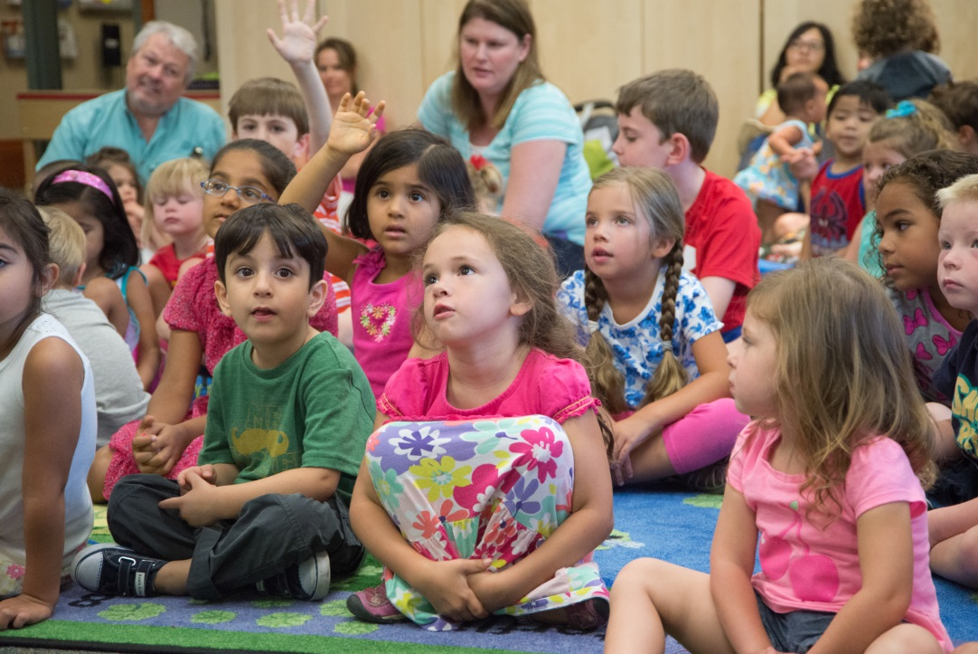
Data Collection
User Information
Household identification
Name
Primary language
Birthdate
Ethnicity
Permission to photograph
Registration site
Program Information
Program name
Age groups served
Program attributes
Program site

Slide 5
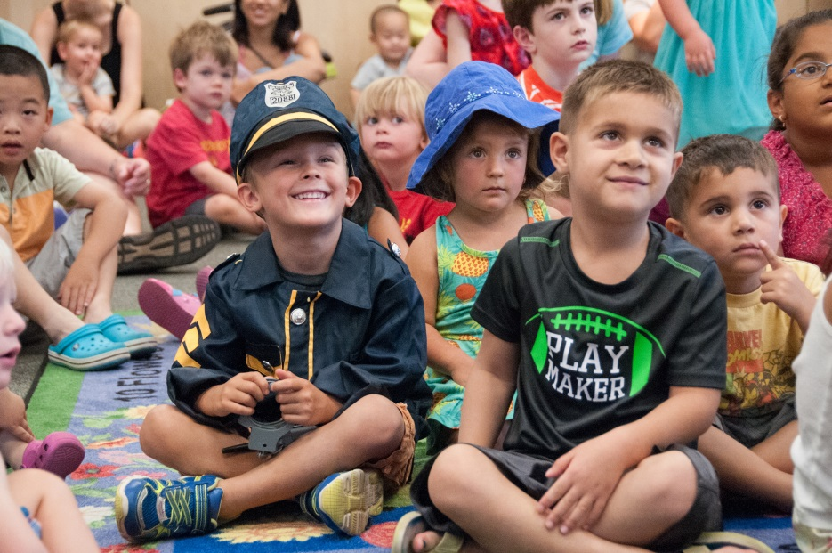
Unduplicated Counts
Satisfy grant funders with accurate data, such as:
Age
Ethnicity
Primary language
Programs attended
Program location
Date
Manual count box for unregistered families
Duplicates will be immediately identified during registration

Slide 6
Easy-Scan Cards
Scan cards make registration and data entry simple & fast
Child’s name will pop up on screen when their card is scanned
Flag preset attendance award
Generic count button if participant has forgotten their card

Slide 7
Customizable
Libraries can customize:
Fonts, colors & graphics
Program names
Program attributes
Site names/locations

Slide 8
Cloud-based Security
Keep your data safe
Access & update information from multiple locations simultaneously

Slide 9
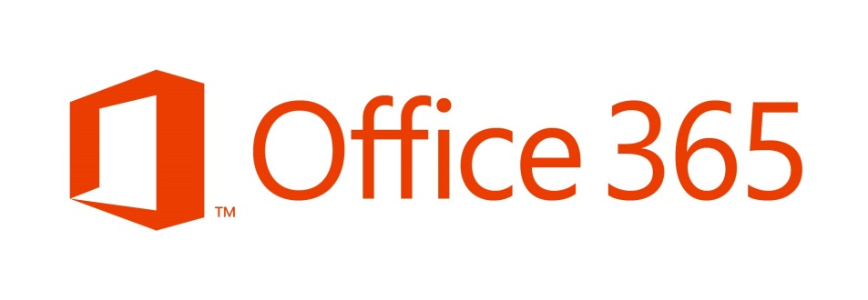
Microsoft 365 & Access
Access 2010 is minimum version required, 64 bit
Microsoft 365 provides online site with multiple branch access
Documentation provided for :
Basic Installation
Administrators
Users
Access Technician needed for basic support of system
Monthly fee for each user license
Possibly available through Tech Soup at ~75% discount

Slide 10
how do you get a copy?
Tool Kit and Product
Expected release by end of December, 2016
Open Source
Make any adaptations you wish
Customize for your system
No tech support
Presentations at CLA
ELF Reception, November 3, 4-6pm
Summer Reading Program Pre-session, November 3
Webinar will be archived and available
Contact Carolyn Brooks at carolyn.brooks@eldoradolibrary.org
To indicate interest in receiving further updates and information
Information on how to access to the application at the end of December

