Slide 1


Building an Effective
Learning Culture:
Introductory Webinar
November 1, 2016
A. Webinars
B. Online Courses

Slide 2

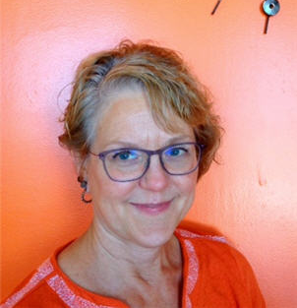
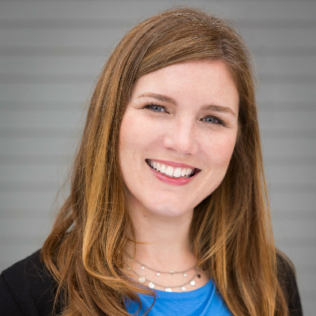

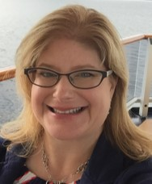
Today’s Speakers
January-June
2017
Lisa Barnhart
Crystal Schimpf
Brenda Hough
Stephanie Gerding

Slide 3
Today’s Agenda
Definition
Learning Culture Cycle
Library Examples
Team-Based Learning Benefits
Opportunity

Slide 4
Building an
Effective Learning Culture
A new online learning program from Infopeople:
  Team focused
  Mentoring component
  New delivery methods
  Bite-sized learning
January-June
2017
January-June
2017

Slide 5

What is a
Learning Culture?
  Less emphasis on formal training
  More opportunities for informal training
  Learning is integrated into strategic planning
  Organization supports learning & growth

Slide 6
Why build a
Learning Culture?
  Greater retention of new skills & knowledge
  Staff actively seek learning opportunities
  Staff apply new skills & knowledge on the job
Increase organizational performance

Slide 7
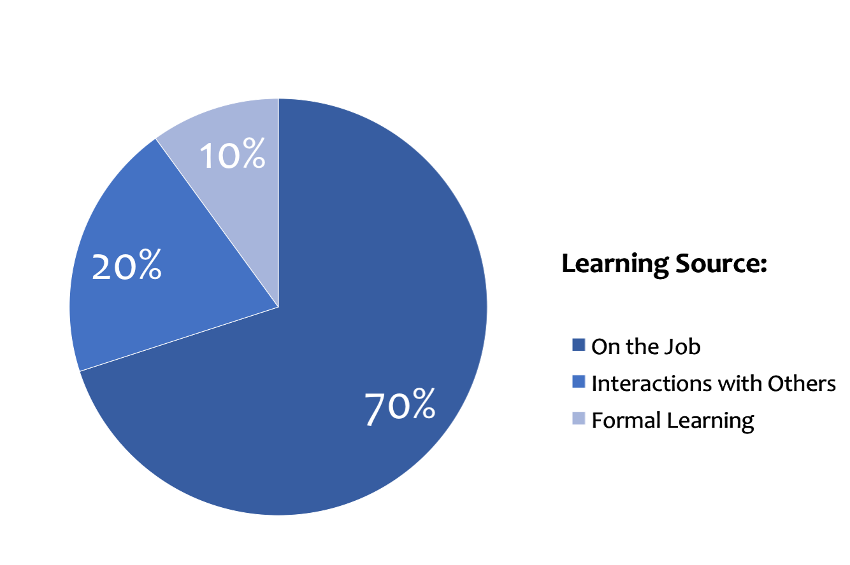
The 70/20/10 Rule

Slide 8
Why are you interested in
“Building an Effective Learning Culture”
at your library?
Please share in chat

Slide 9
Cycle for
Building a Learning Culture
Assess
Plan
Design
Learn
Transfer

Slide 10
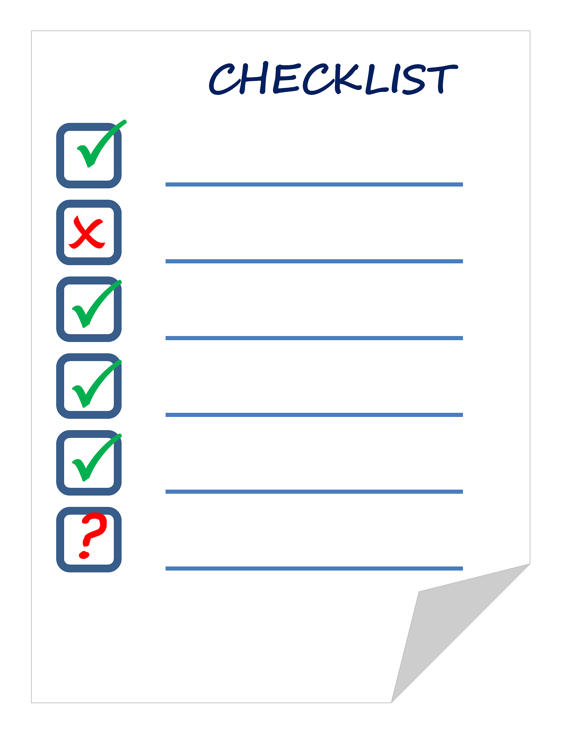
Assess
Take inventory of current learning opportunities.
Assess
Plan
Design
Learn
Transfer
Notes:
https://pixabay.com/en/checklist-list-check-check-list-911840/

Slide 11

Assess
Identify gaps in learning culture.
Assess
Plan
Design
Learn
Transfer
Notes:
https://pixabay.com/en/puzzle-missing-particles-654963/

Slide 12

Assess
Set goals for building a learning culture.
Assess
Plan
Design
Learn
Transfer
Notes:
https://pixabay.com/en/big-data-data-blocks-info-graphic-1514977/

Slide 13
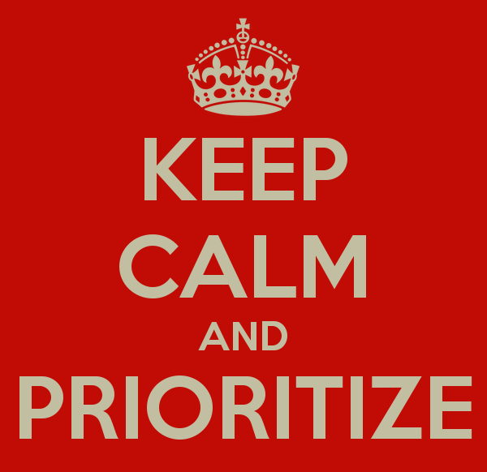

Plan
  Examine current plans.
Assess
Plan
Design
Learn
Transfer

Slide 14
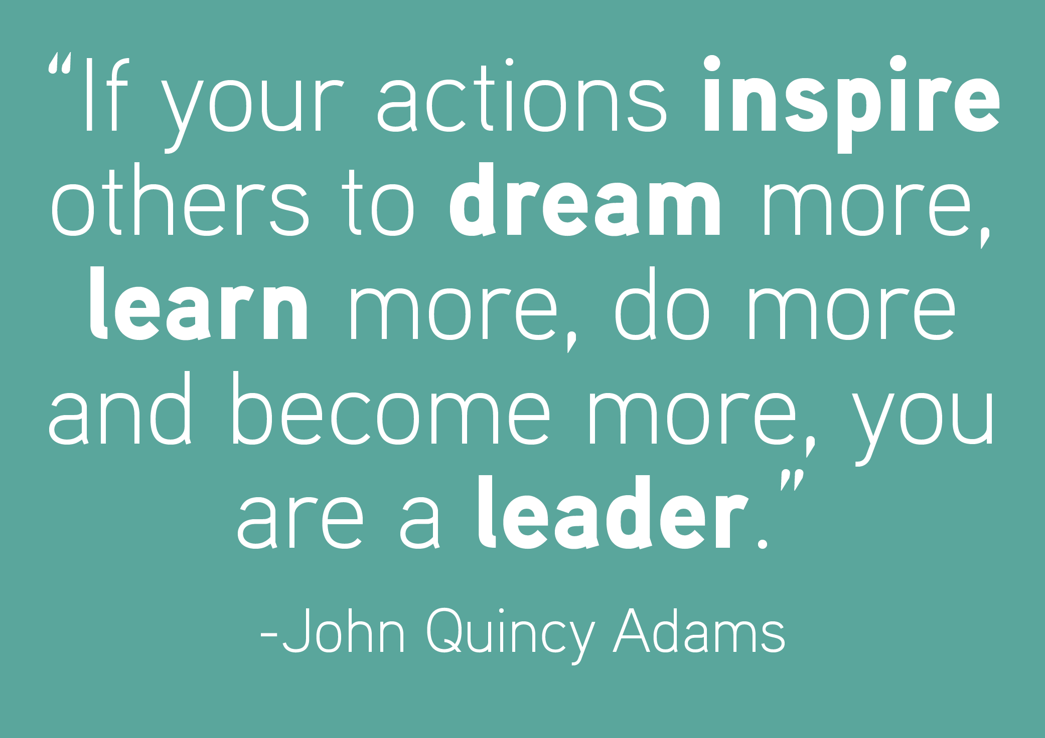
Plan
Model learning behaviors.
Assess
Plan
Design
Learn
Transfer

Slide 15

Plan
Provide support.
Assess
Plan
Design
Learn
Transfer

Slide 16
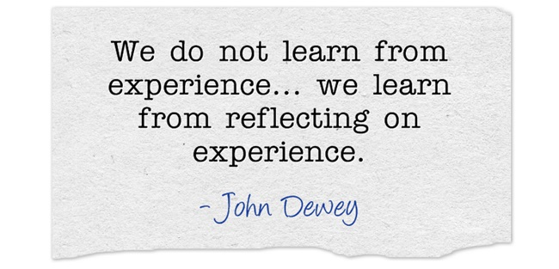
Design
Develop learning resources and activities that create opportunities for:
individual learning
peer sharing and collaboration
reflection on daily work/life experiences
Assess
Plan
Design
Learn
Transfer

Slide 17

Design
Create a safe environment for risk taking and experimentation while learning.
Assess
Plan
Design
Learn
Transfer

Slide 18

Design
Communicate learning options.
Assess
Plan
Design
Learn
Transfer

Slide 19
Top 6 Ways We are Succeeding
Training funds are in budget

Slide 20
Top 6 Ways We are Succeeding
Training funds are in budget
Staff have time for learning

Slide 21
Top 6 Ways We are Succeeding
Training funds are in budget
Staff have time for learning
Library has an organized staff development program

Slide 22
Top 6 Ways We are Succeeding
Training funds are in budget
Staff have time for learning
Library has an organized staff development program
There is buy-in from leadership regarding the importance of a learning culture

Slide 23
Top 6 Ways We are Succeeding
Training funds are in budget
Staff have time for learning
Library has an organized staff development program
There is buy-in from leadership regarding the importance of a learning culture
There is buy-in from staff regarding the importance of a learning culture

Slide 24
Top 6 Ways We are Succeeding
Training funds are in budget
Staff have time for learning
Library has an organized staff development program
There is buy-in from leadership regarding the importance of a learning culture
There is buy-in from staff regarding the importance of a learning culture
Library has implemented successful methods for building a learning culture

Slide 25
Top 6 Ways We are Succeeding
Training funds are in budget
Staff have time for learning
Library has an organized staff development program
There is buy-in from leadership regarding the importance of a learning culture
There is buy-in from staff regarding the importance of a learning culture
Library has implemented successful methods for building a learning culture
How is your library succeeding?
Please share in chat.

Slide 26
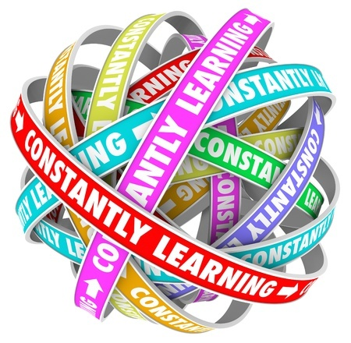
Learn
Learn constantly.
Assess
Plan
Design
Learn
Transfer

Slide 27

Learn
Learn collaboratively.
Assess
Plan
Design
Learn
Transfer

Slide 28

Learn
Embrace innovation.
Assess
Plan
Design
Learn
Transfer

Slide 29
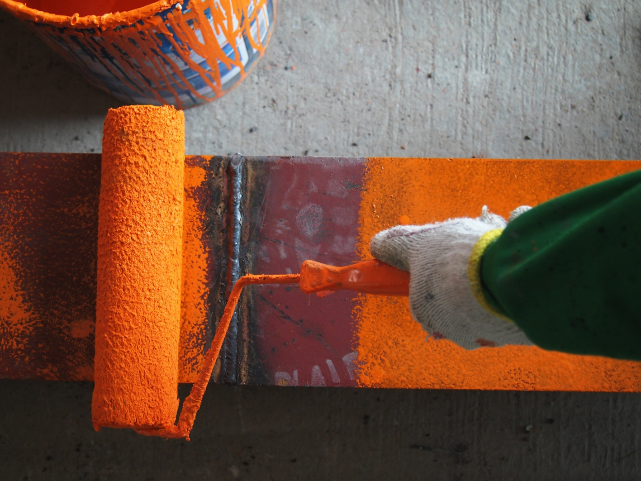
Transfer
Encourage application.
Assess
Plan
Design
Learn
Transfer
Notes:
https://www.graphicstock.com/stock-image/painting-metal

Slide 30

Transfer
Start a conversation.
Assess
Plan
Design
Learn
Transfer
Notes:
https://pixabay.com/en/chat-discussion-meeting-talk-23713/

Slide 31

Transfer
Give recognition.
Assess
Plan
Design
Learn
Transfer
Notes:
https://www.graphicstock.com/stock-image/great-job-note-shows-praise-or-approval

Slide 32
3 Ways to Support
Knowledge Transfer
Encourage application
Start a conversation
Give recognition
How could you support
knowledge transfer
at your library?
Please share in chat.

Slide 33
5 Phases of
Building a Learning Culture
                Assess
                Plan
                Design
                Learn
                Transfer
Assess
Plan
Design
Learn
Transfer
Download the PDF Handout

Slide 34
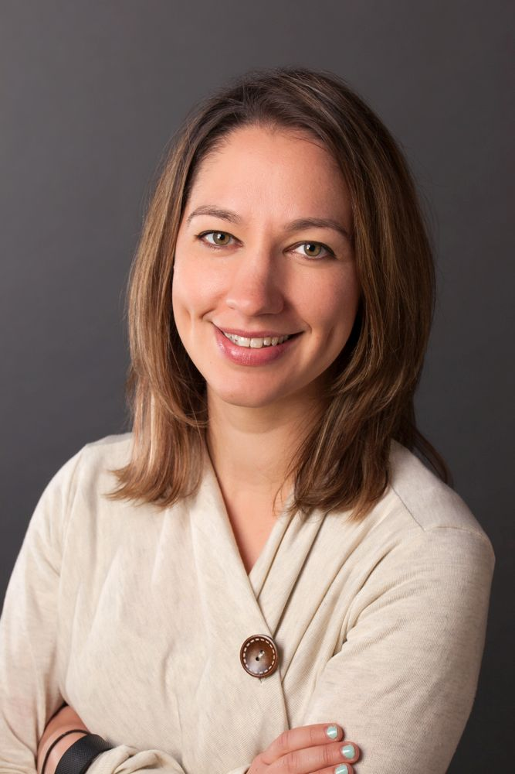
Rachel Rubin
Bexley Public Library
From Nothing to Something
Developing a Culture of Learning at
Bexley Public Library

Slide 35
We’re not there yet.
(Where is there, anyway?)

Slide 36
In the Beginning
No budget
No culture of learning
No support from administration for staff development

Slide 37
Getting Started
Make a commitment
  Financial (who do you have to convince?)
  Time
A culture of learning starts at home
  Department meetings, Supervisor/Manager meetings, all-staff meetings
  Open communication, breaking down silos

Slide 38
A Little Bit Louder Now
Creating opportunities for learning & teaching internally
  Database quizzes
  In-house training – who are the “experts”?
Getting out of the building
  Webinars
  Meetings
  Conferences
Culture is about people
  Hire smart

Slide 39
A Work in Progress
Formalize expectations
  How many development opportunities are staff expected to participate in? Each quarter? Each year?
  Can it be fun?
  Formalizing documentation
How can new learning be shared?
  Presentations? Intranet?
Dedicated off-desk time
Development of consistent, effective onboarding orientation & training processes

Slide 40
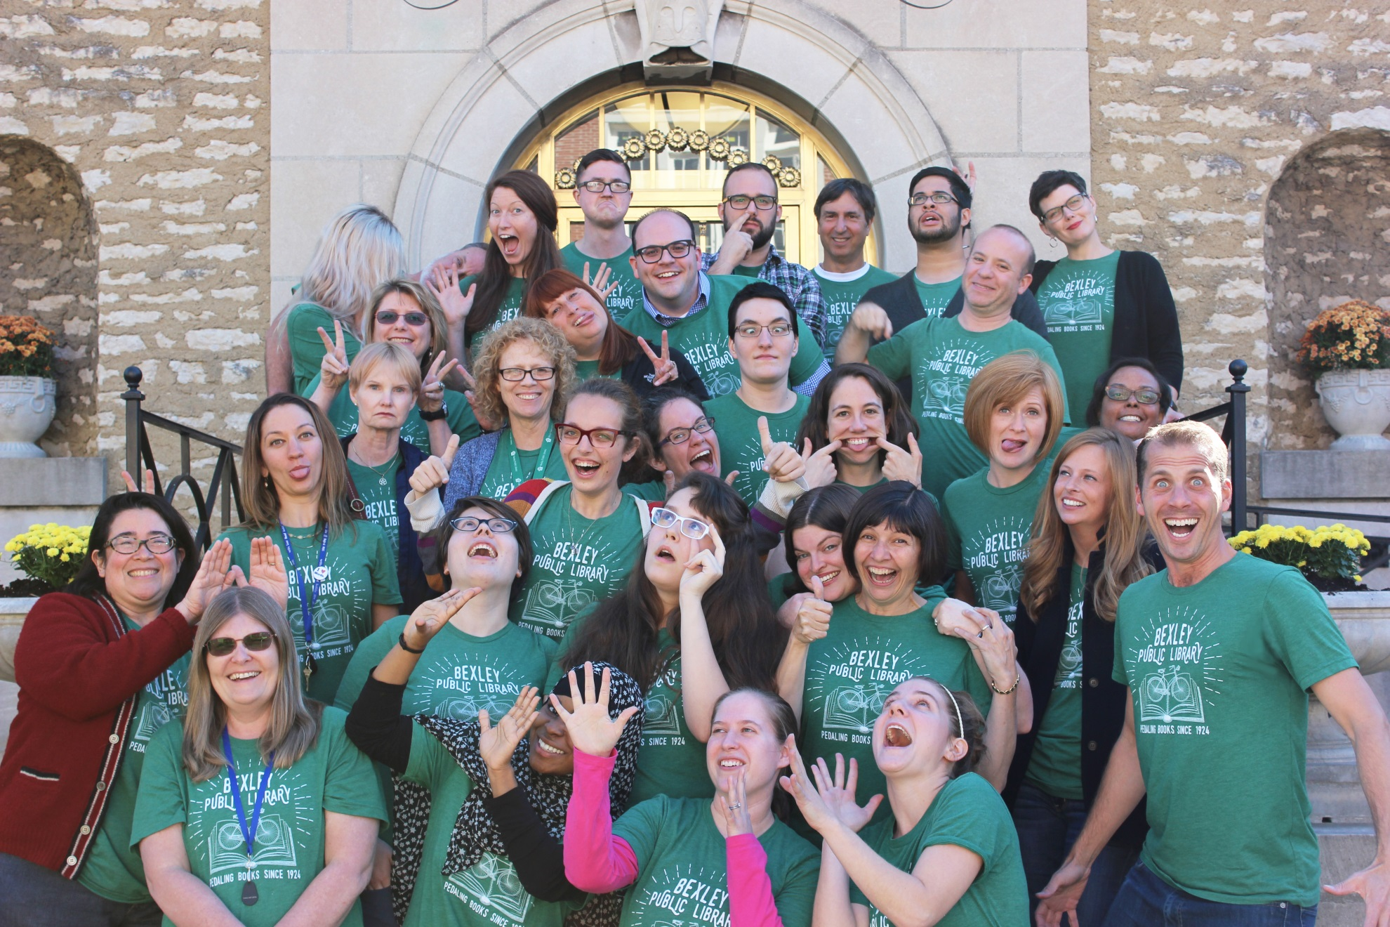

Slide 41

Maurice Coleman
Harford County Public Library
Learning Libraries –
A Systems Approach for Change

Slide 42
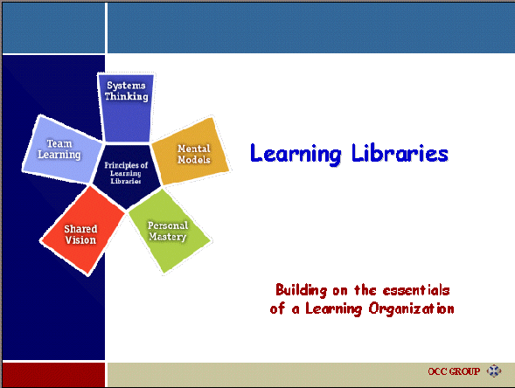

Slide 43
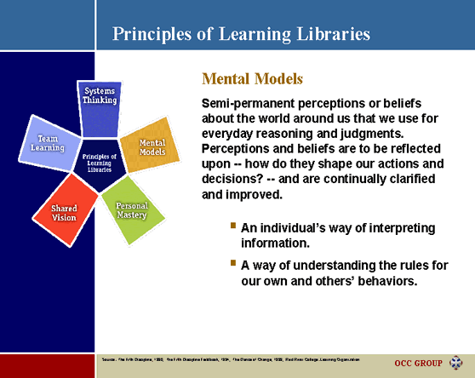

Slide 44
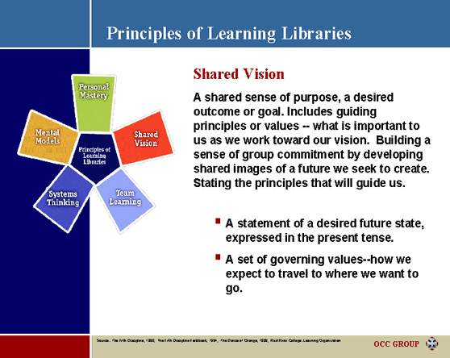

Slide 45
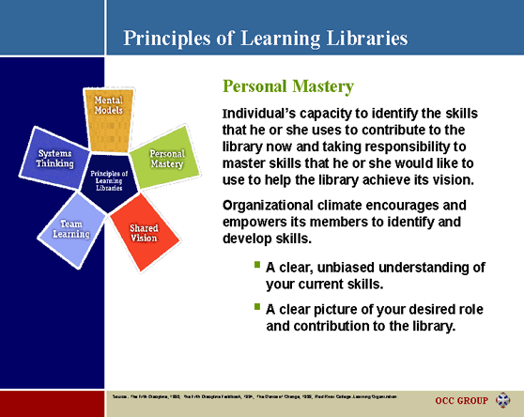

Slide 46
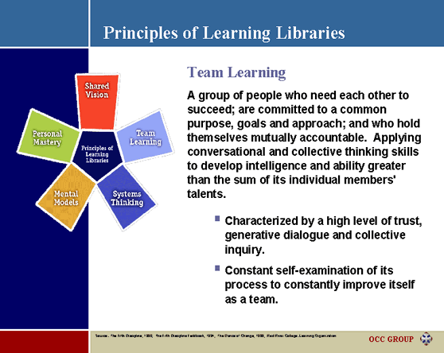

Slide 47
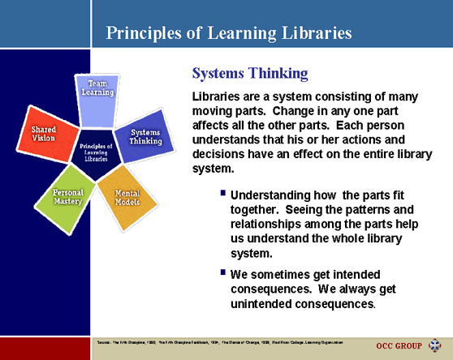

Slide 48
Building an
Effective Learning Culture
What Topics will be covered?
Assess
Plan
Design
Learn
Transfer
How to…
Assess organizational learning culture
Create a plan for organizational learning.
Design programs to foster staff development.
Build the capacity for rapid, continuous learning.
Support the transfer of knowledge to workplace.

Slide 49
Building an
Effective Learning Culture
What to Expect?
  Content will follow 70/20/10 rule
  Delivery will be non-traditional: videos, podcasts, interactive
  Each team will be paired with a mentor
  Reinforcement will be both individual- and team-driven
  Will focus on practical application within libraries
  Online content will be mostly asynchronous but team based

Slide 50
Building an
Effective Learning Culture
Who should apply?
  Participants will apply as a team
  Teams will consist of 3 to 5 people with a designated team lead
  Mix of administrators, managers, front line staff
  Teams should be from the same library, branch, or department
  Team makeup will be determined by the library applying

Slide 51
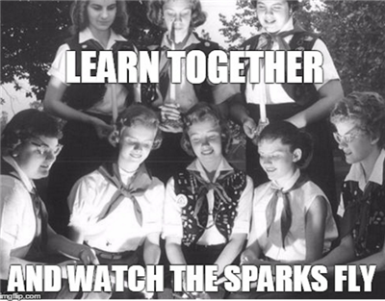
Building an
Effective Learning Culture
Why teams?

Slide 52
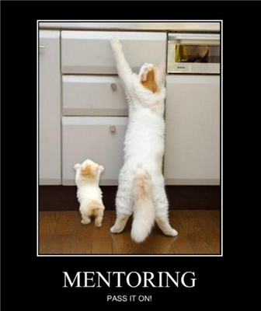
Building an
Effective Learning Culture
What will mentors do?

Slide 53
Building an
Effective Learning Culture
Who are the mentors?
  Jami Carter Tooele City Library, Utah
  Maurice Coleman Harford County Public Library, Maryland
  Colleen Hooks Orange County Library System, Florida
  Shana Munn Arlington Public Library, Texas
  Jennifer Peterson WebJunction, Washington
  Rachel Rubin Bexley Public Library, Ohio
  Sandra Smith Denver Public Library, Colorado
  Cheryl Wright Indianapolis-Marion County Library, Indiana

Slide 54
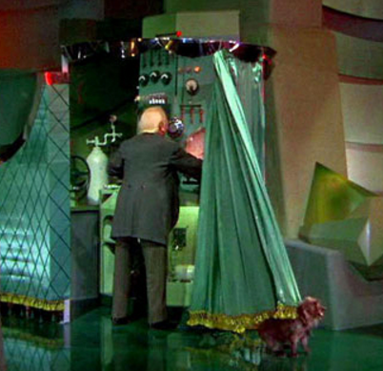
Building an
Effective Learning Culture
What will instructors do?

Slide 55
Building an
Effective Learning Culture
What is expected of participants?
  Average 10 hours per month (individual + group)
  Online participation
  Team work
  Mentor meetings

Slide 56
Building an
Effective Learning Culture
How do libraries apply?
  Application open November 1-23
  Submit one application per team
  Applications will be reviewed November 28-December 9
  Teams must get support of their library administration/management
  10 teams will be accepted

Slide 57
Building an
Effective Learning Culture
How much does it cost?
  Cost is per team (not per individual) for 3 – 5 people
  $500 California Libraries/$600 Out of State
  No application fee
  Accepted teams will be invoiced

Slide 58
Building an
Effective Learning Culture
What is the Time Frame?
    November 1: Application Opens
    December 9: Teams Chosen
    January: Learning Begins
    February-May: Content delivery & Mentoring
    June: Final Assignment & Course Evaluation

Slide 59
Building an
Effective Learning Culture
Interested?
Visit our info page:
https://infopeople.org/belc
Join our email list:
https://www.infopeople.org/belcupdates
Questions? Email belc@infopeople.org
Download the PDF Handout

Slide 60
Questions?
A. Webinars
B. Online Courses
Visit our info page:
https://infopeople.org/belc
Join our email list:
https://www.infopeople.org/belcupdates
Send us an email
belc@infopeople.org
Download the PDF Handout

Slide 61

Thank you for attending today’s Infopeople Webinar!
Infopeople is dedicated to bringing you the best in practical library training and improving information access for the public by improving the skills of library workers. Infopeople, a grant project of the Califa Group, is supported in part by the Institute of Museum and Library Services under the provisions of the Library Services and Technology Act administered in California by the State Librarian. This material is covered by Creative Commons 4.0 Non-commercial Share Alike license. Any use of this material should credit the funding source.

