Slide 1
Welcome to today’s Infopeople Webinar!
Infopeople is dedicated to bringing you the best in practical library training and improving information access for the public by improving the skills of library workers. Infopeople, a grant project of the Califa Group, is supported in part by the Institute of Museum and Library Services under the provisions of the Library Services and Technology Act administered in California by the State Librarian. This material is covered by Creative Commons 4.0 Non-commercial Share Alike license. Any use of this material should credit the funding source.

Slide 2
Tabletop Games and 21st Century Skill Development
An Infopeople Webinar
November 9, 2016
Lauren Hays
Instructional and Research Librarian
Co-Director of the Center for Games & Learning

Slide 4
Do you have games in your collection?
Yes
No

Slide 5
Do you have tabletop games in your collection?
Yes
No

Slide 6
If you have games in your collection, how do you use them?
Specific game nights/days
For children
For teens
Recreation for all ages
Other

Slide 7
Types of Games: SNAKS
Strategy games (such as Monopoly or Risk)
Narrative games (such as Dungeons and Dragons)
Action games (such as Jenga or Kickball)
Knowledge games (such as Trivial Pursuit or Scrabble)
Social games (such as Dictionary or Apples to Apples)
Nicholson, S. (2010). Everyone plays at the library. Medford, NJ: Information Today.

Slide 8
21st Century Skills
Image from P21 Partnership for 21st Century Learning

Slide 9
Creativity

Slide 11
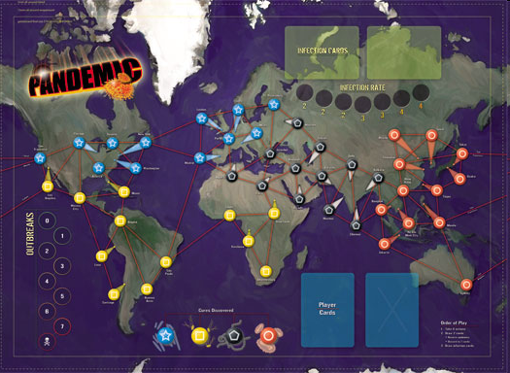
Communication

Slide 13
Critical Thinking

Slide 14
Collaboration

Slide 15
Game Facilitation
Multiple copies of a few games
Play a practice round
Give directions as the game is played

Slide 16
Game Debriefing
Games do not “teach themselves”.
When strong debriefing follows gameplay, then deep learning can occur.
Debriefing steps:
Learning goals should initially guide discussion.
Listen in order to create dialogue, not just to “check off” correct answers.
Feelings first (best, worst, highs, lows).
Storytelling next (as if telling a friend about the game).
“Take aways” next (compare and contrast the game with other content that has been learned).
Modifications and future suggestions last (maybe try it).
Notes:
Best practices for helping patrons reflect on the experience of the gameplay
What questions do you ask in a book club?

Slide 17
Thiagi’s Six Phase Model
How did you feel during the game?
What happened during the game?
What did you learn during the game?
How does that learning connect to your own life experience?
How could you use what you learned in another time or place?
What will you do now with this information?
Thiagarajan, S. (February, 2004). Six phases of debriefing for performance. Retrieved from http://www.thiagi.com/pfp/IE4H/february2004.html

Slide 18
Questions?
Lauren Hays, MLS
Instructional and Research Librarian
Co-Director of the Center for Games & Learning
MidAmerica Nazarene University
ldhays@mnu.edu
@Lib_Lauren

