Slide 1

Welcome to today’s Infopeople Webinar!
Infopeople is dedicated to bringing you the best in practical library training and improving information access for the public by improving the skills of library workers. Infopeople, a grant project of the Califa Group, is supported in part by the Institute of Museum and Library Services under the provisions of the Library Services and Technology Act administered in California by the State Librarian. This material is covered by Creative Commons 4.0 Non-commercial Share Alike license. Any use of this material should credit the funding source.

Slide 2
Measure Your Impact:
Getting Started with
Outcome-Based Evaluation
An Infopeople Webinar
Linda Hofschire, Director, Library Research Service, Colorado State Library
www.lrs.org | @lrs_co | @lindahofschire

Slide 3
Poll Question:
Are you currently measuring outcomes in your library?

Slide 4
Data Trifecta
Inputs
Outputs
Outcomes

Slide 5
Input Measures
Inputs
Quantifying the effort expended on a program

Slide 6

funds expended

Slide 7

number of staff

Slide 8
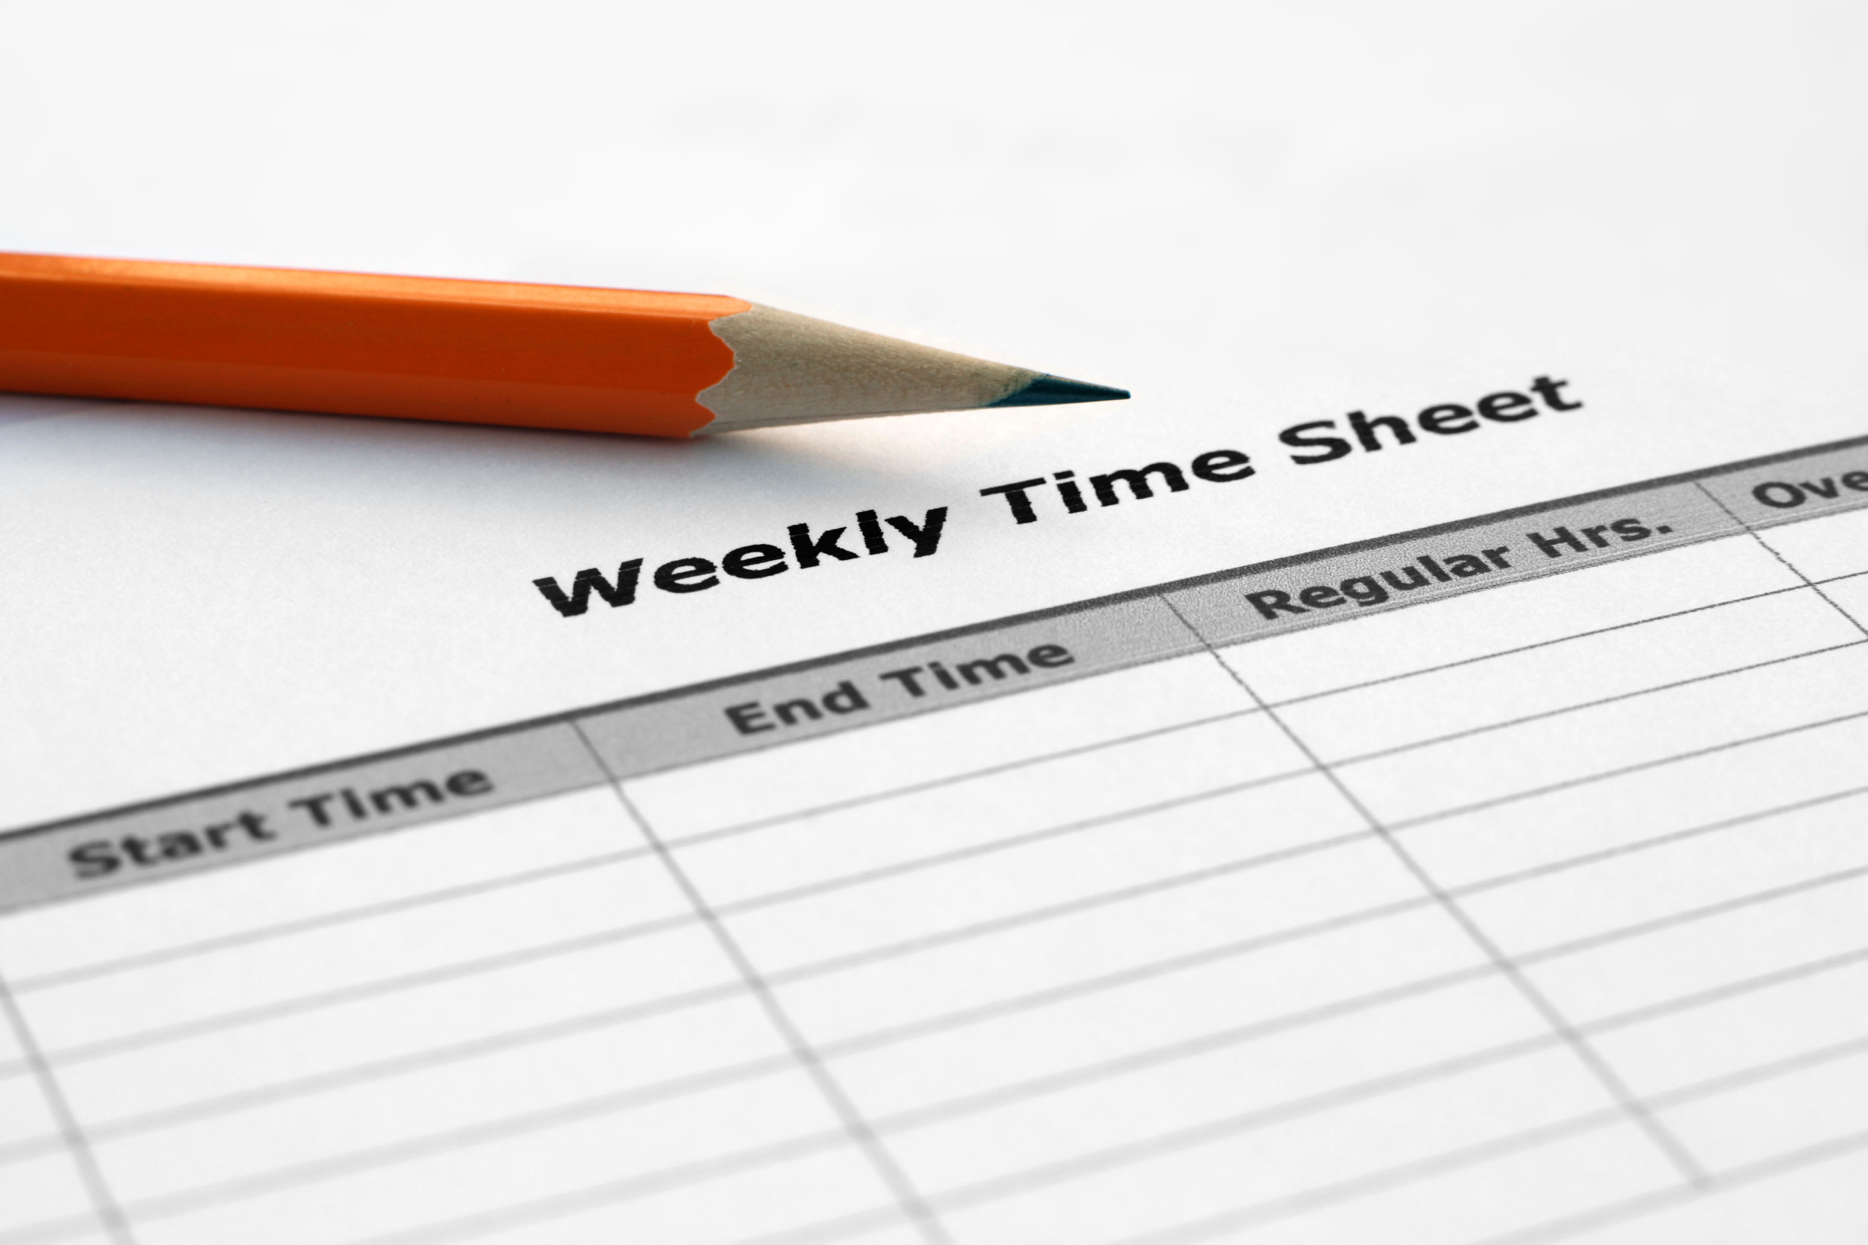
staff hours

Slide 9
Output Measures
Outputs
Quantifying the level of services and materials provided

Slide 10
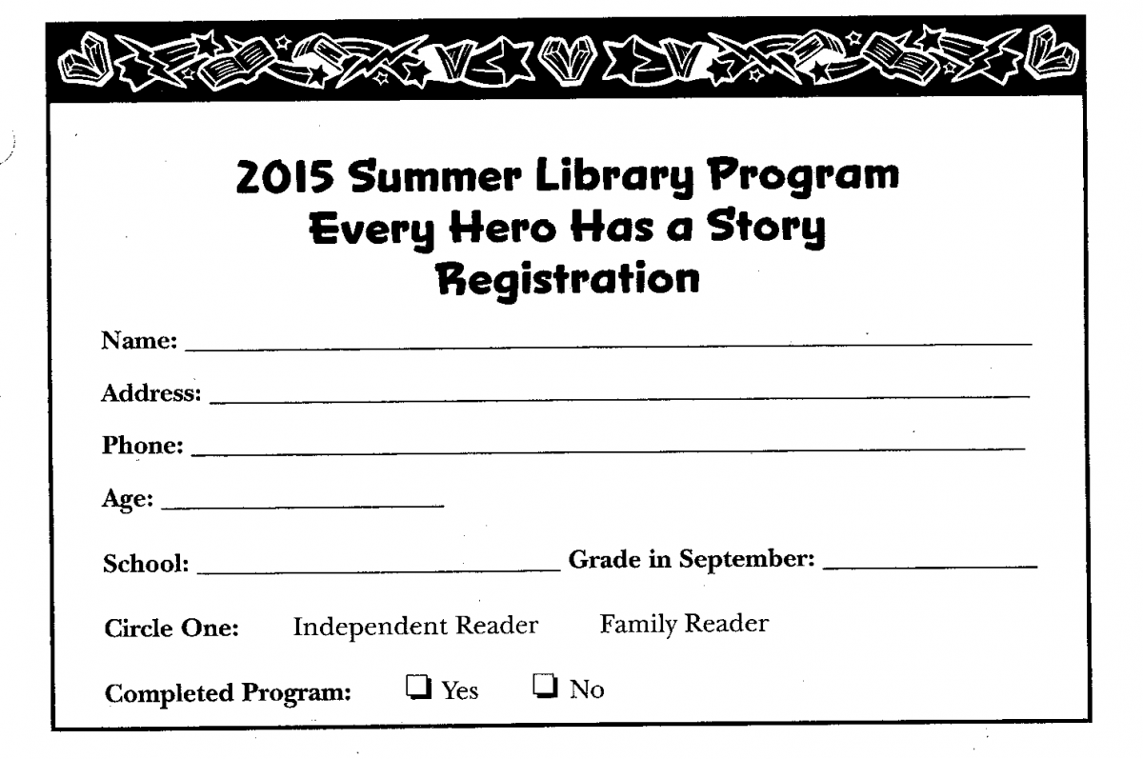
number of registered participants

Slide 11
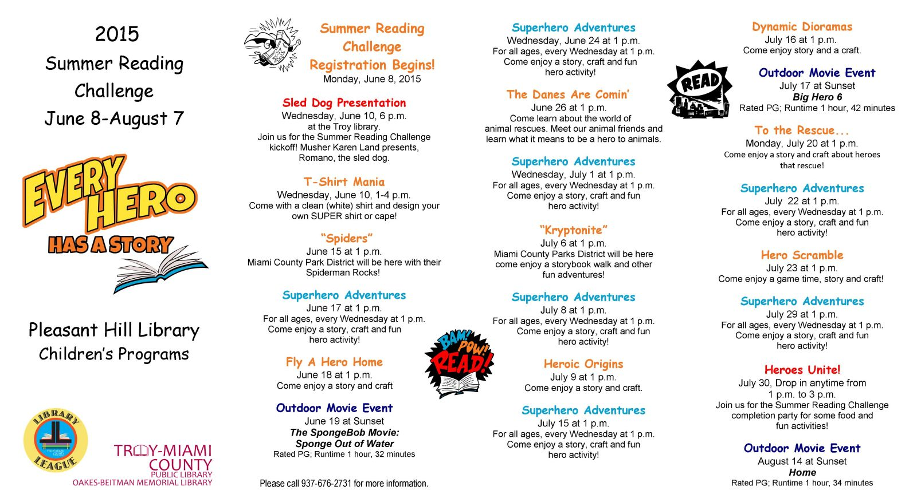
number of events offered

Slide 12
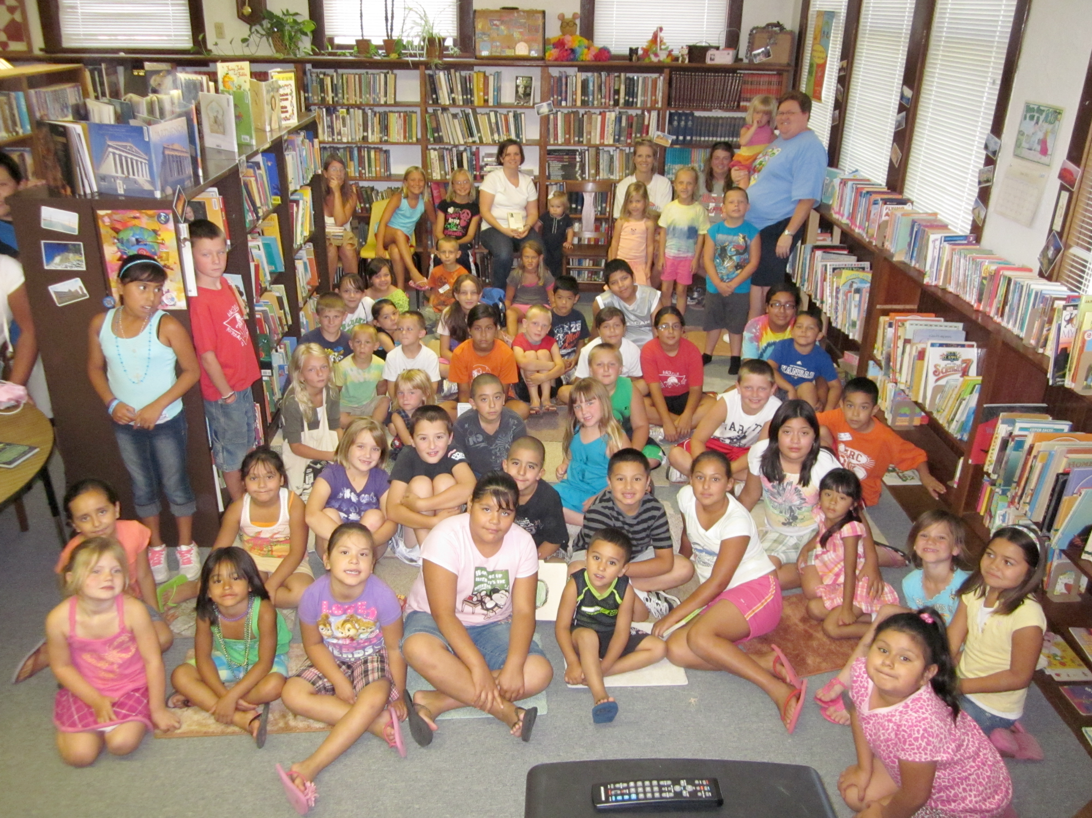
total attendance at events

Slide 13
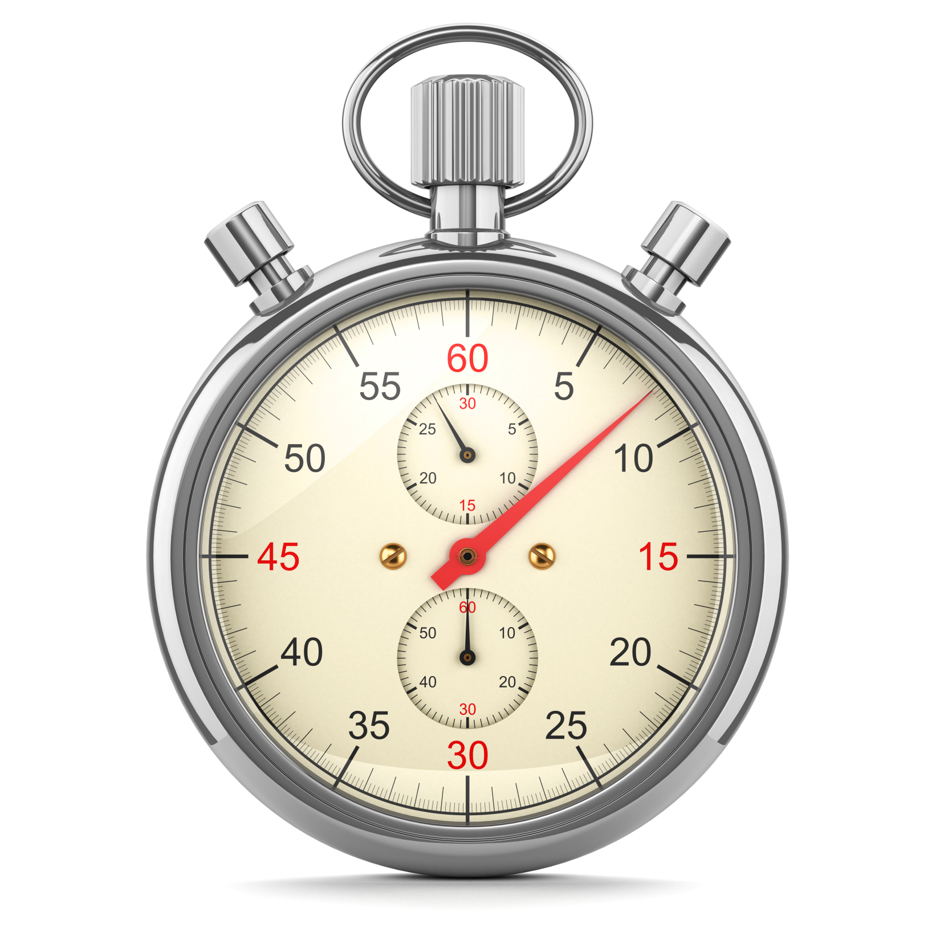
number of minutes spent reading

Slide 14
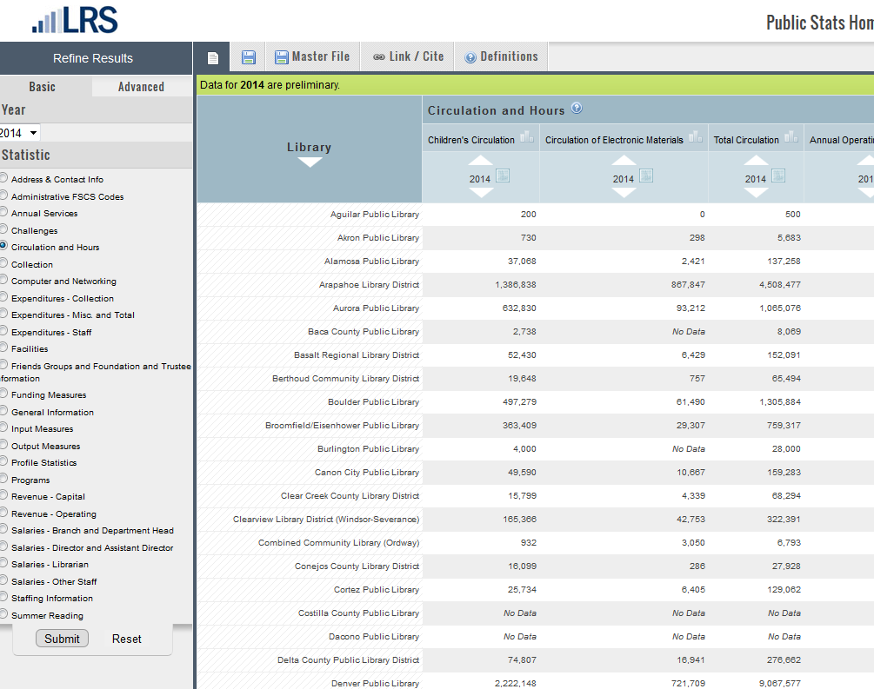
circulation

Slide 15
Outcome Measures
Outcomes
Quantifying the effect a service has on the program’s stated objectives

Slide 16
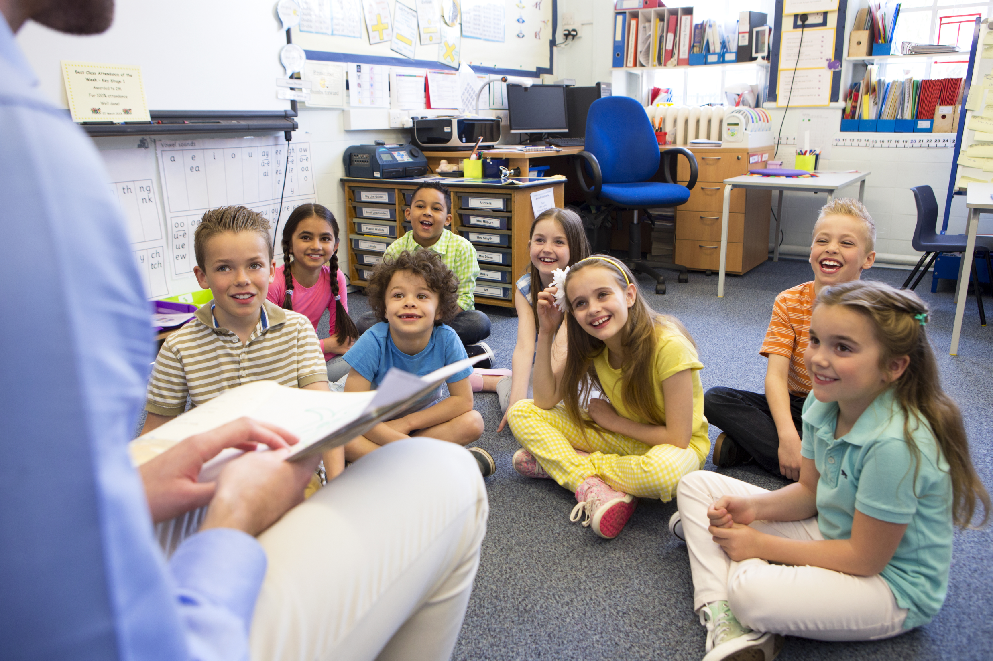
Children’s enjoyment
of reading increased

Slide 17

children maintained
or improved reading skills

Slide 18

children were more
likely to read by choice

Slide 19
Data Trifecta
Inputs
Outputs
Outcomes

Slide 20
Question:
What outcomes are you measuring?

Slide 21



Slide 22
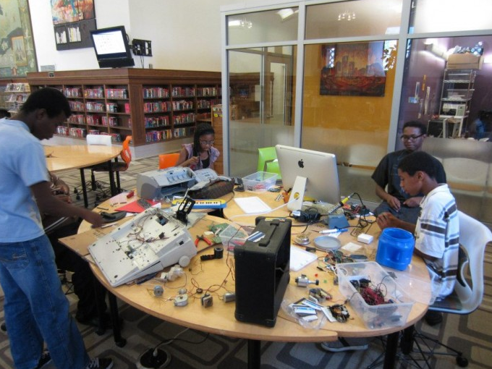

Slide 23
Library A
Library B
Library C

Slide 24
Library A
Library B
Library C
100% of participating children increased or maintained reading skills
85% of participating children increased or maintained reading skills
85% of participating children increased or maintained reading skills

Slide 25
Library A
Library B
Library C
100% of participating children increased or maintained reading skills
85% of participating children increased or maintained reading skills
85% of participating children increased or maintained reading skills
25 children participated
100 children participated
50 children participated

Slide 26
Library A
Library B
Library C
100% of participating children increased or maintained reading skills
85% of participating children increased or maintained reading skills
85% of participating children increased or maintained reading skills
25 children participated
100 children participated
50 children participated
$5,000
$10,000
$2,500

Slide 27
Library A
Library B
Library C
100% of participating children increased or maintained reading skills
85% of participating children increased or maintained reading skills
85% of participating children increased or maintained reading skills
25 children participated
100 children participated
50 children participated
$5,000
$10,000
$2,500
$200/child
$100/child
$50/child

Slide 28
outcomes
Immediate
Intermediate
Long-term

Slide 29
outcomes
Immediate
Intermediate
Long-term
Learn how to complete online job application

Slide 30
outcomes
Immediate
Intermediate
Long-term
Learn how to complete online job application
Get an interview

Slide 31
outcomes
Immediate
Intermediate
Long-term (impacts)
Learn how to complete online job application
Get an interview
Get a job

Slide 32
outcomes
Immediate
Intermediate
Long-term
Learn how to complete online job application
Get an interview
Get a job

Slide 33
Linking immediate outcomes to long-term impact
Reading for pleasure associated with:
Increased empathy
Improved relationships
Reduced depression symptoms
Reduced risk of dementia
The Reading Agency, 2015

Slide 34
Linking outputs to long-term impact
Reading more associated with…
Improved reading skills
Better development of vocabulary, writing, and grammar
Chin & Krashen (2007)

Slide 35
Question:
Are you measuring long-term impacts? If so, how are you doing this?

Slide 36
measuring outcomes

Slide 37

ASK
?

Slide 38


Slide 39
survey
After participating in the Summer Reading Program, did your child’s reading habits change? Please indicate if the following things increased, stayed the same, or decreased for your child:
 | Increased | Stayed the Same | Decreased
Enjoyment of reading
Reading skills
Reading by his/her choice

Slide 40
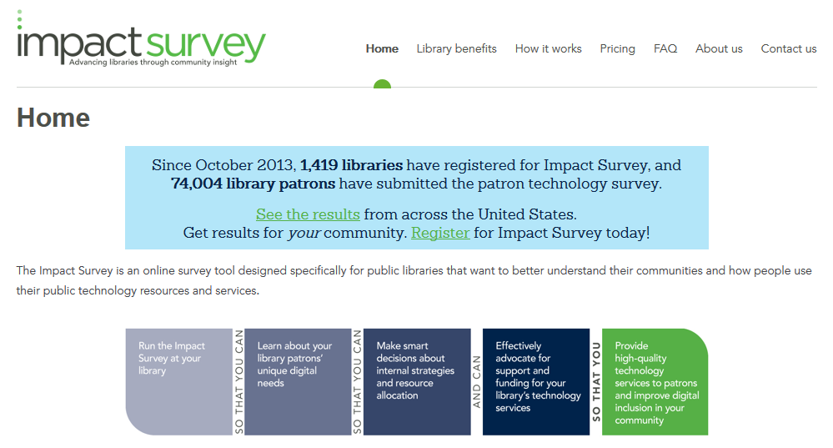
Impact survey

Slide 41
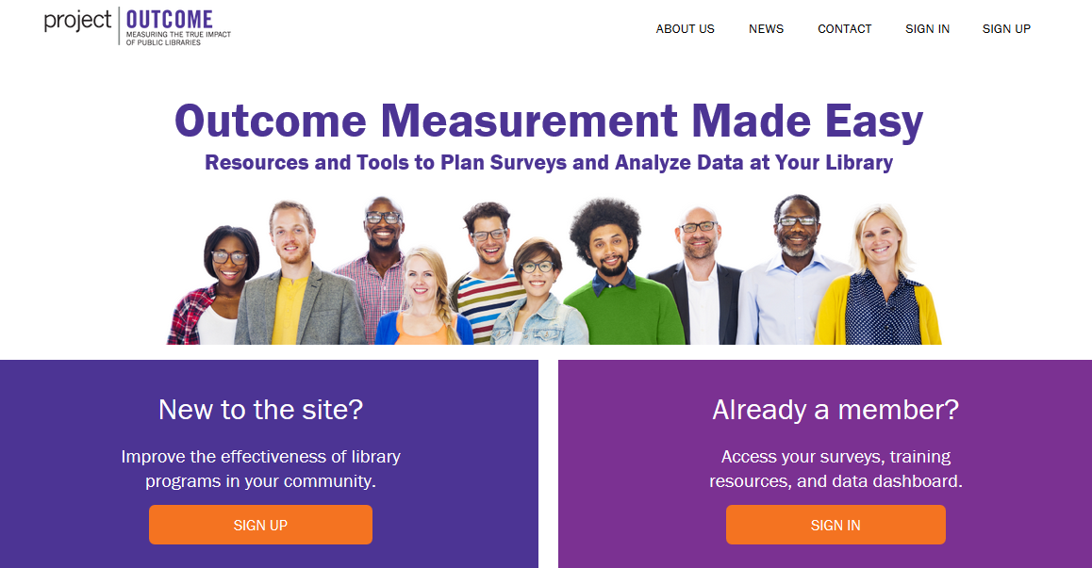
Pla-project outcome

Slide 42
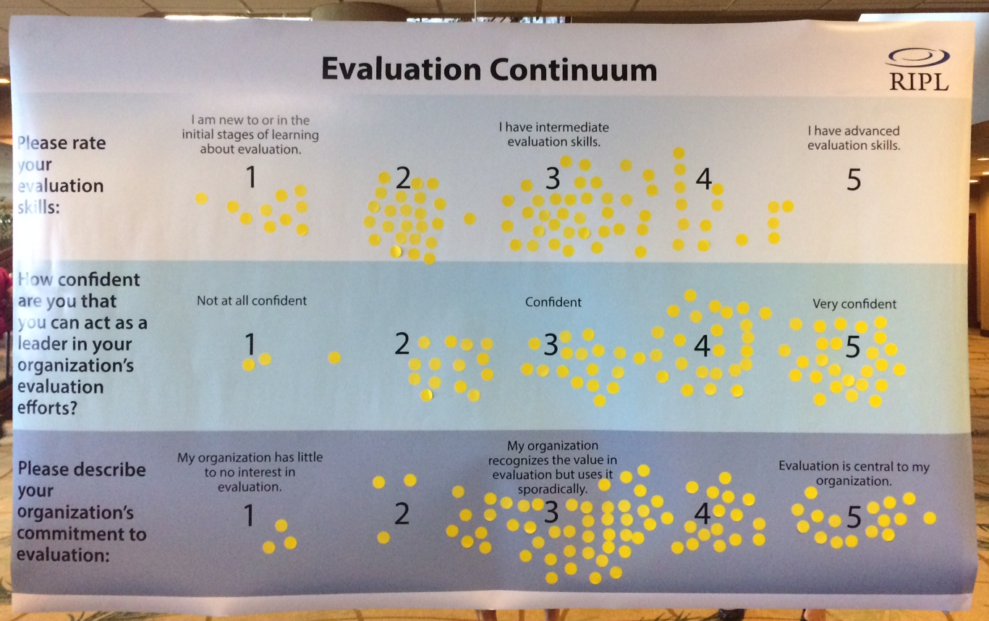
Continuum

Slide 43
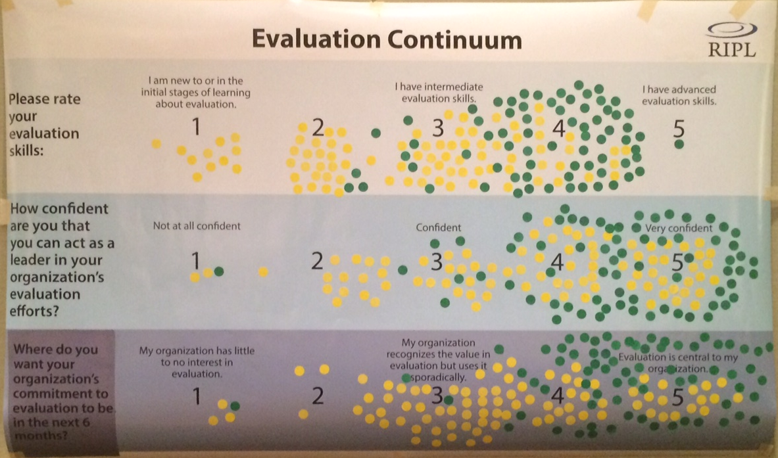
Continuum

Slide 44
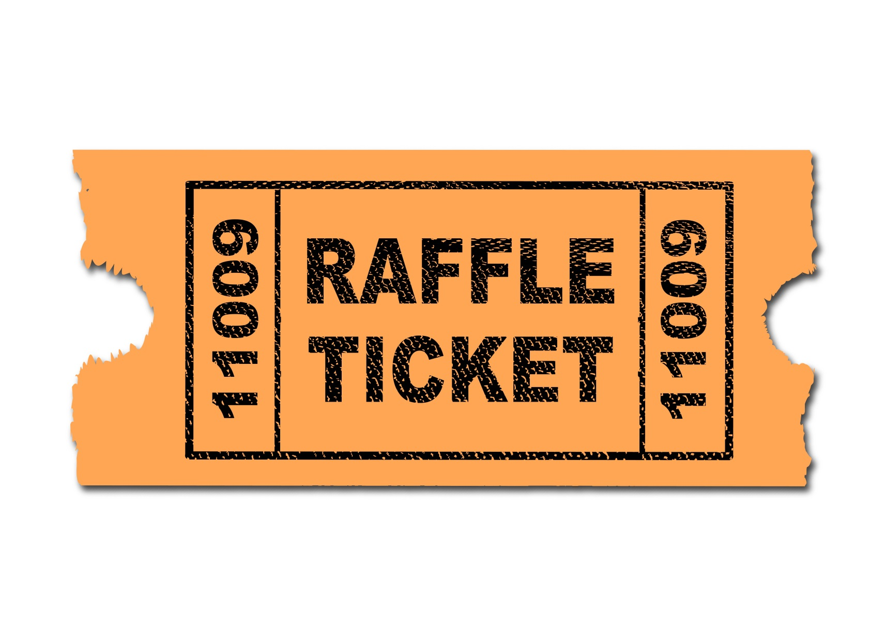
Prize drawing

Slide 45
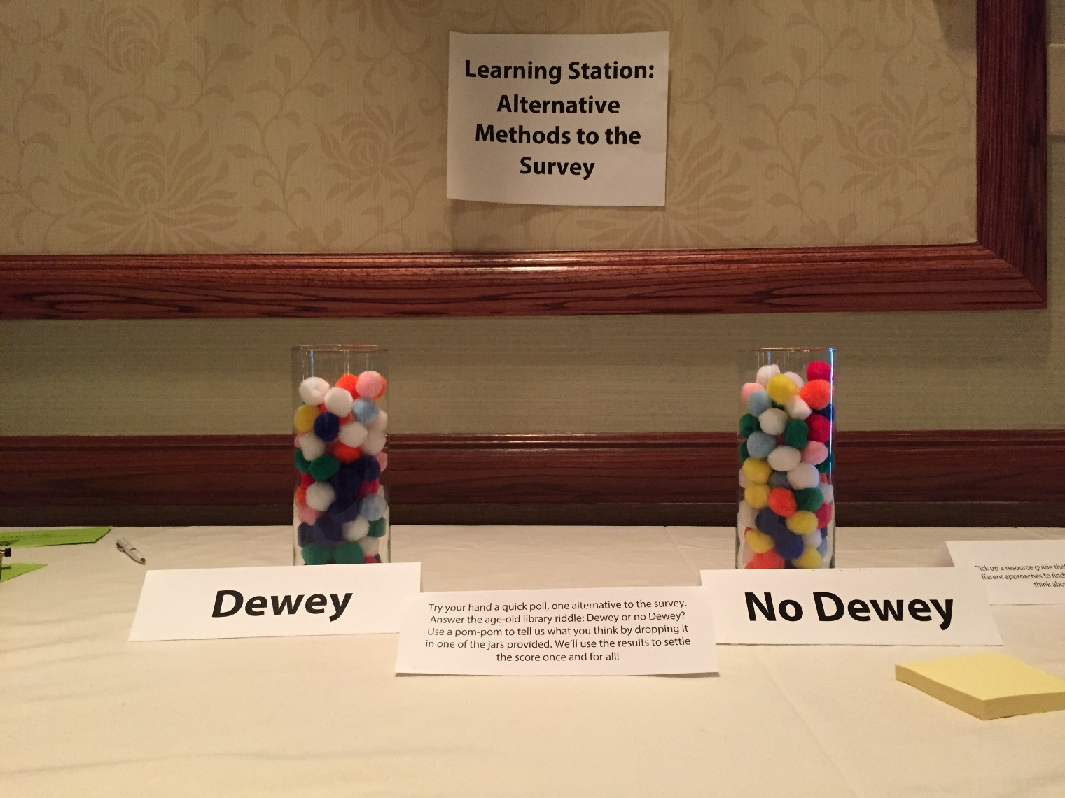
voting

Slide 46

postcard

Slide 47

observe

Slide 48
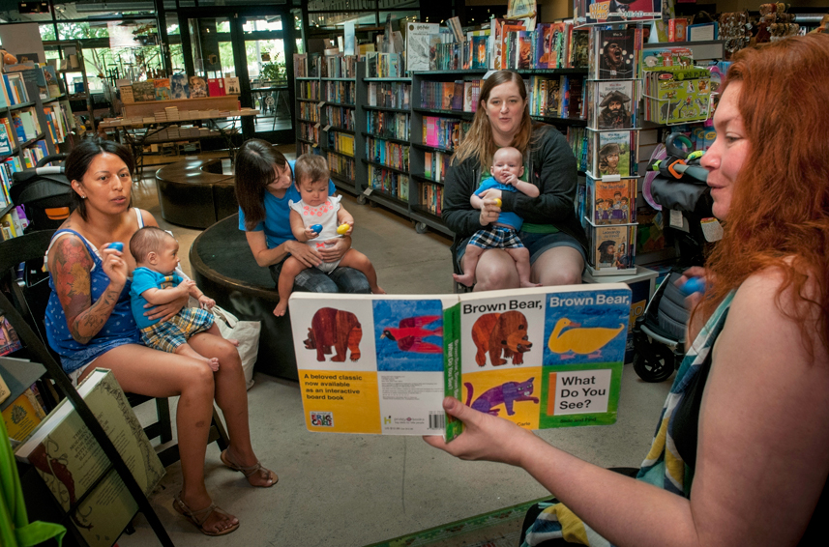

Slide 49


Slide 50
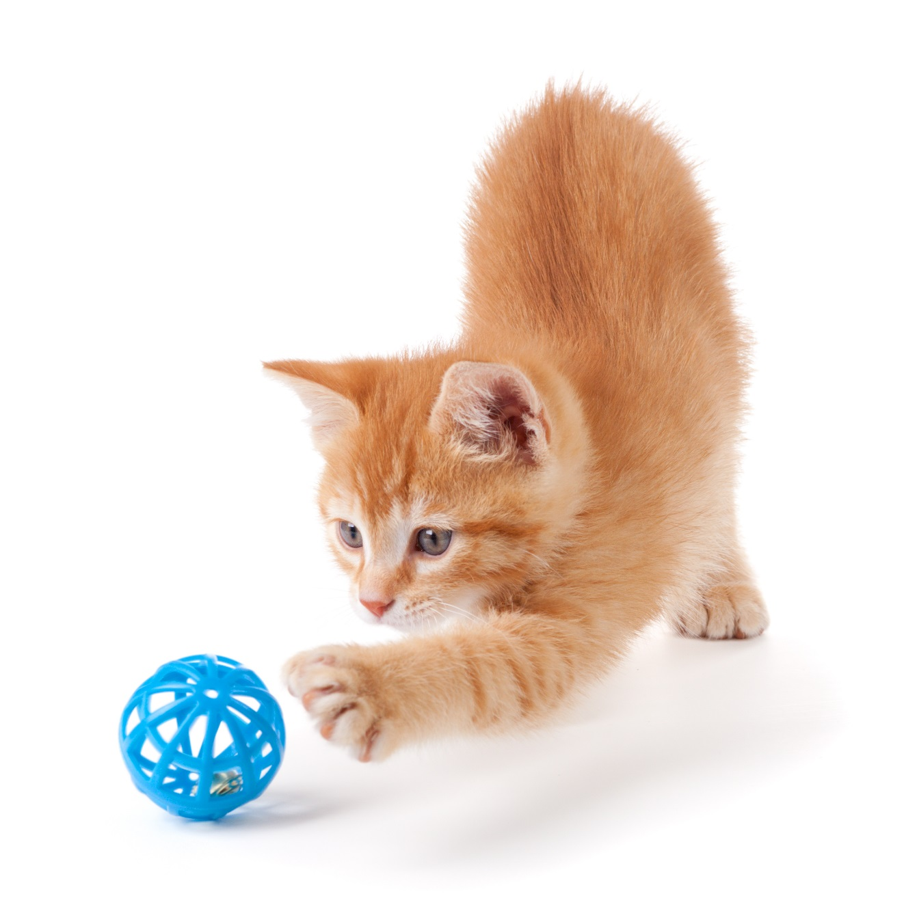
demonstrate

Slide 51
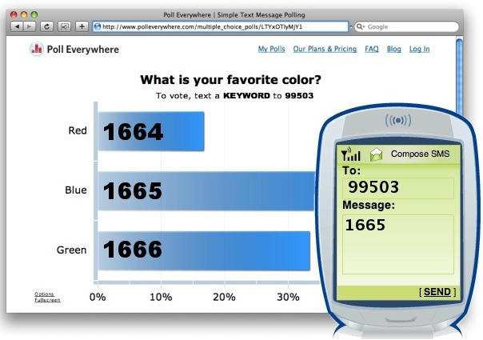

Slide 52
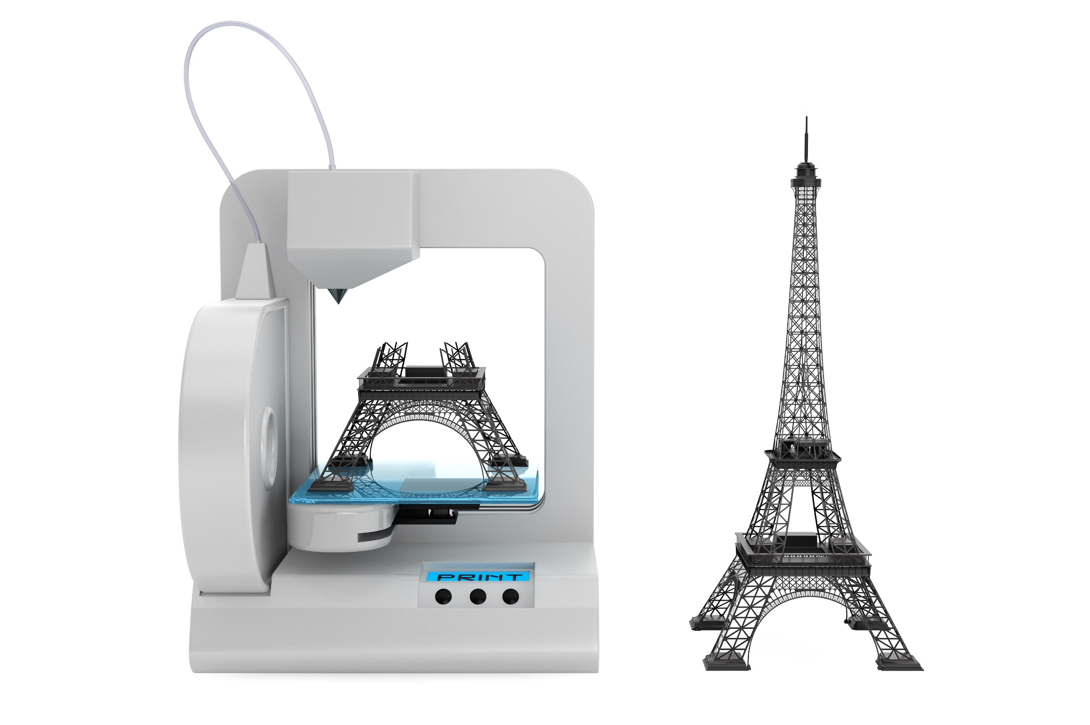

Slide 53
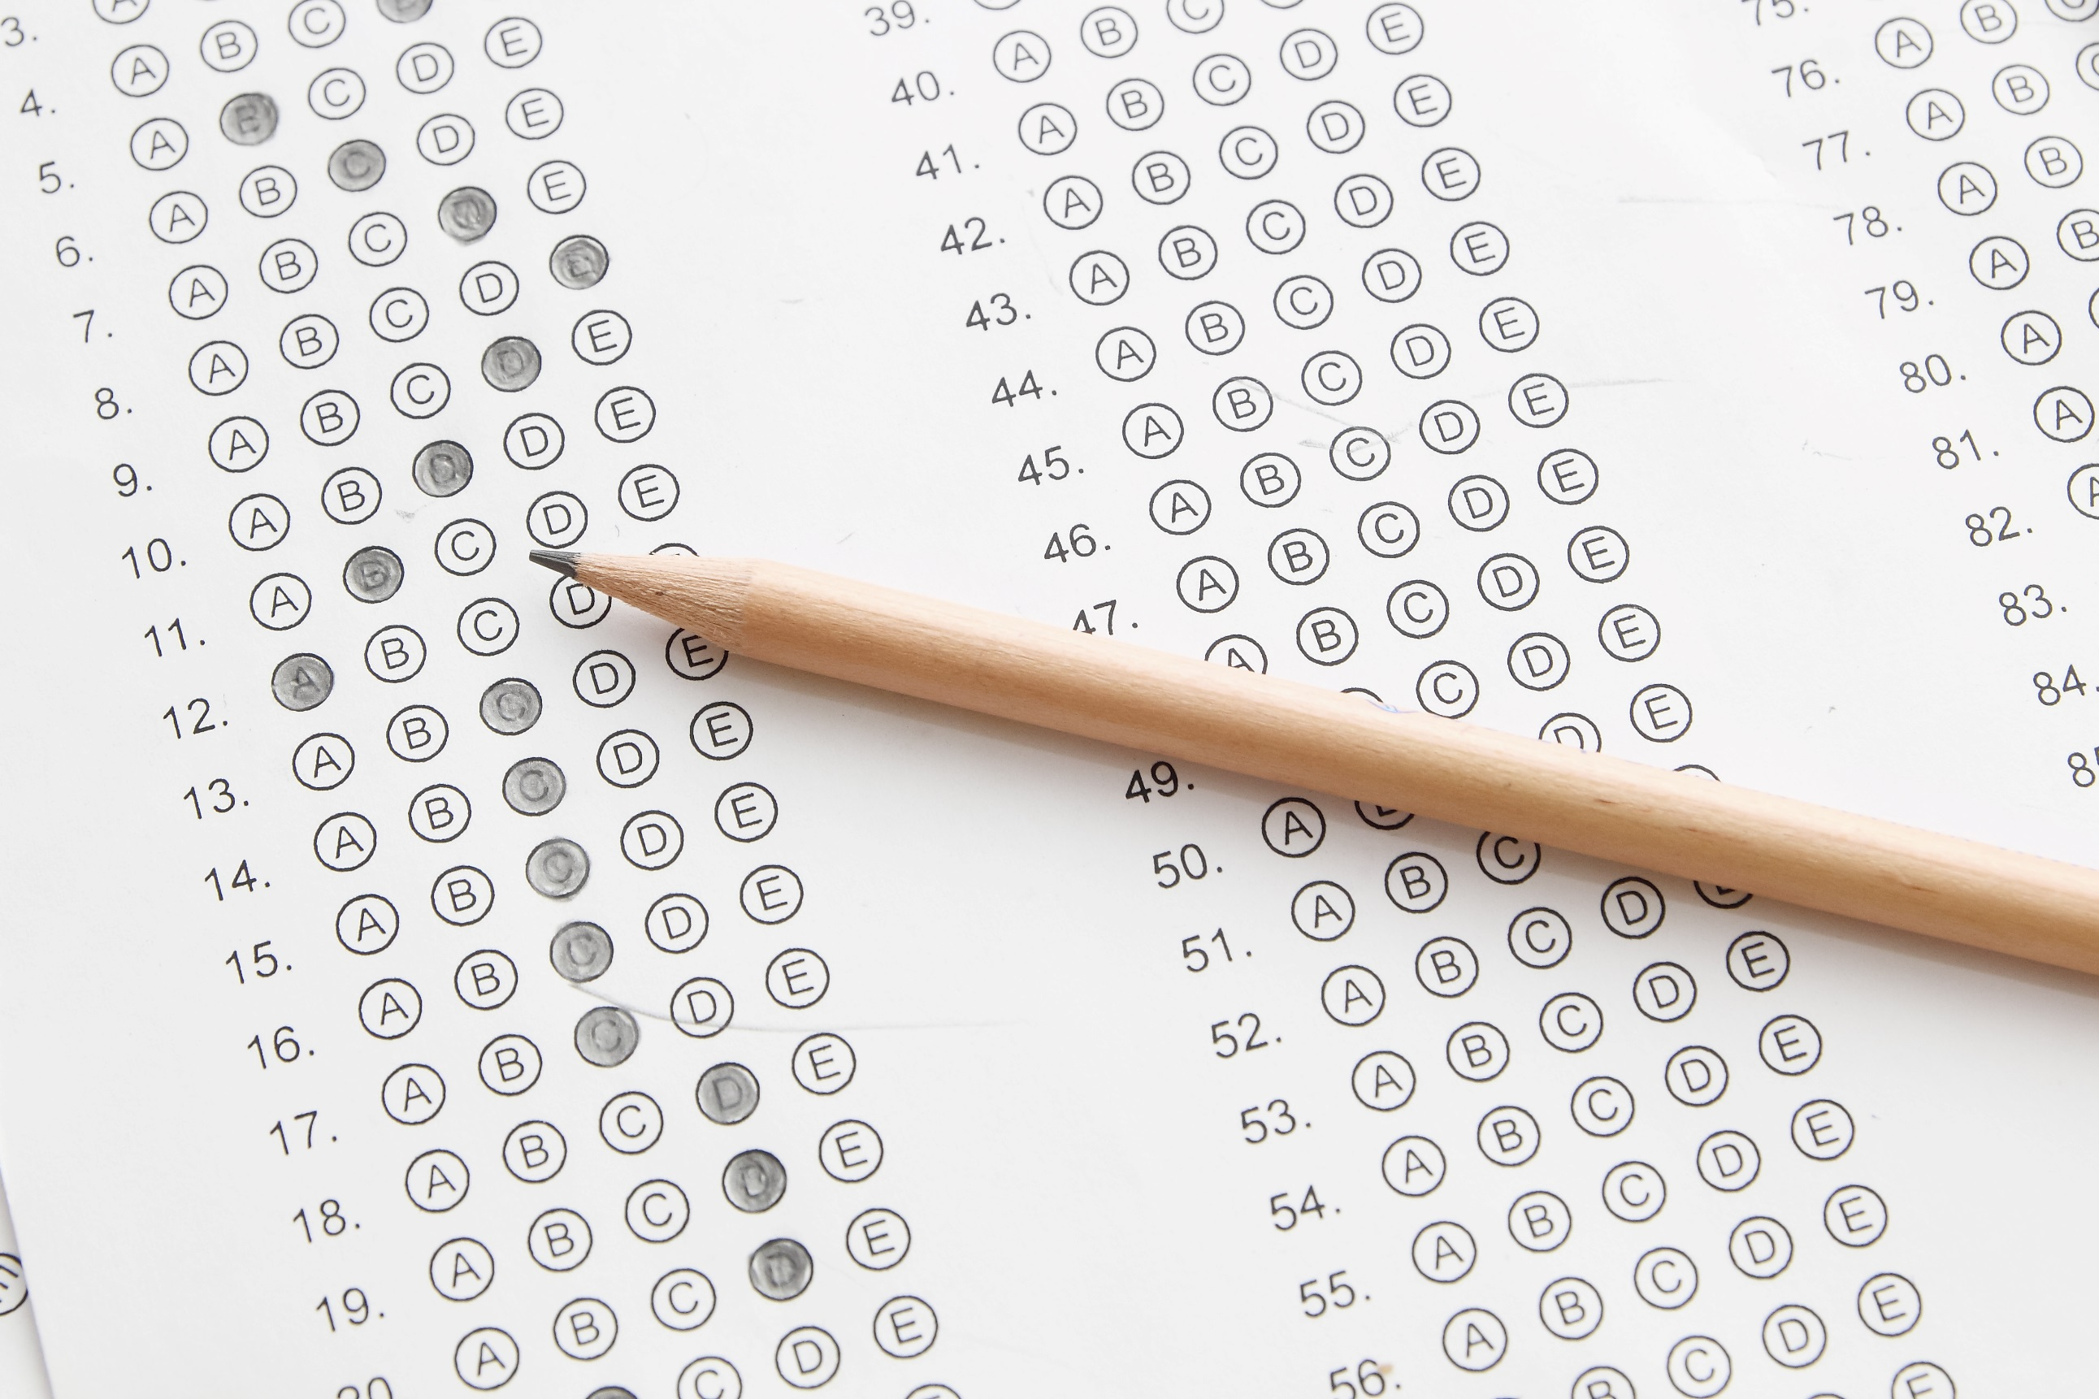

Slide 54
Question:
How are you measuring outcomes in your library?

Slide 55
Next steps
Evaluation Project Handout
Resources Handout

Slide 56
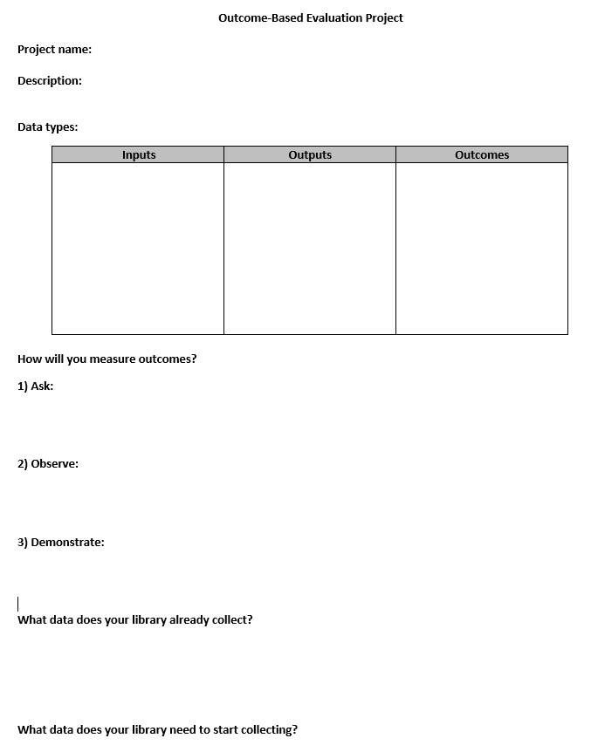

Slide 57
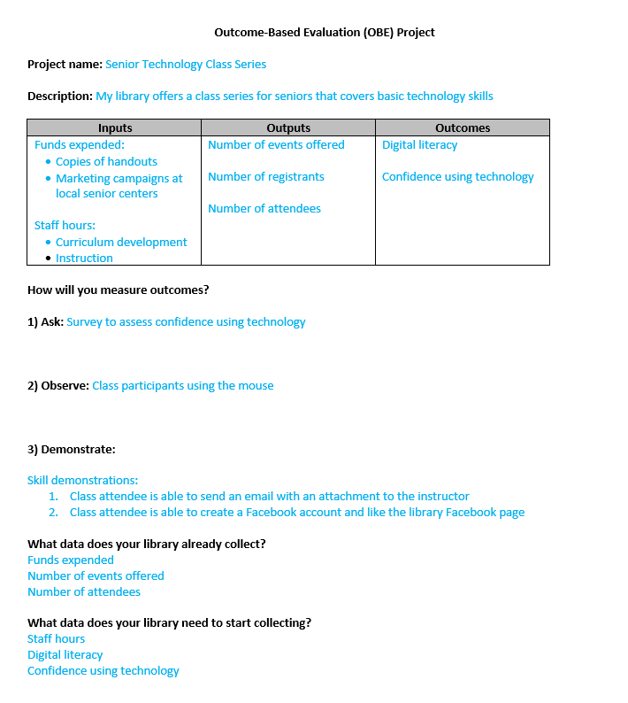

Slide 58
Questions?

Slide 59
Thank you!
Linda Hofschire
Hofschire_L@cde.state.co.us
@lindahofschire

