Slide 1

Welcome to today’s Infopeople Webinar!
Infopeople is dedicated to bringing you the best in practical library training and improving information access for the public by improving the skills of library workers. Infopeople, a grant project of the Califa Group, is supported in part by the Institute of Museum and Library Services under the provisions of the Library Services and Technology Act administered in California by the State Librarian. This material is covered by Creative Commons 4.0 Non-commercial Share Alike license. Any use of this material should credit the funding source.

Slide 2
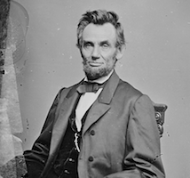
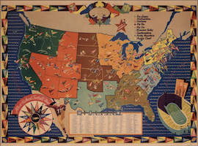
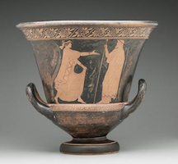
Using Digital Public Library of America for Research and Learning
https://dp.la
Franky Abbott, Curation and Education Strategist
January 11, 2017
Infopeople Webinar

Slide 3
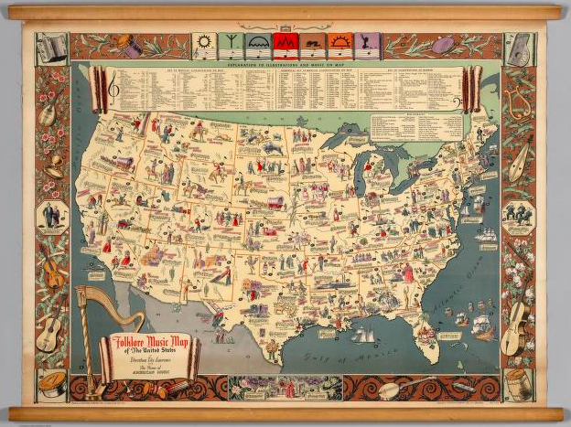
What is DPLA?
A free, national digital library that provides access to materials from libraries, archives, and museums across the US
A network of partners who make their content available through a single website
(One place to find digital content from more than 2,000 institutions!)

Slide 4
Brief History of DPLA
2010-2012: Planning discussions
Launch in April 2013 with 2.4 million items from 500 contributing institutions
January 2017: 14.9 million items from 2,200 contributing institutions

Slide 5
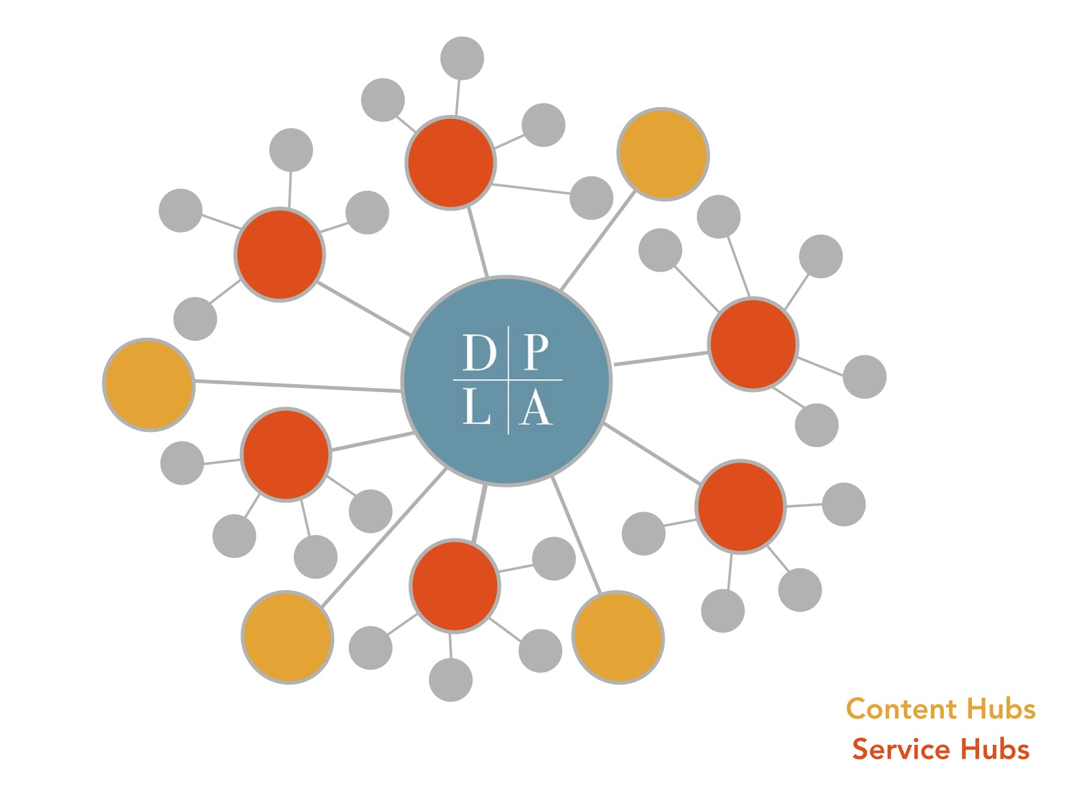
How does DPLA get content?

Slide 6






Content Hubs
Large institutions with more than 150,000 digital items work directly with DPLA

Slide 7



Service Hubs
Provide DPLA a single feed of content from multiple cultural institutions in a state
Helps institutions in that state collaborate and participate in DPLA

Slide 8
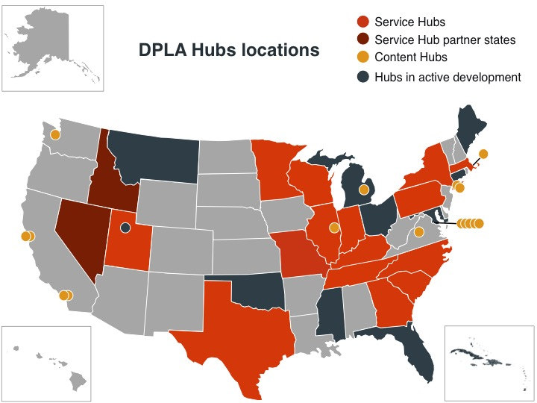

Slide 9
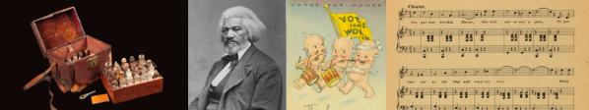
What can I find through DPLA?
Cultural heritage content!
Books, manuscripts, photographs, sheet music, videos, oral histories, correspondence, objects, diaries, illustrations, …and much more

Slide 10

What can I find through DPLA?
US history and culture and more!
National and local sources and stories
Vetted and described by information professionals

Slide 11
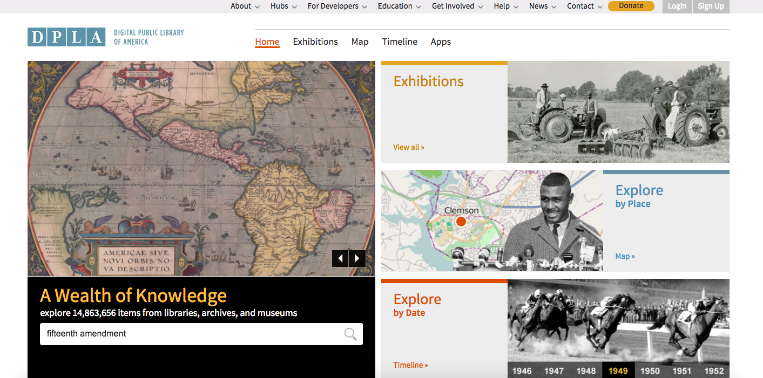
How do I search DPLA?

Slide 12
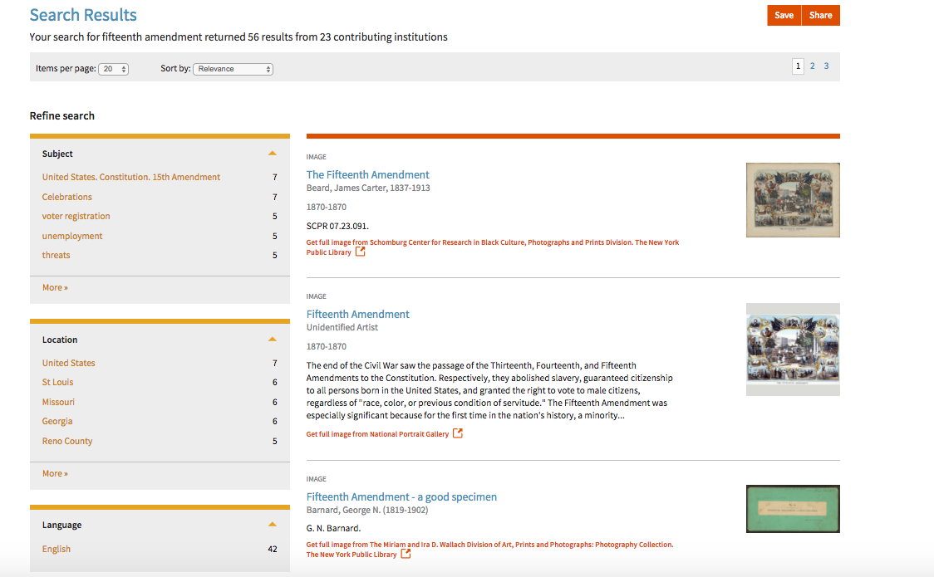

Slide 13
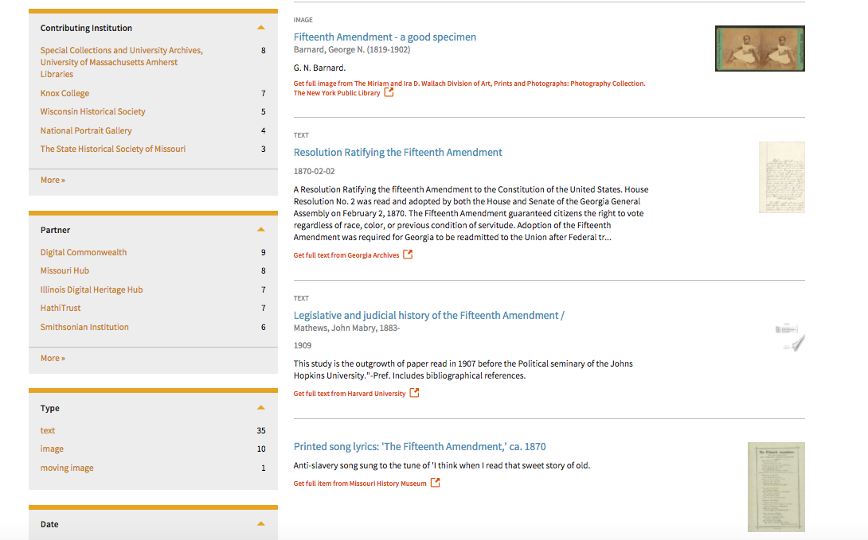

Slide 14
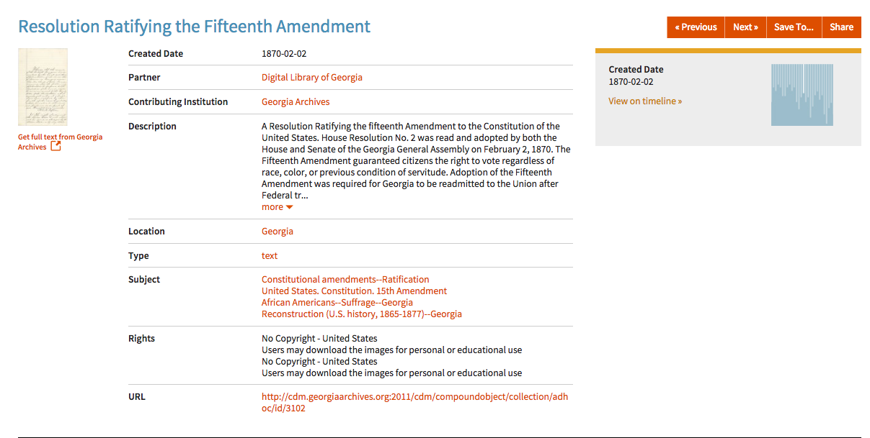

Slide 15
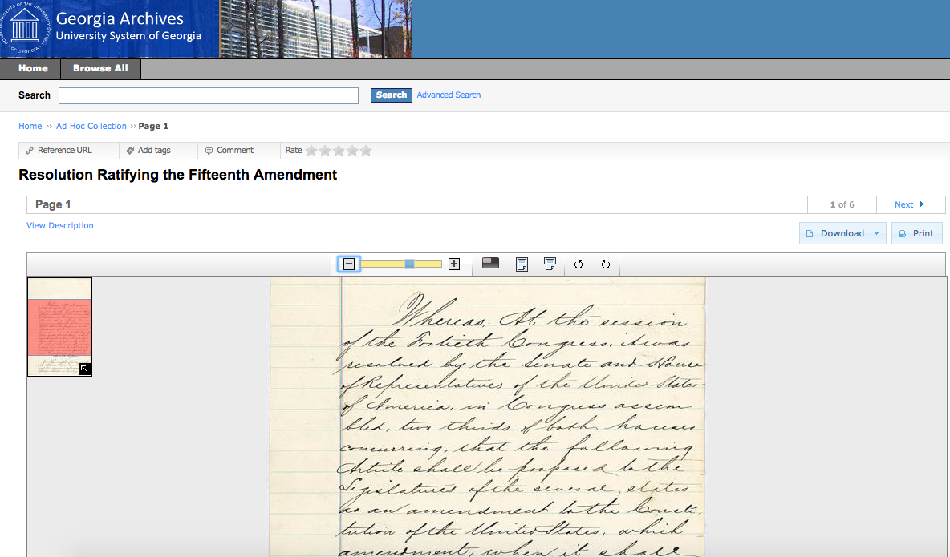

Slide 16
Search Tips
Exact phrases: enclose with question marks
Boolean operators: Combine multiple search terms using OR or NOT. (Default behavior is AND.)
Wildcards: Use an asterisk (*) as a substitute for any collection of characters within a word.

Slide 17
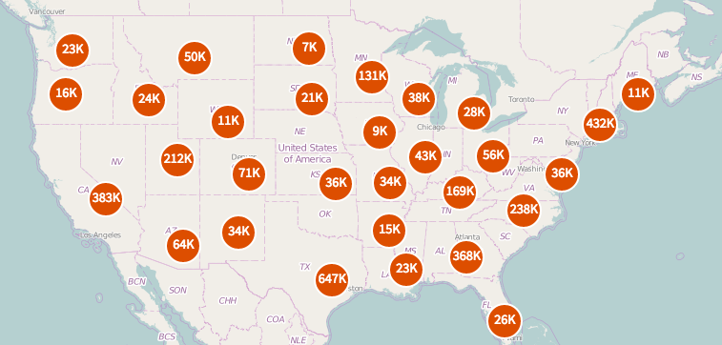
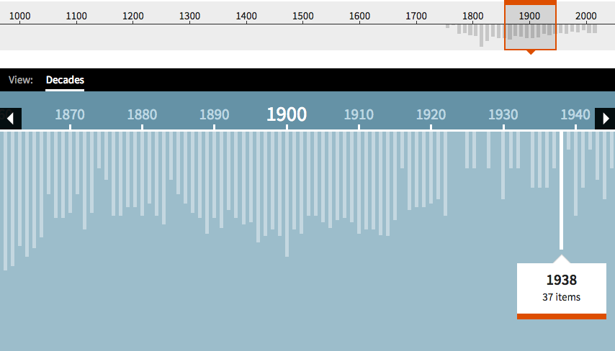
View search results in…
Map
Timeline

Slide 18
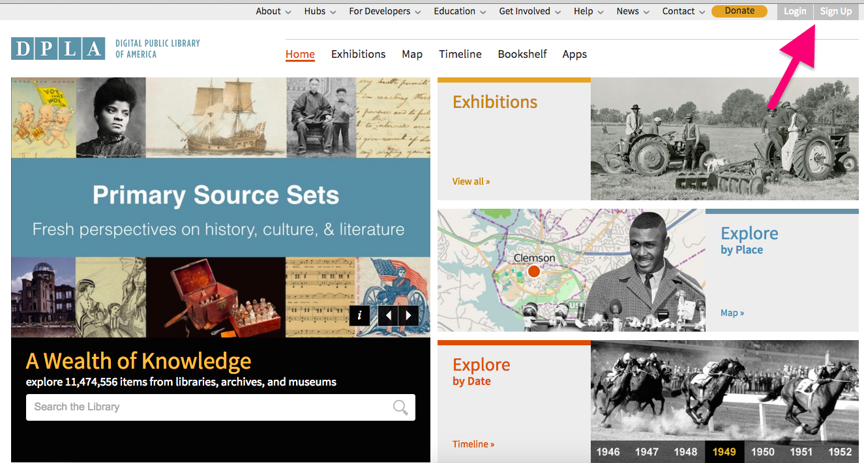
Save/Share Lists

Slide 19
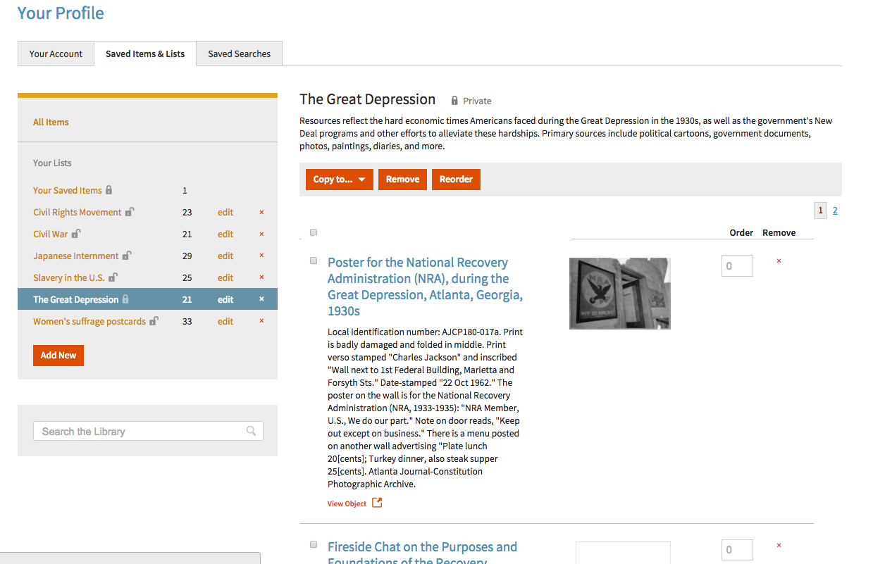

Slide 20
Other Resources and Projects from DPLA

Slide 21
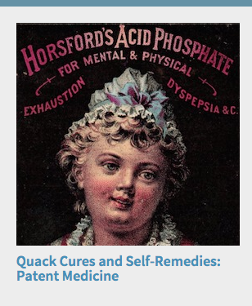
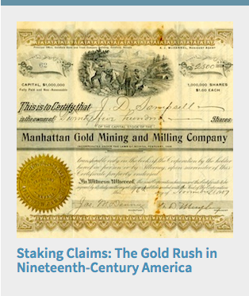
Exhibitions: dp.la/exhibitions

Slide 22
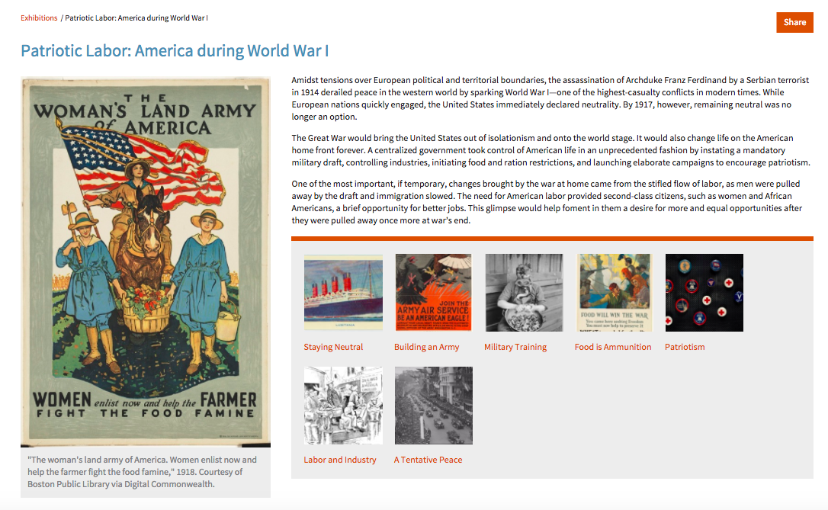

Slide 23
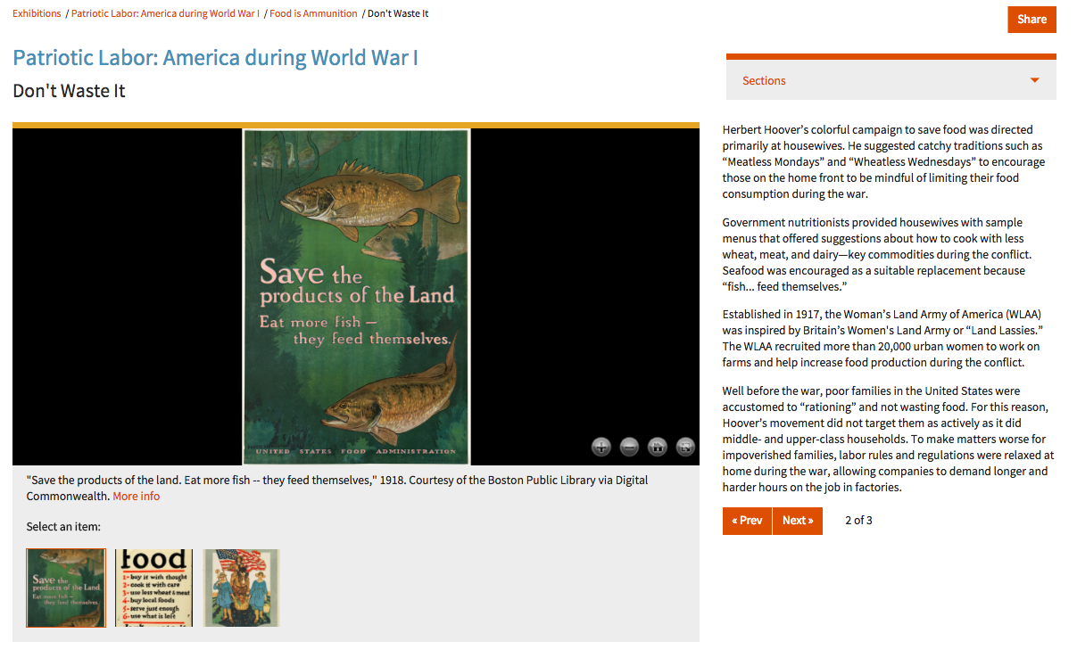

Slide 24
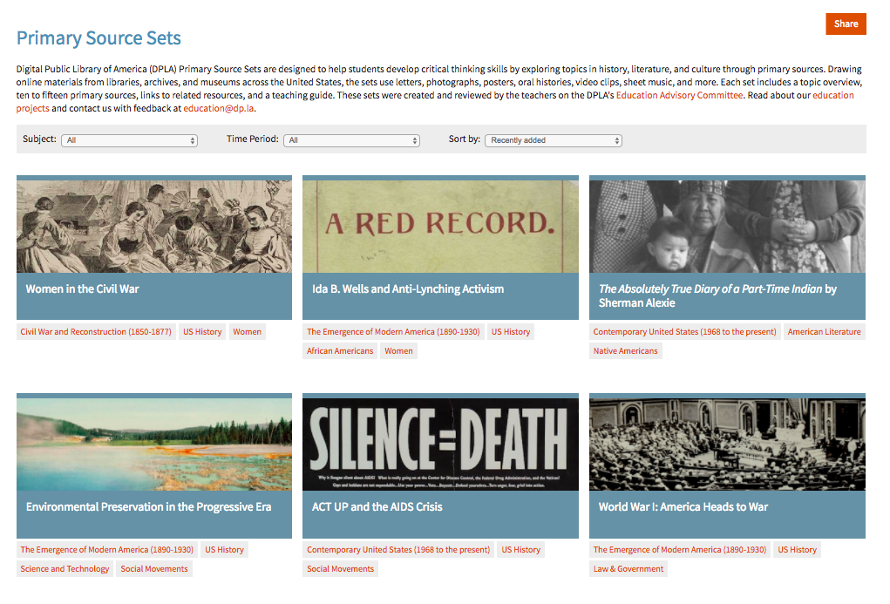
Primary Source Sets: dp.la/primary-source-sets

Slide 25
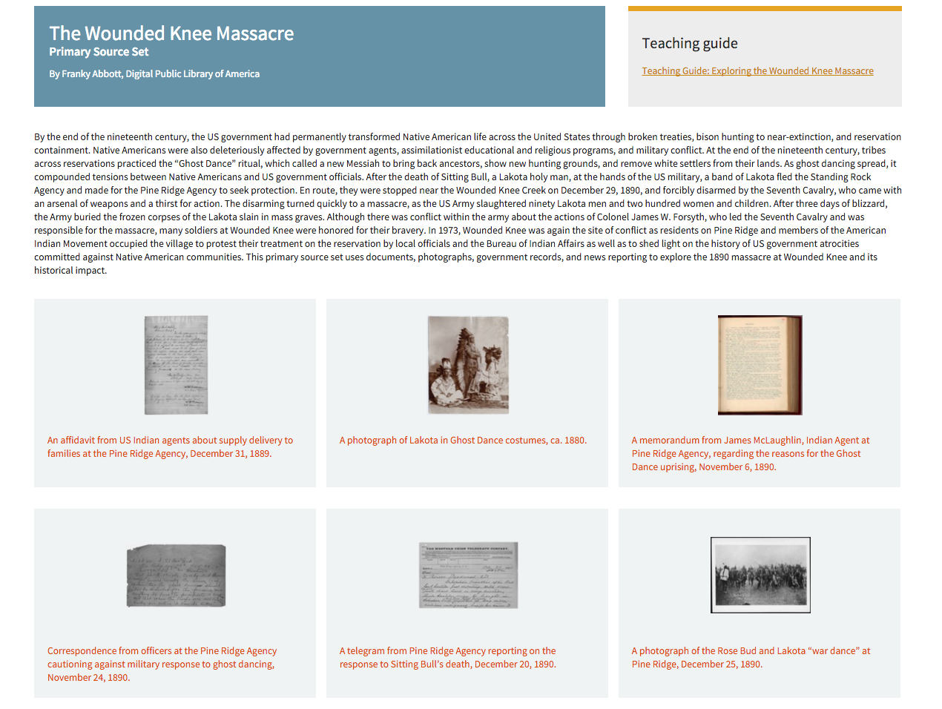

Slide 26
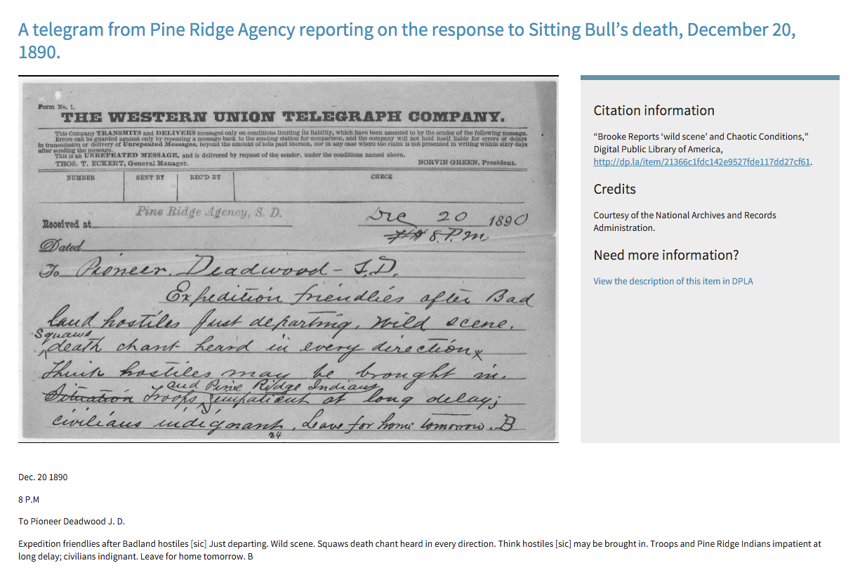

Slide 27
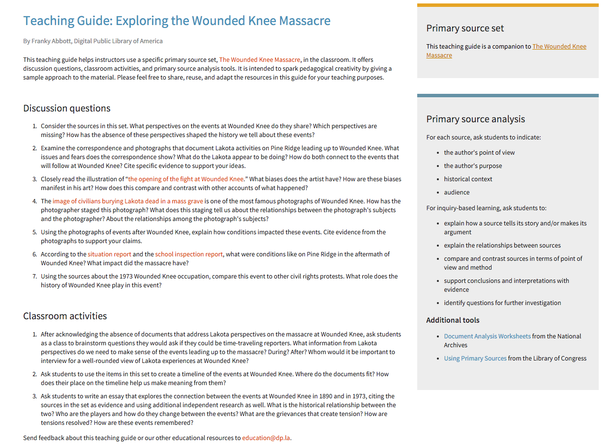

Slide 28
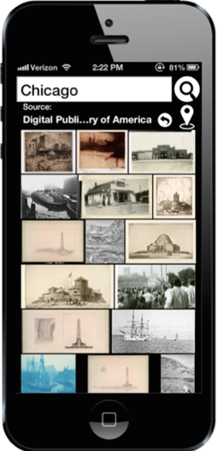
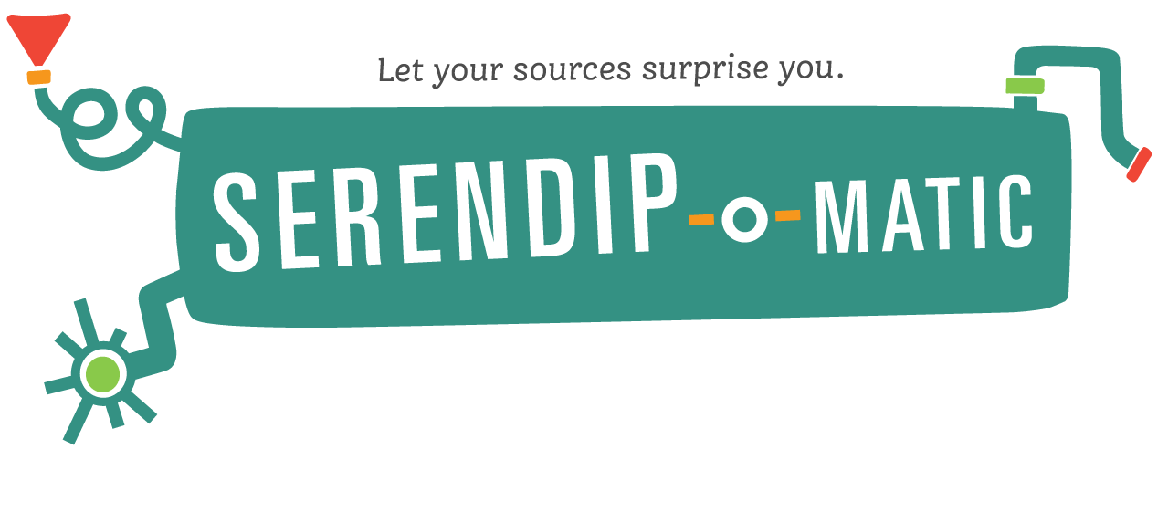
Apps

Slide 29
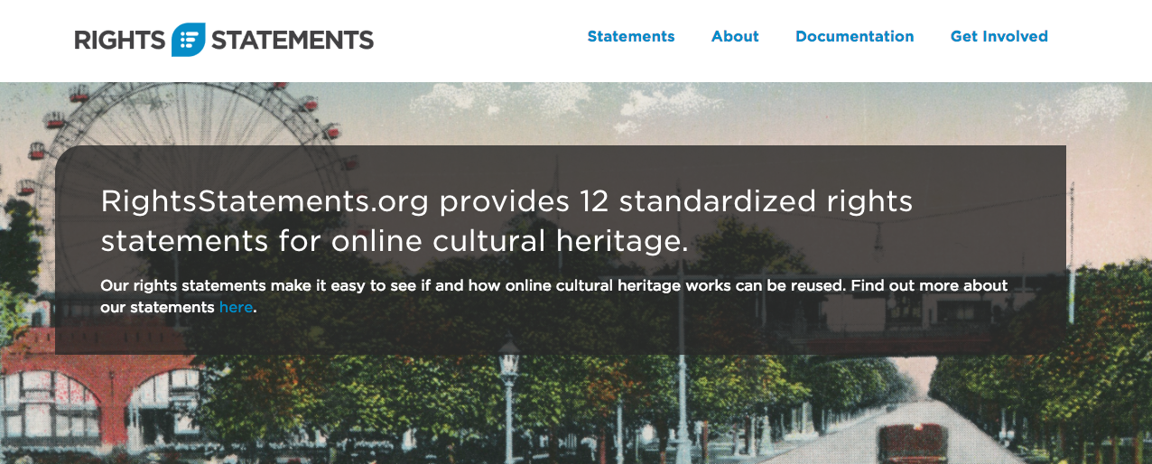
rightsstatements.org

Slide 30
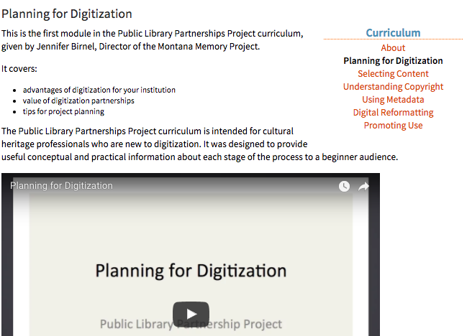
Digitization Training Materials

Slide 31
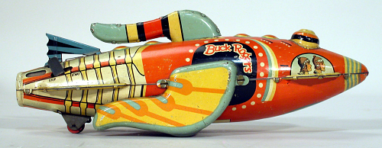
DPLA’s Plans for the Future
More cultural heritage
Ebooks
Newspapers
Data sets
More!
Courtesy of the National Air and Space Museum via the Smithsonian Institution.

Slide 32
Questions?
General DPLA Inquiries
  https://dp.la
  @dpla
  info@dp.la
Franky Abbott
  franky@dp.la
  @franky_abbott

