Slide 1
Welcome to today’s Infopeople Webinar!
Infopeople is dedicated to bringing you the best in practical library training and improving information access for the public by improving the skills of library workers. Infopeople, a grant project of the Califa Group, is supported in part by the Institute of Museum and Library Services under the provisions of the Library Services and Technology Act administered in California by the State Librarian. This material is covered by Creative Commons 4.0 Non-commercial Share Alike license. Any use of this material should credit the funding source.

Slide 2
Burnout or Bounce Back? Building Resilience
Presented by Debra Westwood
January 19, 2017
Notes:
We work in times of:
Changing roles for libraries
Changing technological landscape
Pressure to do more with less
Committed staff who want to do it all yet may lack time or resources
Long-term staff who have been in this field for a long time.
A devaluation of public employees
Uncertainty & pressures at home
All of these things can contribute to the gradual grinding down, loss of joy, fading enthusiasm or passion that we call burn out.

Slide 3
What is Burnout?
Occupational Stress
Compassion Fatigue
Karoshi
Vital Exhaustion
Secondary
Traumatic
Stress Disorder
Professional
Stress
Syndrome
Notes:
Karoshi – a Japanese term meaning “overwork death”, coined in 1969
“A syndrome of emotional exhaustion and cynicism that occurs frequently among individuals who do ‘people-work’ of some kind…”
Christina Maslach & Susan Jackson
The Measurement of Experienced Burnout
Journal of Occupational Behavior, p. 99-113
1981
Burnout is observed in priests, nurses, physicians, social workers, law enforcement personnel, lawyers, teachers., library staff.
Not just American.
Most vulnerable?
Highly people oriented, high expectations for themselves especially.
For these individuals, work is a major source of satisfaction, one of the ways they derive meaning in life.
Some perceive a certain stigma to the term “burnout” perhaps most likely those folks most susceptible to it. “I should be able to do this” or “I don’t want to admit that I’m struggling” frame of mind.
“When emotions turn and stay sour, when thoughts become cynical and judgmental, good and compassionate treatment is on the line.
Helpers who become sour and cynical tend to begrudge their high need clients for their neediness. There is a risk that helpers become too well-practiced at taking a bleak view of those they have avowed to assist.
There is a temptation to begin to blame clients for their failure to improve. If treatment ends pre-maturely, with either a client never returning to treatment or a helper 'firing' them out of frustration, there is a tendency for the client to take the fall.
Of course what we are talking about here are signs of burnout.”
― Scott E. Spradlin, therapist

Slide 4
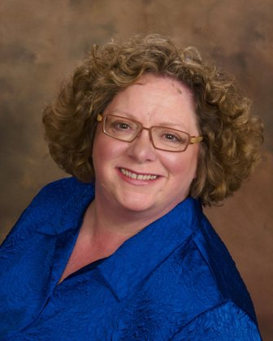
Thanks for being here.
Your presenter today:
Debra Westwood
Library Regional Manager
King County Library System
Bellevue, WA
dwestwood@kcls.org
Notes:
29 years in public libraries
11 in library management
55 years a patron

Slide 5
What we’ll cover:
Burnout – what is it?
What factors contribute to Burnout?
Resilience – what is it?
What can you do to nurture your own Resilience?

Slide 6
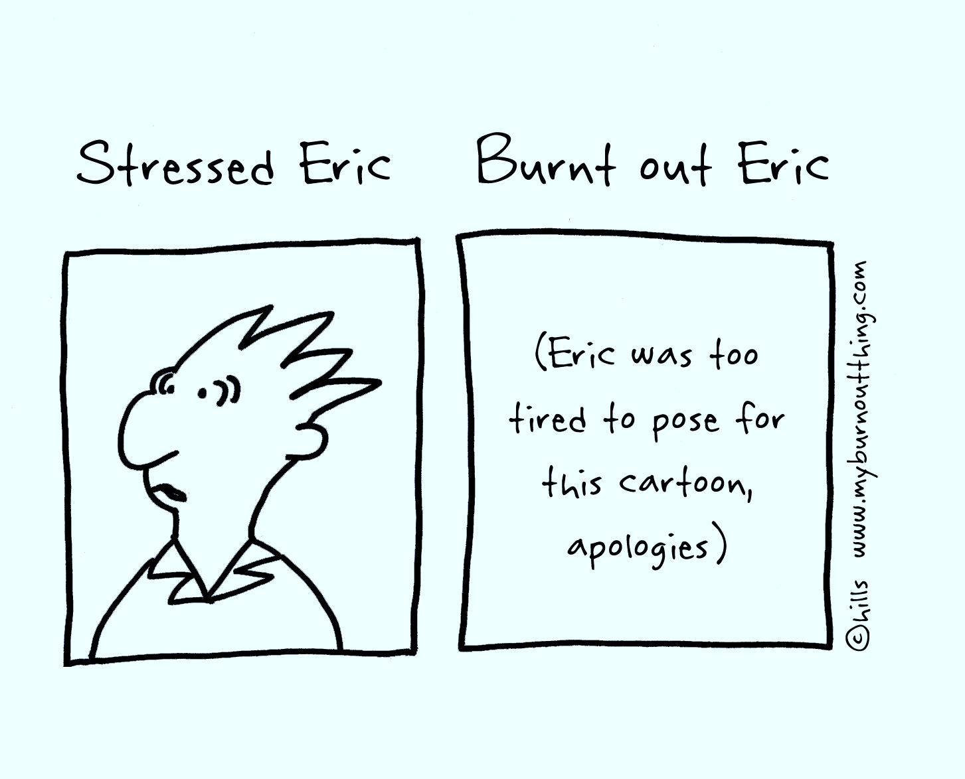
Stress vs. Burnout
Notes:
STRESS – Burnout
Characterized by OVERengagement Characterized by DISengagement
Emotions may be over-reactive Emotions may be blunted
Sense of urgency & hyperactivity Sense of helplessness or hopelessness
Primary damage is physical Primary damage is emotional/mental
Stress is all about too much. Too much to do, to say, Burnout is about not enough. Not enough energy, not enough gas in the tank,
too much pressure, too much adrenaline. not enough emotional or psychic resources left.
One researcher said that “If stress is like drowning in responsibilities, burnout is like being dried out.”

Slide 7
Physical signs and symptoms
Feeling tired or drained (exhausted) most of the time
Lowered immunity, frequent illnesses
Frequent headaches, back pain, muscle aches
Changes in appetite or sleep habits
Notes:
Feeling exhausted all the time is the #1 most frequent described symptom of burnout.
May be observable in ones posture – slumped, shoulders down, eyes down. Slowed responses.

Slide 8
Emotional Signs & Symptoms
Detachment, blunted emotions
Sense of helplessness or low self worth
Self blame
Depression
Notes:
Detached, blunted emotions – the #1 description of the emotional side of burnout.
“I just don’t care anymore.”
“I just can’t get excited about work anymore.”
Note the “I just….” phrasing.
May cycle into self blame – “If I only tried harder, came in earlier, did a better job …..”
Yet when that trying harder doesn’t produce the desired result, it creates a cycle of defeat, leading to loss of motivation, inner emptiness.

Slide 9
Behavioral Signs & Symptoms
Withdrawal or isolation
Taking longer to get things done
Using food, drugs, or alcohol to cope
Taking out frustrations on others
Skipping work, coming in late and leaving early
Notes:
Caveat – there are other reasons for all these behaviors. But a pattern and in combination with physical and emotional signs, may be a red flag.
The key is the change in the behavior. This is a person who didn’t used to do this and now they do.
The change in pattern is an opportunity for a conversation, to begin exploration.
Withdrawal – no longer part of the gang or, in a group, expresses persistent negativity.
Example: Previous top performer, now missing deadlines, not following up.

Slide 10
What Factors Contribute to Burnout?
Personality
Lifestyle
Work
Notes:
Why do some people burn out and others don’t?
Each person has their own way of moving through life, their own perspectives and attitudes.
Some attributes keep the person buoyed up and allow them to rebound from disappointment or setbacks.
Others leave people more vulnerable to the persistent disappointments that can lead to feeling burned out.
Knowing these factors can help create safeguards.
Some may be within your realm of influence as an employer. Some are not (ex: poor dietary habits, hard partying) but you may be able to address them if they begin to affect performance in the workplace (i.e. your party animal shows up hungover at work or is frequently late)
Will work through the chart, starting at the top and moving clockwise

Slide 11
What work-related factors might contribute to burnout?
Work
Notes:
What do you think?
DISCUSS

Slide 12
WORK-RELATED FACTORS
Feeling like you have little or no control over your work
Lack of recognition or rewards for good work
Unclear or overly demanding job expectations
Doing work that’s monotonous or unchallenging
Working in a chaotic or high-pressure environment

Slide 13
Which of these factors can you influence?
As an employee?
As a manager?
Notes:
DISCUSS
As an employee –
Unclear job expectations – can you get clarification? Who can provide that?
Increased control over your work or lack of recognition – perhaps less so because those come from others unless it’s peer recognition. You could ask for it.
Change in chaos level – probably happens at a higher level. But can you control/mollify things within your own work team? Do any of your own behaviors contribute to the chaos?
As a manager, you can influence most of these.
Clarify expectations,
Provide recognition
Provide variety in tasks
Reduce chaos.
From Shine: Using Brain Science to Get the Best from Your People by Dr. Edward Hallowell.
“It should come as no surprise that people perform better when they are happy. While we must be prepared to suffer necessary pain in order to achieve our best, it is hugely counterproductive to suffer unnecessary pain. Yet even the best, most enlightened modern workplace continues to set traps that create unnecessary pain. Examples: the trap of social isolation, the trap of free-floating fear and insecurity, the trap of information overload, and the trap of a boundary-less, interruption-infested work environment. Managers need a plan to tap into what’s best in their people while minimizing the damage from these common traps. Unless managers realize how crucial it is to create an emotionally stable, connected environment in the midst of the maelstrom of modern business life, they will –and do– sacrifice performance in the name of speed, cost cutting, efficiency, and what they perceive to be necessity. In such a context, deep thought disappears, only to be replaced by decisions based on fear. Frazzled becomes the order of the day.”

Slide 14
What LIFESTYLE FACTORS might contribute to burnout?
Lifestyle
Notes:
DISCUSS
What do you think?
What aspects of how one conducts ones life might contribute to burnout?

Slide 15
LIFESTYLE–RELATED FACTORS
Work & life are out of balance
High demands on the homefront
Unbalanced sleep or nutritional habits
Lack of close, supportive relationships
Poor time management habits
Notes:
Also
Chaotic home life,
Strong external demands from family circumstances (illness, aging parents, personal challenges, etc.)
What else?

Slide 16
Which of these factors can you influence?
As an employee?
As a manager?
Notes:
DISCUSS
From the employee perspective – most of these are within your realm.
You control your time management skills, your willingness or unwillingness to ask for help or delegate, your eating or sleep habits.
Managers can generally only respond to how these qualities manifest themselves in the workplace. i.e. poor sleep habits mean the employee falls asleep at work, then can address it as a performance issue or as an opportunity to refer to an EAP.
Much of what’s going on at home, employers never know about.
As supervisors or managers, we tend to notice when something changes.
Consider those “disturbances in the field” can be an early warning system, opportunities for early intervention.

Slide 17
What PERSONALITY TRAITS might make one more vulnerable to burnout?
Personality
Notes:
What do you think?
DISCUSS

Slide 18
PERSONALITY-RELATED FACTORS
Pessimistic view of yourself and the world
Perfectionism or reluctance to delegate to others
High-achieving, Type A personality
Can’t say “No.”
Notes:
Perfectionism + high need for control

Slide 19
Which of these factors can you influence?
As an employee?
As a manager?
Notes:
DISCUSS
As an employee, control of most of these factors lies within me.
May not be the kind of thing I can easily change except with intense work and self evaluation.
Some may simply require that I cut myself (& others) some slack.
Or learn to say no.
As a manager, I can respond to how these factors manifest themselves in the workplace.
Coach about chronic negativity or perfectionism if a person spends too much time on tasks.
Can advocate for the need to delegate.
SUPERVISORS CAN MODEL THE DESIRED BEHAVIORS & CHECK THE MESSAGES THEY SEND.
Do you send the message that you value work-life balance?
Do you expect people to check their e-mail from home? Do you do it yourself?
Do you secretly enable that behavior in others?
If one of your direct reports regularly skips their break or works through lunch, do you reward that behavior?
____________HALF WAY POINT ______________

Slide 20
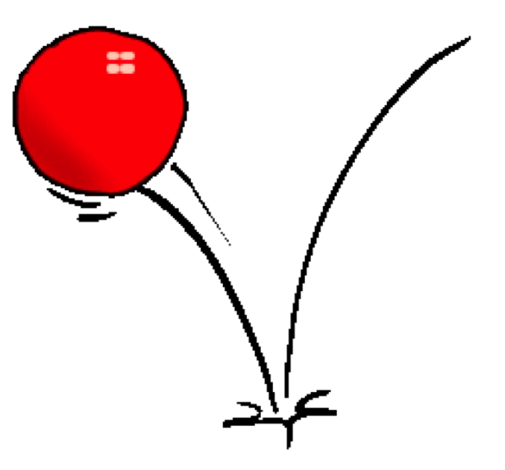
Maintaining Your Bounce
What can do to enhance your ability to bounce back?
How can you build your Resilience?
Notes:
Is it based on how you’re wired or can you adjust how you respond to your environment?

Slide 21
What is Resilience?
Notes:
The challenge then is to develop or restore resilience.

Slide 22
“...the positive psychological capacity to rebound, to ‘bounce back’ from adversity, uncertainty, conflict, failure or even positive change progress or increased responsibility.”
Anne S. Masten, (2001). "Ordinary Magic: Resilience Processes in Development".
American Psychologist 56 (3): 227–238.
Notes:
The challenge then is to develop or restore resilience.

Slide 23
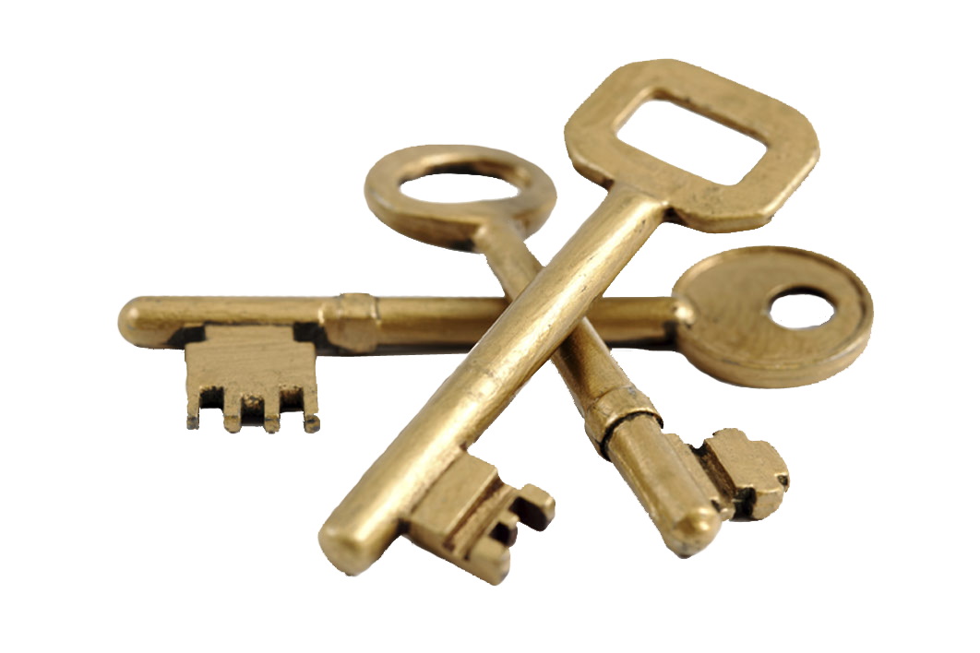
Building Resilience
Self Care
Physically
Psychologically
Socially
Vanderbilt University Center for Faculty & Staff Health & Wellness http://healthandwellness.vanderbilt.edu/ql/resilience-toolkit.php
Notes:
What does “Taking Care of Yourself” mean?

Slide 24
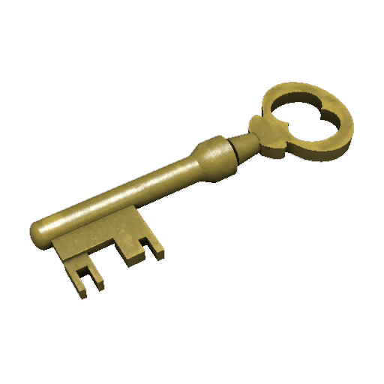
Physically
Nutrition
Sleep
Exercise/Physical Activity
Disconnect
Notes:
Boring but true:
Eating balanced meals appropriate to your dietary needs. “Eat your veggies/balanced meals/breakfast”
Avoid self medication thru alcohol & drugs
Getting adequate sleep. “Adequate” varies with the individual but for most people, it’s 6-8 hrs/night.
Step away from stressors, take vacations, turn off your phone.
Exercise – get some fresh air, move your joints & major muscle groups, generate endorphins

Slide 25
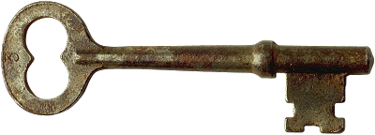
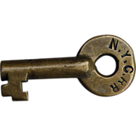
Psychologically
Boundaries
Ask for help (really, it’s okay!)
Perspective
Gratitude
Forgive & forget learn
Notes:
Boundaries are a “personal property line” that marks the things for which we, not others, are responsible.
Focus on the things you can control
Increase your exposure to negative experiences/minimize your exposure to negative
Use your sense of humor
Give yourself credit
Take pleasure where you can
What gets in the way?
Working for the approval of overly critical or perfectionist coworkers.
Projecting your feelings onto others.
Yielding to others expectations.
Allowing others to dump their work or responsibilities on you.
Taking it on yourself to change others who are not yours to change.
Owning others’ “stuff”
Carrying grudges
“She made me….”

Slide 26
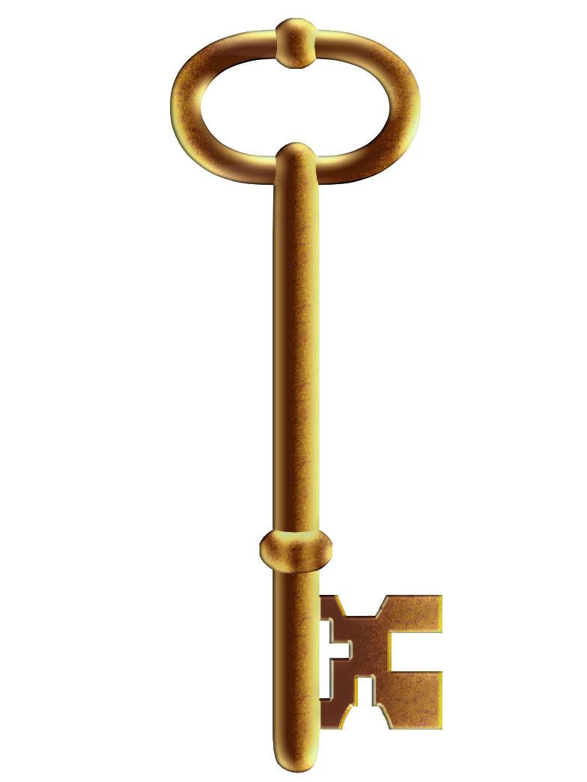
Socially
Nurture your network
Seek out mentors or helpers
Let yourself laugh
Communicate
Notes:
Applies to both introverts or extroverts
You need time to recharge, either by yourself or with friends
Refill the tank
Let work stay at work (this may be hard, depending on the culture of your workplace and your own tendencies)
Ask others for guidance @ work, through church, EAPs, professional services. It’s okay to ask for help
Lighten up.
Take vacation. Don’t check your e-mail from home.

Slide 27
Tools : Models for Resilient Problem Solving
AIA (Action-Insight Acceptance) Model Resiliency Advantage Model
Notes:
Copies included in worksheet packet
Do everything you can but at some point, know when it’s time to stop.
Let responsibility (or the consequences) rest with those who are responsible.
You don’t have to save anyone.
Am I helping or am I beating my head against a wall? If the latter, who am I hurting?
KEYS:
Assess
Options
Attempt
Evaluate

Slide 28
What did we cover:
Burnout – what is it?
What factors contribute to Burnout?
Resilience – what is it?
What can you do to nurture yours?
What’s next?
Notes:
We’ve looked at contributing factors to help with self awareness
Methods of nurturing or restoring resilience
Tools to help with understanding or developing new practices
But now you need a plan
How will you/can you incorporate those things into your daily life?

Slide 29
What’s YOUR plan?
Take a few moments to make a contract with yourself (or with a colleague) :
What are 2 things I can do to help bolster or restore my own resilience?
AND/OR
What is one thing I can do to create an environment that promotes resilience?

Slide 30
Questions?
Insights?
Additions?

Slide 31
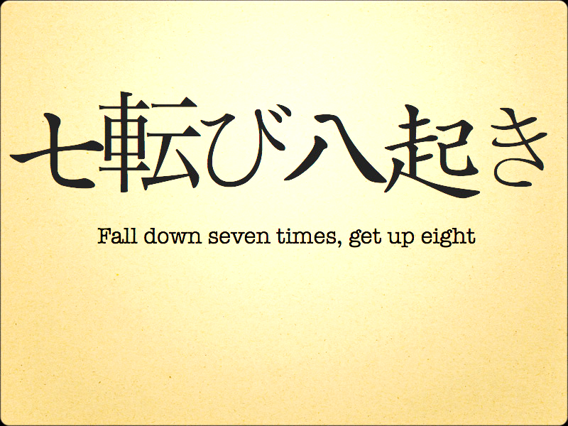
Thank you for joining us today.
Notes:
Japanese proverb:
“Nanakorobi yaoki” which translates as per the slide
Thanks for being here today.

