Slide 1
Pitch an Idea Grant Program FY 2017/18
Library Development Services Bureau
California State Library
February 8, 2017

Slide 2
General Information
$5000 minimum, $100,000 maximum
Must fall under California’s current LSTA plan (http://www.library.ca.gov/grants/lsta/docs/lsta5yearplan2013-2017.pdf)
No pitches for digitization projects (wait for California Revealed application process in April 2017)
May pitch ideas complementary to other LSTA statewide projects

Slide 3
Process
Pitch proposals due by 4 PM, Monday, Feb. 27, 2017.
See the State Library’s website for details on applying and proposal form (http://www.library.ca.gov/grants/lsta/apply.html)
New this year: The initial proposal you submit is considered your “pitch”; some proposals may be moved to the application stage without further review
Conference calls will be held March 27-30 and April 3-4
All applicants will be notified by mid-April
Full applications will be due by May 30, 2017

Slide 4
Proposal Form
http://www.library.ca.gov/grants/lsta/docs/17-18/1718PAIProposal.doc

Slide 5
Proposal Form

Slide 6
Proposal Form

Slide 7
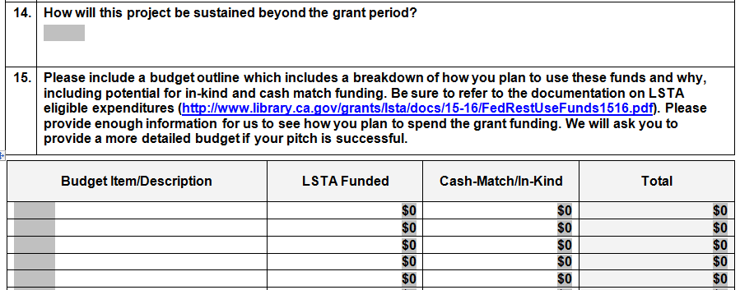
Proposal Form

Slide 8
Proposal Form

Slide 9
Resources
A sample proposal is available on our website (http://www.library.ca.gov/grants/lsta/apply.html)
Please don’t hesitate to contact a CSL library programs consultant if you have questions.
Natalie Cole (natalie.cole@library.ca.gov)
Janet Coles (janet.coles@library.ca.gov)
Susan Hanks (susan.hanks@library.ca.gov)
Lena Pham (lena.pham@library.ca.gov)

Slide 10
Q & A

Slide 11
Thank you for attending!

