Slide 1
Welcome to today’s Infopeople Webinar!
Infopeople is dedicated to bringing you the best in practical library training and improving information access for the public by improving the skills of library workers. Infopeople, a grant project of the Califa Group, is supported in part by the Institute of Museum and Library Services under the provisions of the Library Services and Technology Act administered in California by the State Librarian. This material is covered by Creative Commons 4.0 Non-commercial Share Alike license. Any use of this material should credit the funding source.

Slide 2
Developmentally Appropriate Programming for Babies & Toddlers
An Infopeople Webinar
February 9, 2017
Presented by
Brooke Newberry & Amy Koester

Slide 3
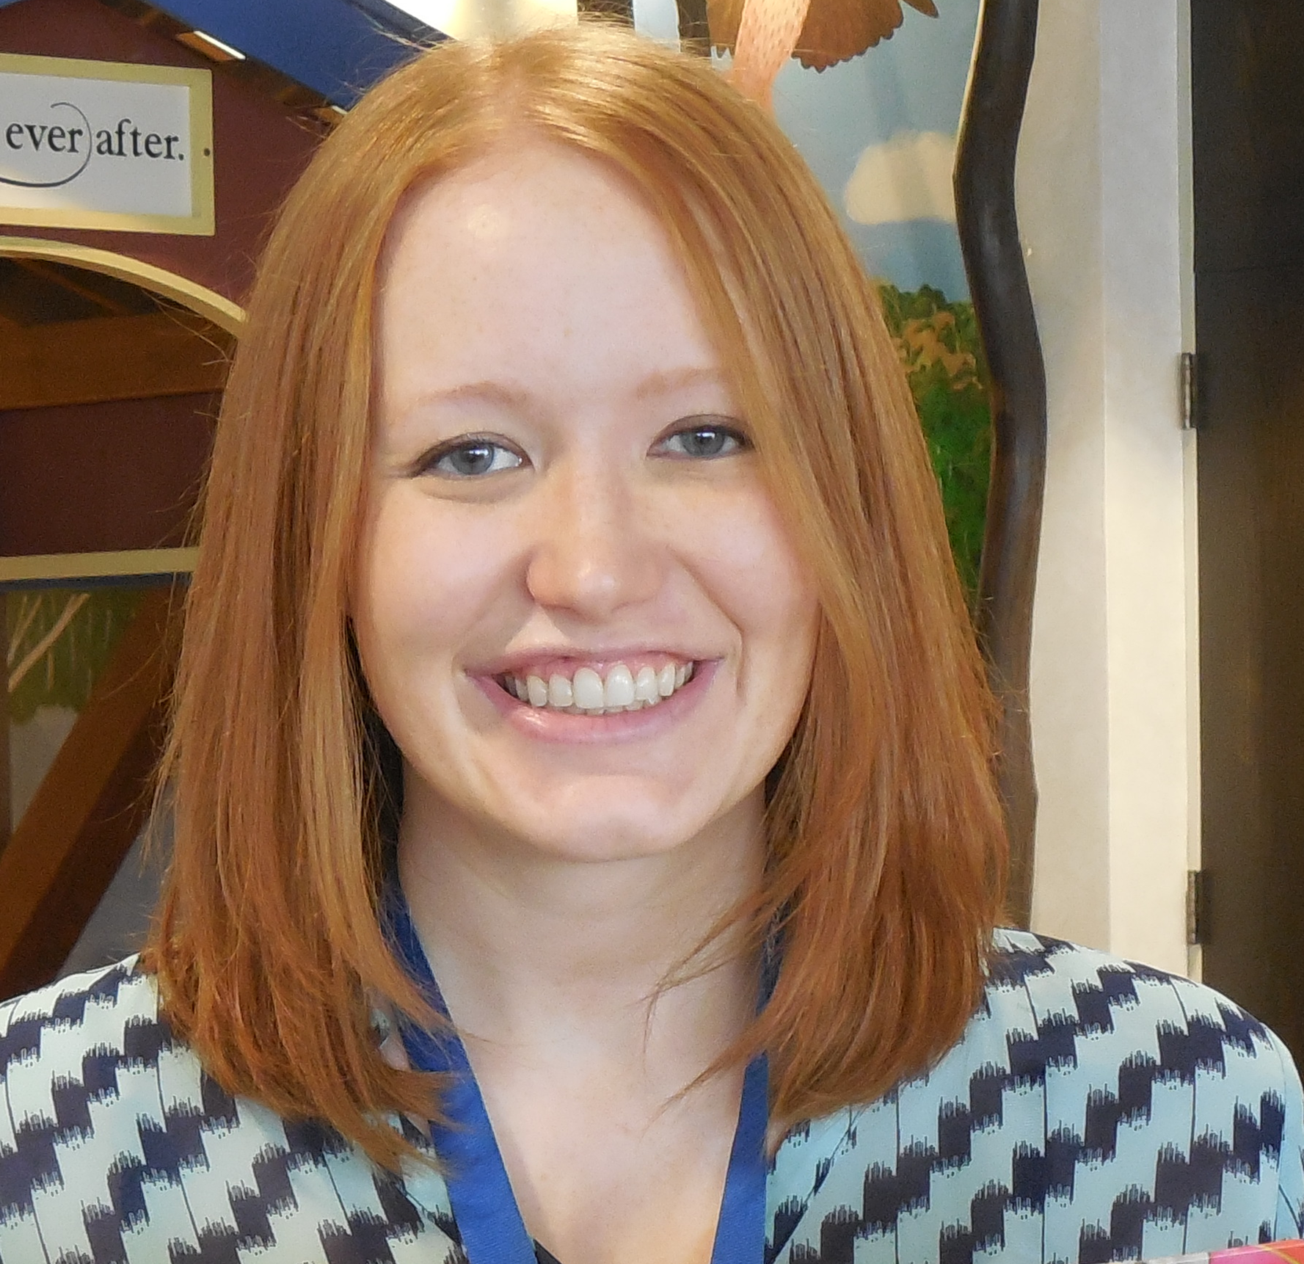
Hello!
I’m Brooke from La Crosse.
And I’m Amy from Skokie.

Slide 4
On Our Agenda Today
Developmentally Appropriate Programming for 0-23 months
Great Programming for Babies & Infants
Developmentally Appropriate Programming for 24-35 months
Great Programming for Toddlers
Great Resources
Time for Questions

Slide 5
Developmentally Appropriate Programming for Children 0-23 Months

Slide 6
Let’s Talk Developmental Milestones
 | Physical/Motor Development | Socioemotional Development | Cognitive Development | Language & Communication
0-11 months | - Eyes follow across the midline - Supported sitting to sitting to standing | - Smiles at familiar faces - Enjoys social games (peek-a-boo) | - Awareness based on sensation & movement - Puts objects in mouth | - Babbles ~6mo - Responds to repeated stimuli (“How big is baby? So big!”)
12-23 months | - Walks - Handedness - Throws & kicks - Pats objects - Ascends stairs in childlike way | - Separation anxiety - Parallel play or engaging as onlooker | - Object permanence | - Uses 10 words

Slide 7
Let’s Talk Developmental Milestones
 | Physical/Motor Development | Socioemotional Development | Cognitive Development | Language & Communication
0-11 months | - Eyes follow across the midline - Supported sitting to sitting to standing | - Smiles at familiar faces - Enjoys social games (peek-a-boo) | - Awareness based on sensation & movement - Puts objects in mouth | - Babbles ~6mo - Responds to repeated stimuli (“How big is baby? So big!”)
12-23 months | - Walks - Handedness - Throws & kicks - Pats objects - Ascends stairs in childlike way | - Separation anxiety - Parallel play or engaging as onlooker | - Object permanence | - Uses 10 words

Slide 8
Let’s Talk Developmental Milestones
 | Physical/Motor Development | Socioemotional Development | Cognitive Development | Language & Communication
0-11 months | - Eyes follow across the midline - Supported sitting to sitting to standing | - Smiles at familiar faces - Enjoys social games (peek-a-boo) | - Awareness based on sensation & movement - Puts objects in mouth | - Babbles ~6mo - Responds to repeated stimuli (“How big is baby? So big!”)
12-23 months | - Walks - Handedness - Throws & kicks - Pats objects - Ascends stairs in childlike way | - Separation anxiety - Parallel play or engaging as onlooker | - Object permanence | - Uses 10 words

Slide 9
Let’s Talk Developmental Milestones
 | Physical/Motor Development | Socioemotional Development | Cognitive Development | Language & Communication
0-11 months | - Eyes follow across the midline - Supported sitting to sitting to standing | - Smiles at familiar faces - Enjoys social games (peek-a-boo) | - Awareness based on sensation & movement - Puts objects in mouth | - Babbles ~6mo - Responds to repeated stimuli (“How big is baby? So big!”)
12-23 months | - Walks - Handedness - Throws & kicks - Pats objects - Ascends stairs in childlike way | - Separation anxiety - Parallel play or engaging as onlooker | - Object permanence | - Uses 10 words

Slide 10
Let’s Talk Developmental Milestones
 | Physical/Motor Development | Socioemotional Development | Cognitive Development | Language & Communication
0-11 months | - Eyes follow across the midline - Supported sitting to sitting to standing | - Smiles at familiar faces - Enjoys social games (peek-a-boo) | - Awareness based on sensation & movement - Puts objects in mouth | - Babbles ~6mo - Responds to repeated stimuli (“How big is baby? So big!”)
12-23 months | - Walks - Handedness - Throws & kicks - Pats objects - Ascends stairs in childlike way | - Separation anxiety - Parallel play or engaging as onlooker | - Object permanence | - Uses 10 words

Slide 11
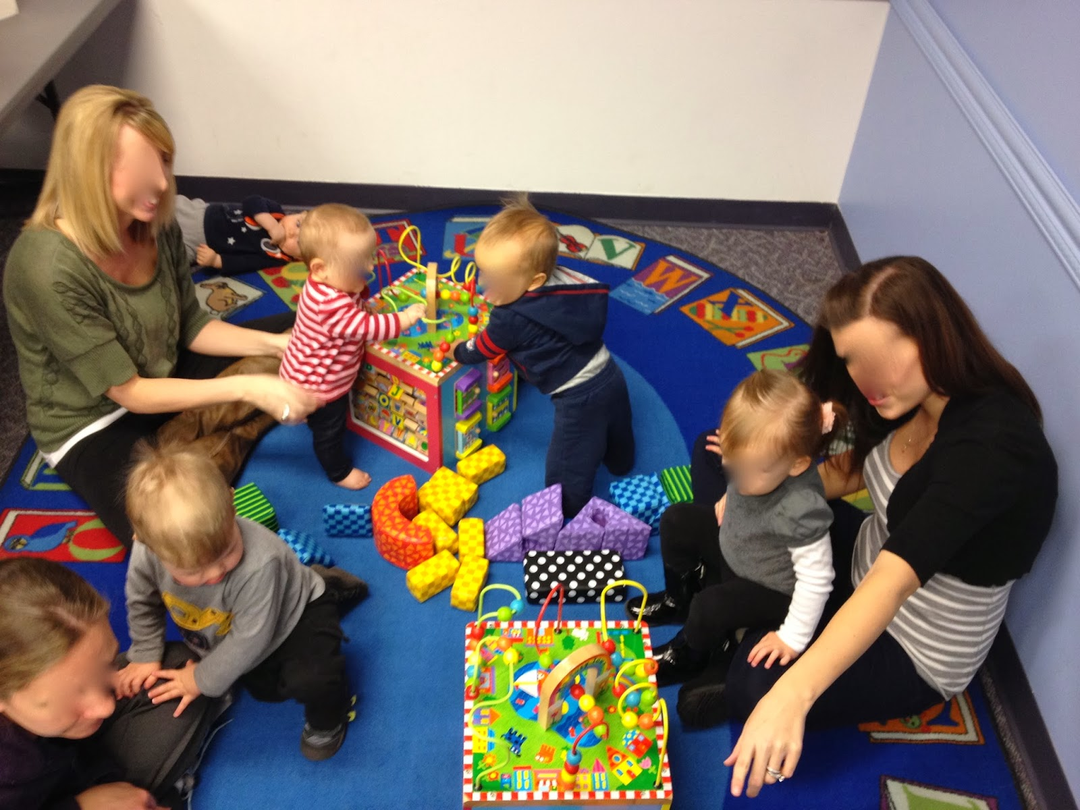
Optimal Program Space
Activity low to the ground
Items of sensory interest are within view and easy grasp
Child-sized
Structures can support child’s weight
Board books accessible
Space for solitary play & interaction
Out-of-bounds areas inaccessible
*this info is on your handout

Slide 12
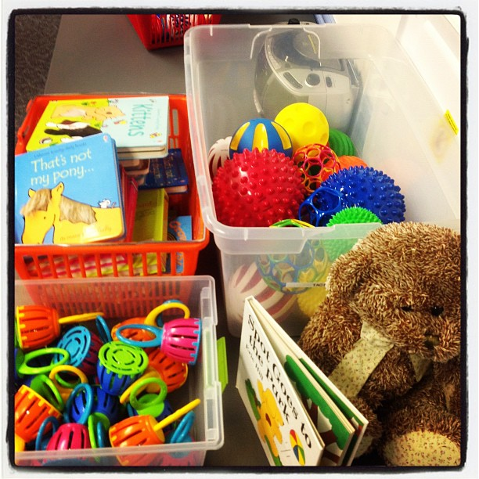
Optimal Program Format
Length relatively short (30 minutes max, 10-20 minutes better)
Opportunities for movement
Clear & consistent opening rituals, including waving “goodbye”
Smaller program size for better engagement
Caregivers present at all times & interacting
*this info is on your handout

Slide 13
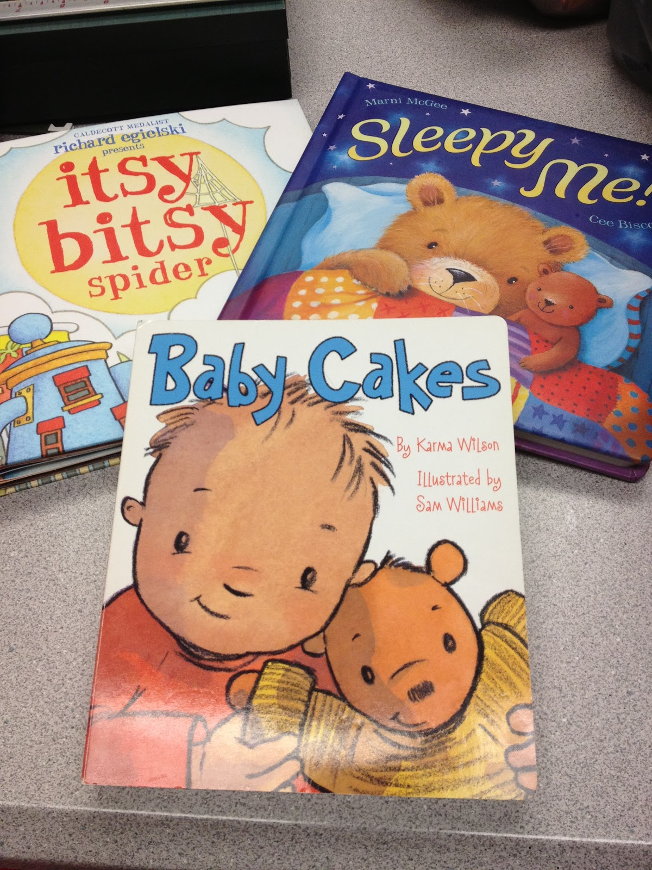
Optimal
Program Content
Include singing/music
Include opportunities for one-on-one book sharing
Include opportunities for play with developmentally appropriate toys
Narrate/explain all program activities
Model modifications for action rhymes & movement songs
*this info is on your handout

Slide 14
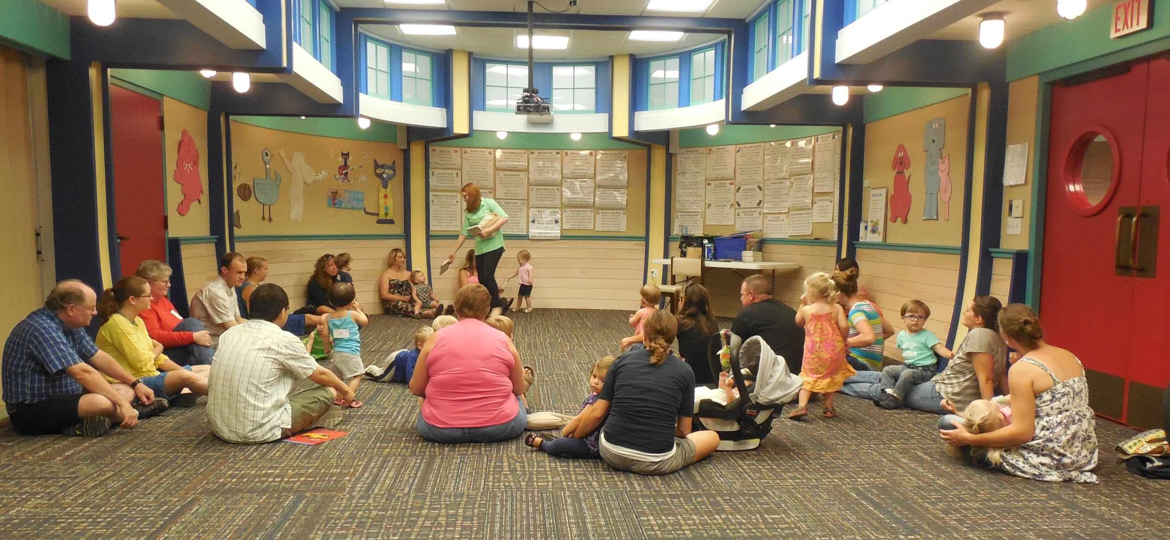
Optimal
Program Staffing
Have a consistent program leader
Leader actively encourages caregiver participation
Leader responds positively to movement, vocalizations from children
Leader will ideally have training specific to serving this age children
*this info is on your handout

Slide 15
Great Programming for Babies & Infants

Slide 16
POLL:
How long is your typical program for babies/infants?

Slide 17
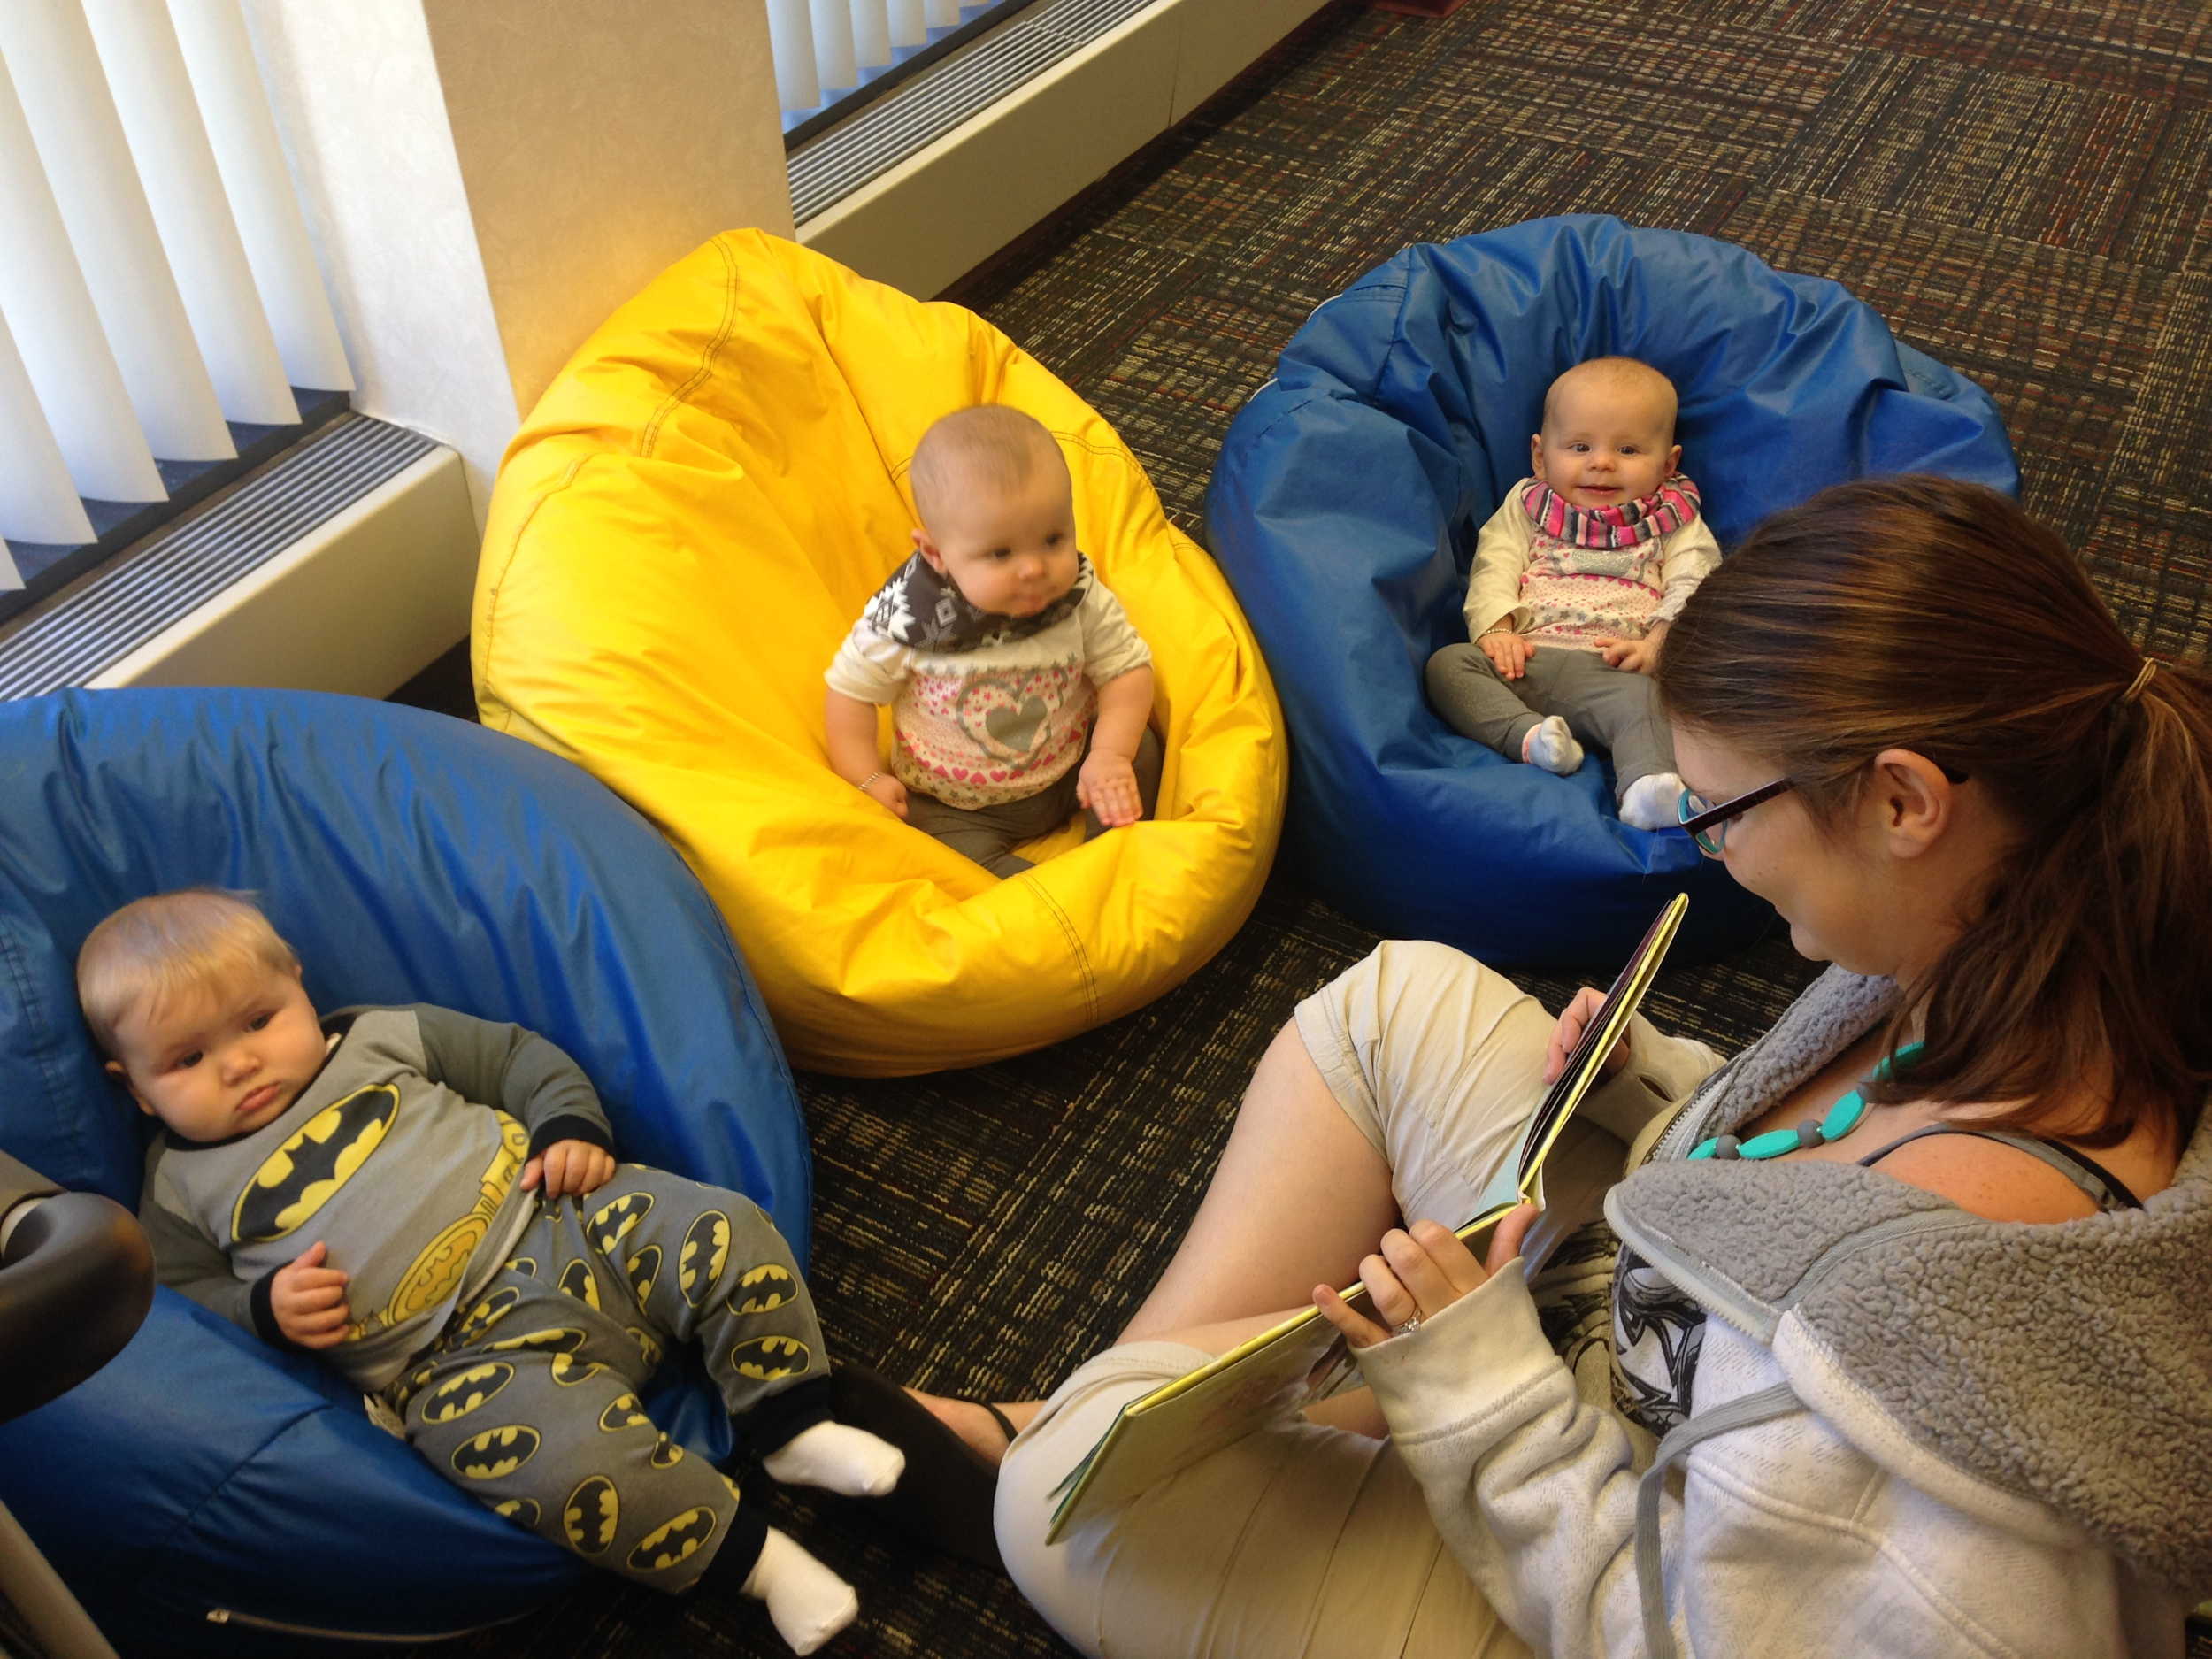
Optimal Baby/Infant Storytime Format
Short books
Repeated songs
Play opportunities
Caregiver engagement
Restricted space

Slide 18
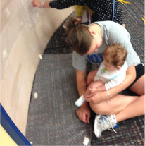
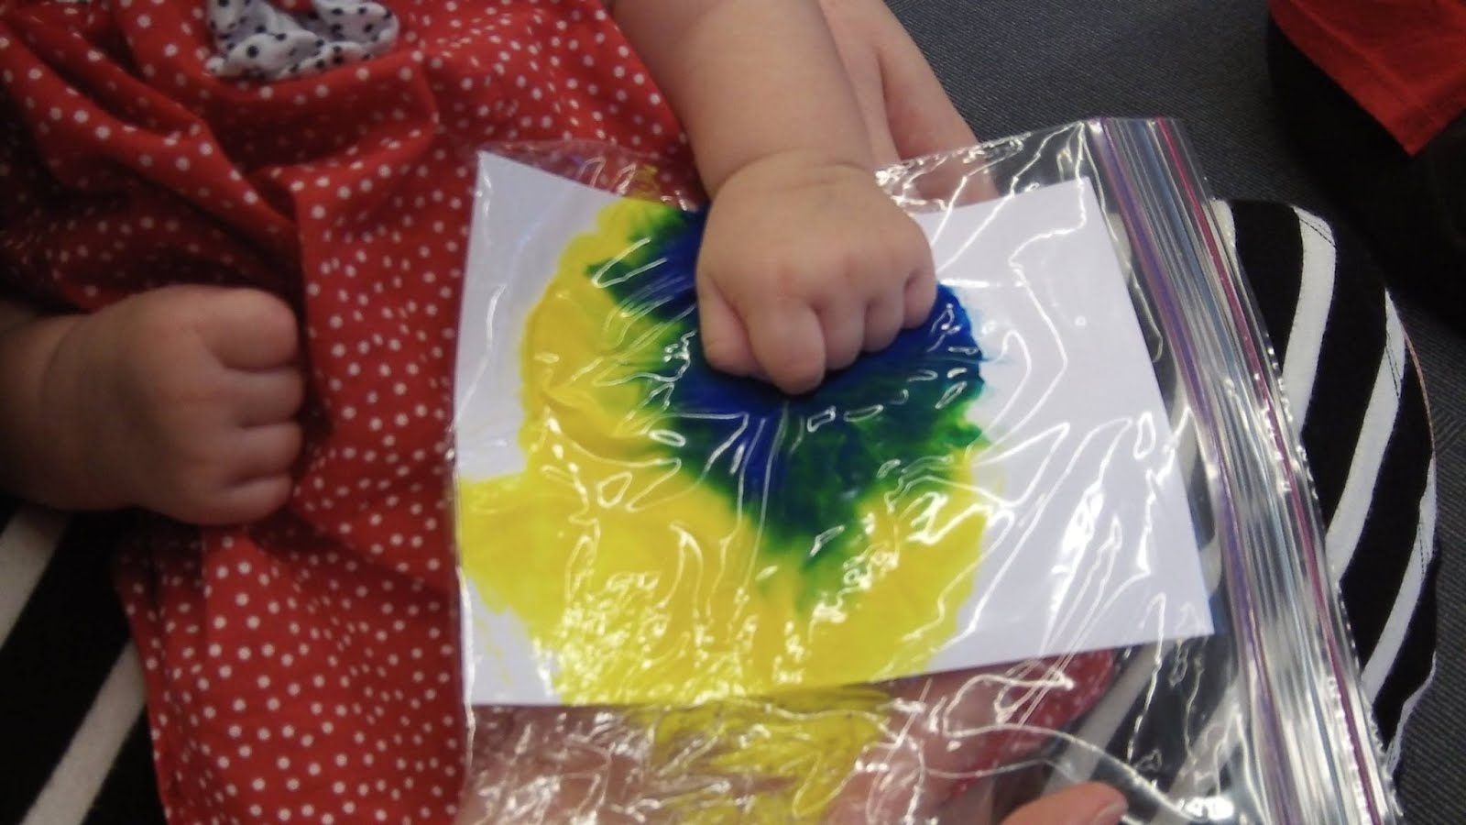
Programming for Babies/Infants Beyond Storytime
Paint in a bag
Bubble wrap wall
Ribbon crawl

Slide 19
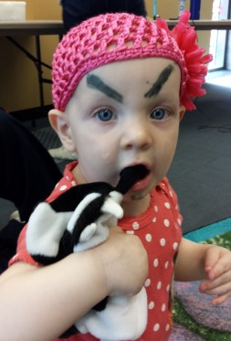
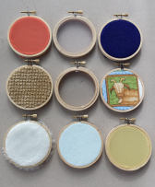
Programming for Babies/Infants Beyond Storytime
Music
Eyebrows
Sensory board

Slide 20
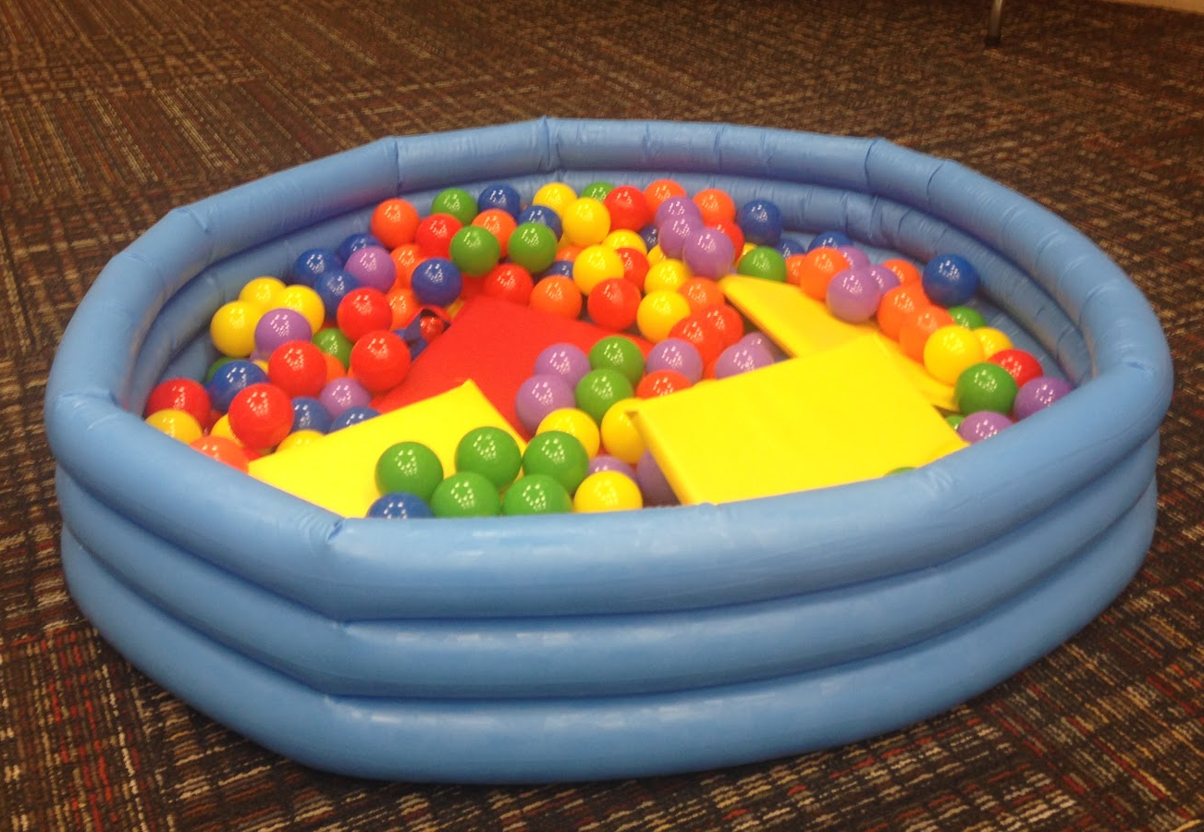
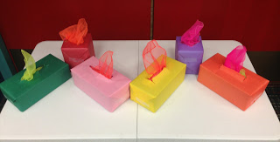
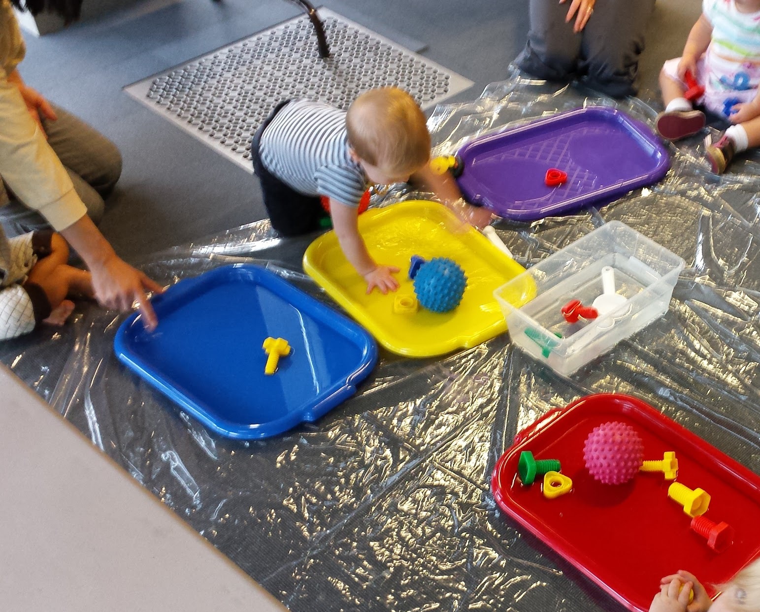
Programming for Babies/Infants Beyond Storytime
Ball pit
Scarf pull
Water play

Slide 21
Optimal Parent/Caregiver Messages
Singing slows down langauge. This allows children to build vocabulary and identify that language is made of parts.
Every time you read the same book, your child is learning new things. Repetition is key!
When your baby babbles, talk back to him! It’s his way of communicating with you and you are increasing his conversational skills and vocabulary.
Narrate your day to your child. This increases her vocabulary and the knowledge of the world around her.

Slide 22
Developmentally Appropriate Programming for Children 24-35 Months

Slide 23
Let’s Talk Developmental Milestones
 | Physical/Motor Development | Socioemotional Development | Cognitive Development | Language & Communication
24-35 months | - Scribbles with crayons - Can aim & throw an object - Can turn doorknobs, screwtops - Walks backward - Can descend stairs in childlike way | - Self-centered & selfish - Mimics observed mannerisms - Uses “no” frequently | - Concrete use of objects - Understands & uses some symbols - Uses transition objects (e.g., security blanket) | - Uses 250 words - Uses pronouns - Uses two-word sentences - Caregivers can better understand communication

Slide 24
Let’s Talk Developmental Milestones
 | Physical/Motor Development | Socioemotional Development | Cognitive Development | Language & Communication
24-35 months | - Scribbles with crayons - Can aim & throw an object - Can turn doorknobs, screwtops - Walks backward - Can descend stairs in childlike way | - Self-centered & selfish - Mimics observed mannerisms - Uses “no” frequently | - Concrete use of objects - Understands & uses some symbols - Uses transition objects (e.g., security blanket) | - Uses 250 words - Uses pronouns - Uses two-word sentences - Caregivers can better understand communication

Slide 25
Let’s Talk Developmental Milestones
 | Physical/Motor Development | Socioemotional Development | Cognitive Development | Language & Communication
24-35 months | - Scribbles with crayons - Can aim & throw an object - Can turn doorknobs, screwtops - Walks backward - Can descend stairs in childlike way | - Self-centered & selfish - Mimics observed mannerisms - Uses “no” frequently | - Concrete use of objects - Understands & uses some symbols - Uses transition objects (e.g., security blanket) | - Uses 250 words - Uses pronouns - Uses two-word sentences - Caregivers can better understand communication

Slide 26
Let’s Talk Developmental Milestones
 | Physical/Motor Development | Socioemotional Development | Cognitive Development | Language & Communication
24-35 months | - Scribbles with crayons - Can aim & throw an object - Can turn doorknobs, screwtops - Walks backward - Can descend stairs in childlike way | - Self-centered & selfish - Mimics observed mannerisms - Uses “no” frequently | - Concrete use of objects - Understands & uses some symbols - Uses transition objects (e.g., security blanket) | - Uses 250 words - Uses pronouns - Uses two-word sentences - Caregivers can better understand communication

Slide 27
Let’s Talk Developmental Milestones
 | Physical/Motor Development | Socioemotional Development | Cognitive Development | Language & Communication
24-35 months | - Scribbles with crayons - Can aim & throw an object - Can turn doorknobs, screwtops - Walks backward - Can descend stairs in childlike way | - Self-centered & selfish - Mimics observed mannerisms - Uses “no” frequently | - Concrete use of objects - Understands & uses some symbols - Uses transition objects (e.g., security blanket) | - Uses 250 words - Uses pronouns - Uses two-word sentences - Caregivers can better understand communication

Slide 28
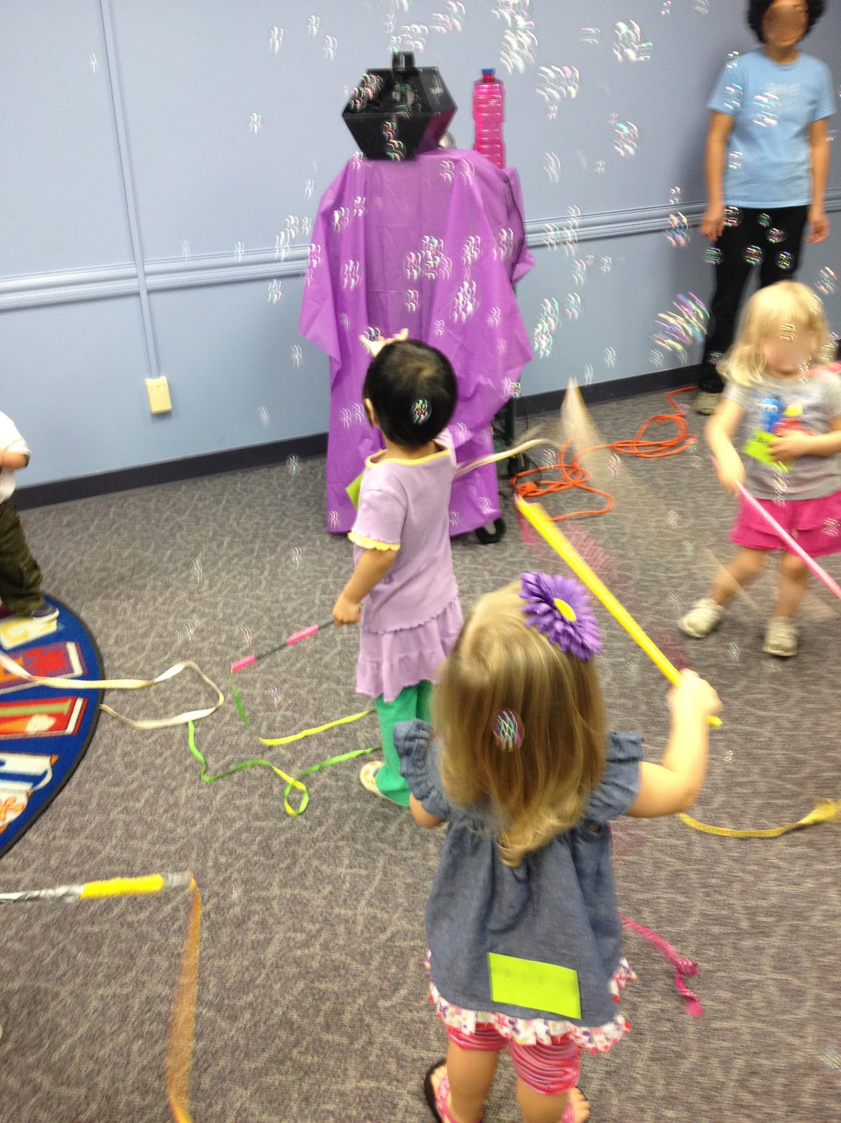
Optimal Program Space
Includes room for gross motor play
Child-sized props/furniture
Objects accessible throughout the program
Space is organized for discrete activities
Picture books reflecting diversity are available
Play materials can easily be moved and secured
*this info is on your handout

Slide 29
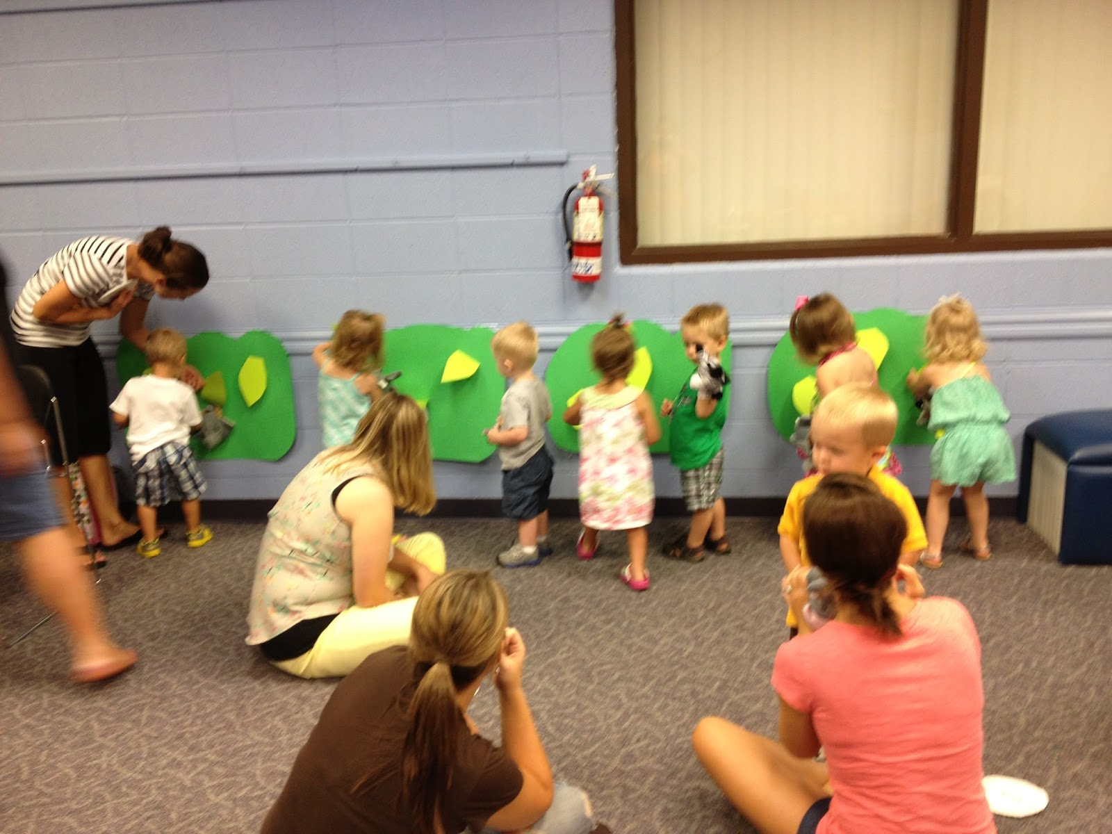
Optimal Program Format
Opening ritual sharing names, with children stating their own names
Encourage participation regardless of ability
Ensure time for children to complete activities
Children choose between limited options
Children help clean up
Smaller program size for better engagement
*this info is on your handout

Slide 30
POLL:
What activities do you regularly include in your two-year-old programs?

Slide 31
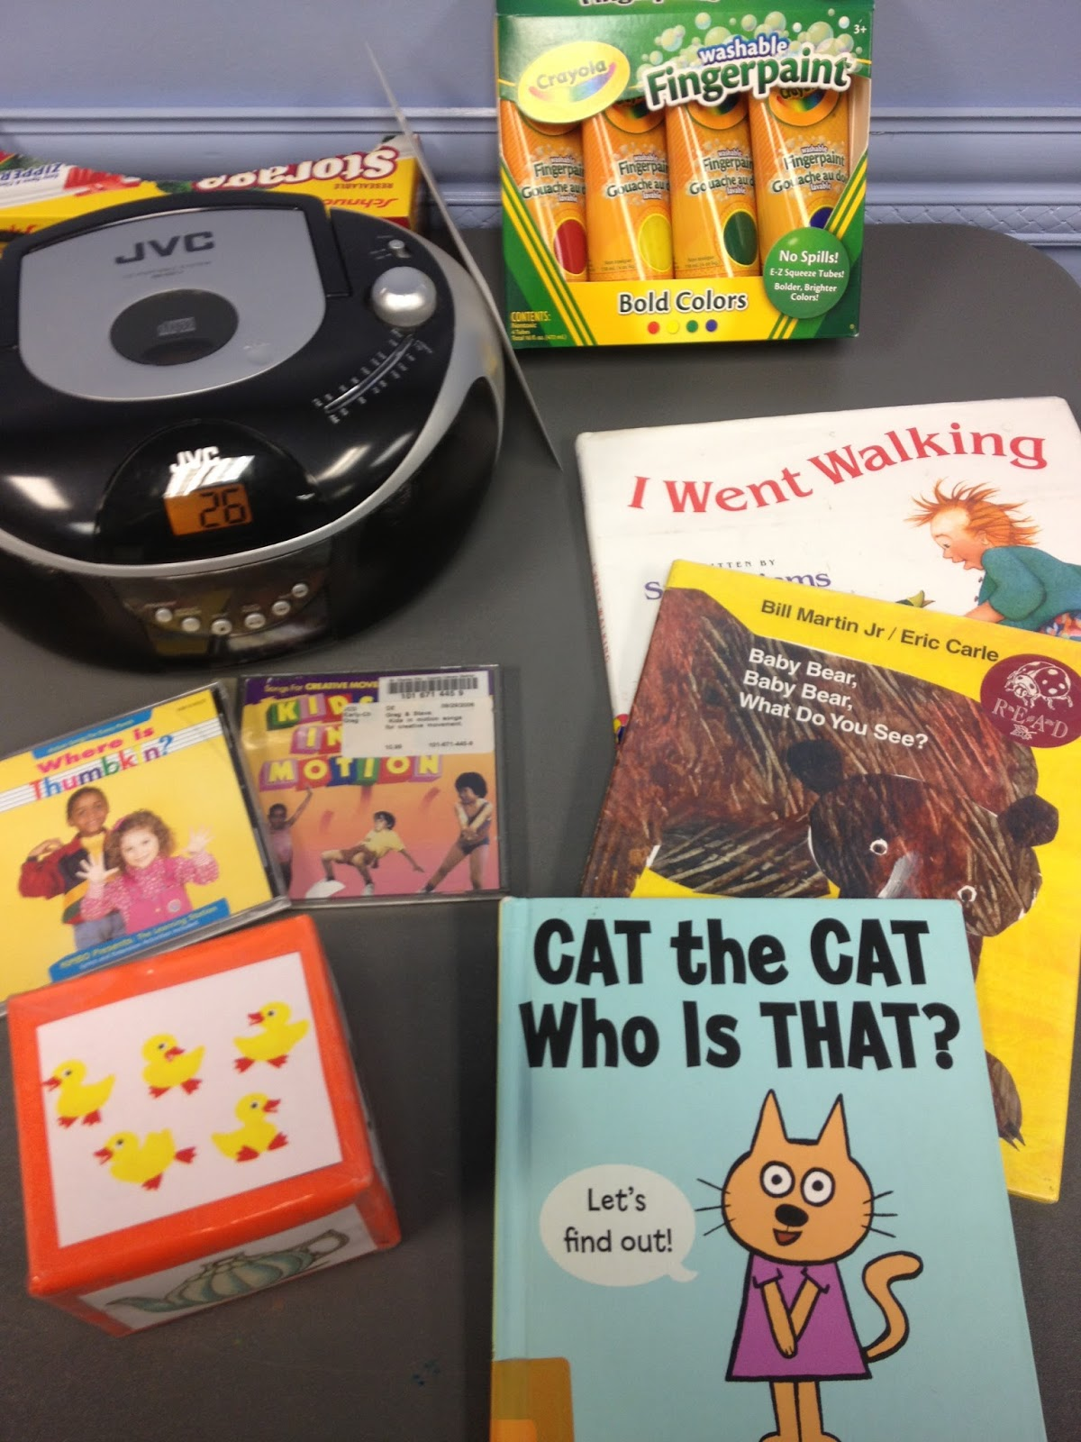
Optimal
Program Content
Reading is frequent & in close adult contact
Singing, fingerplays, action rhymes taught & repeated
Activities described aloud with appropriate vocab
Process art/crafts
Opportunities for pretend play
Follow-the-leader activities
*this info is on your handout

Slide 32
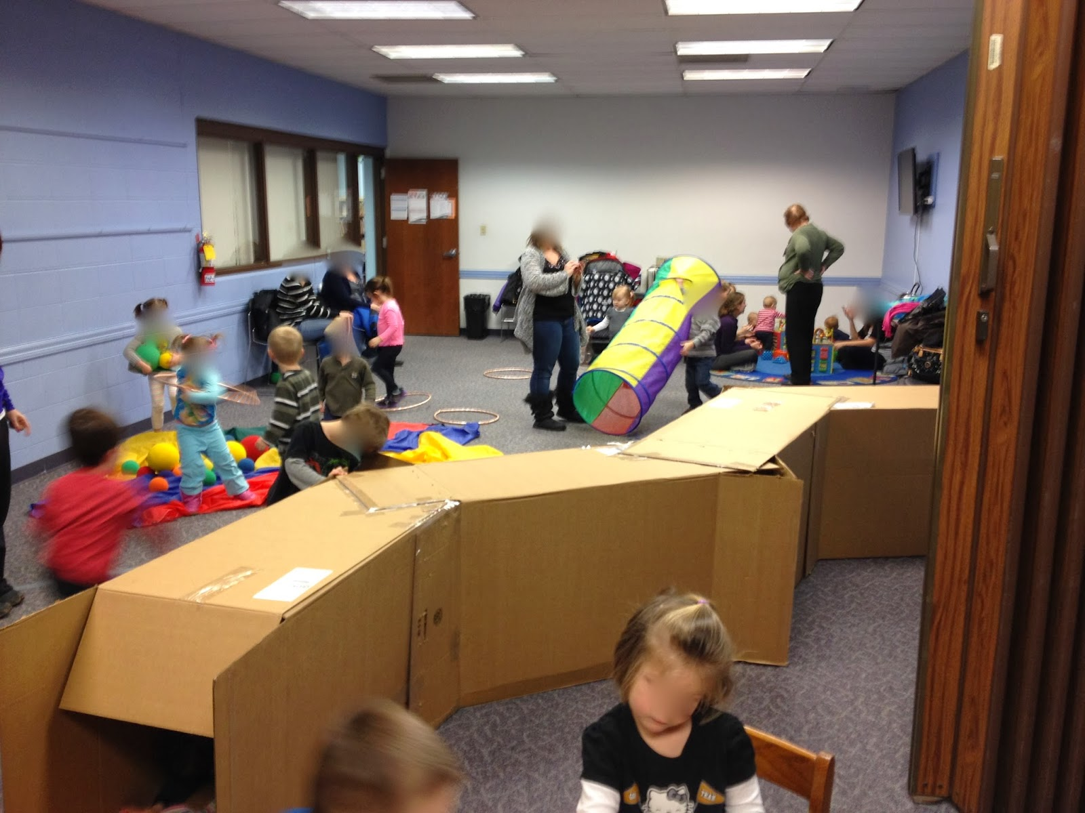
Optimal
Program Staffing
1-2 program leaders
Leader confirms vocalizations &/or asks for clarification
Model & narrate appropriate behaviors
Engage children in play
Engage caregivers to get to know children
Leader will ideally have training specific to serving this age children
*this info is on your handout

Slide 33
Great Programming for Toddlers

Slide 34
Optimal Toddler Storytime Format
Short books with action
Introducing key concepts
Letters, numbers, colors, shapes
Consistent songs and rhymes
Nametags
Opportunities for play
Lots of talking!

Slide 35
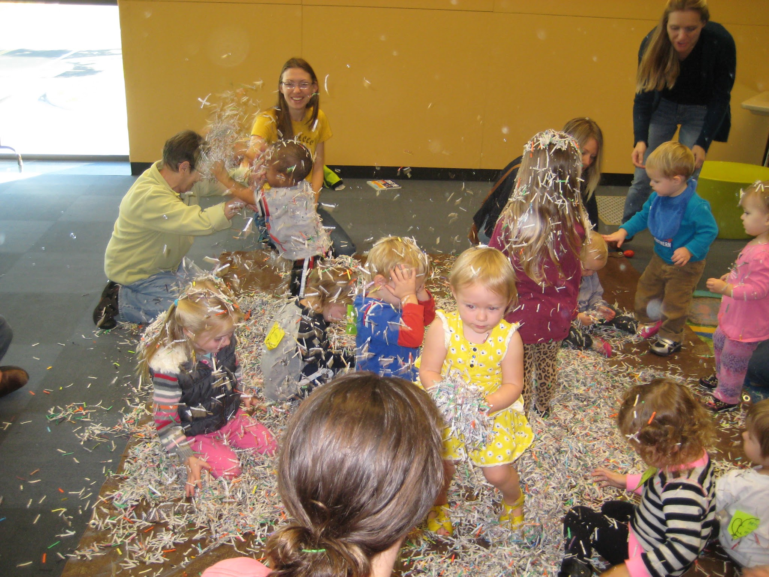
Programming for Toddlers Beyond Storytime
Drive in movie
Parachute play

Slide 36
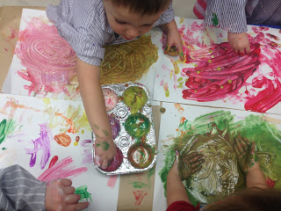
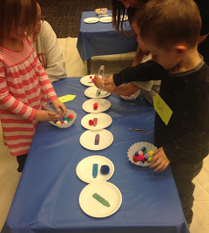
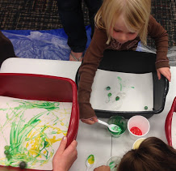
Programming for Toddlers Beyond Storytime
STEAM

Slide 37
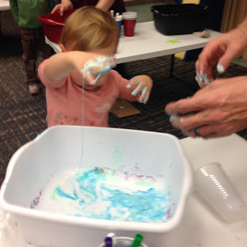
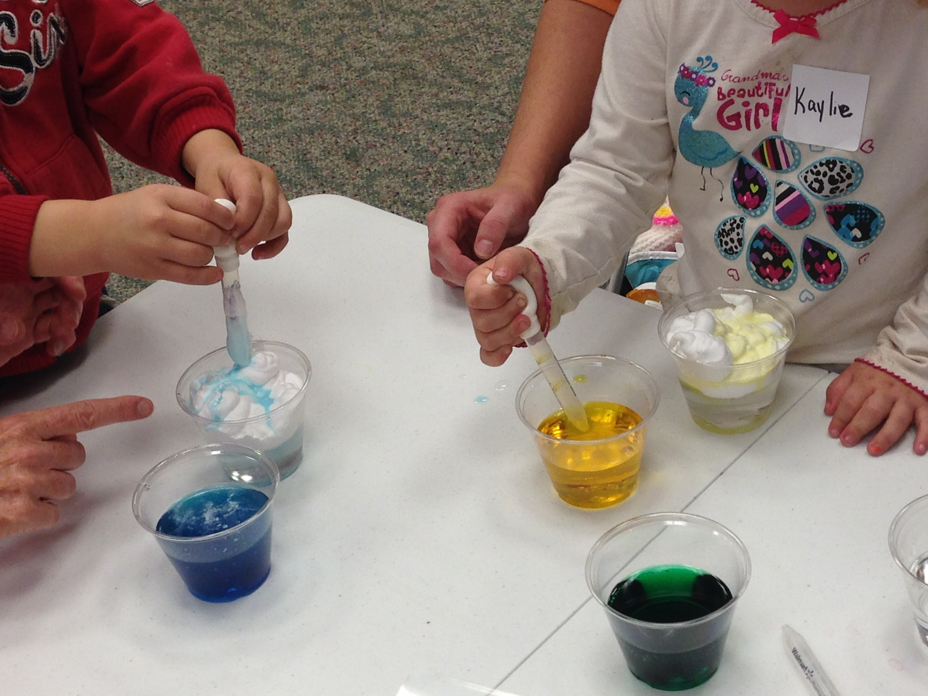
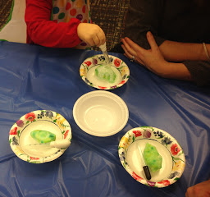
Programming for Toddlers Beyond Storytime
STEAM

Slide 38
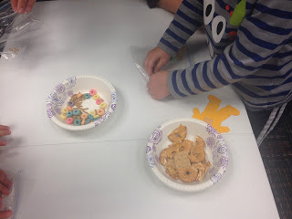
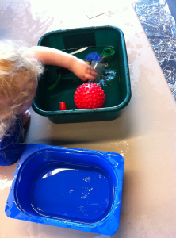
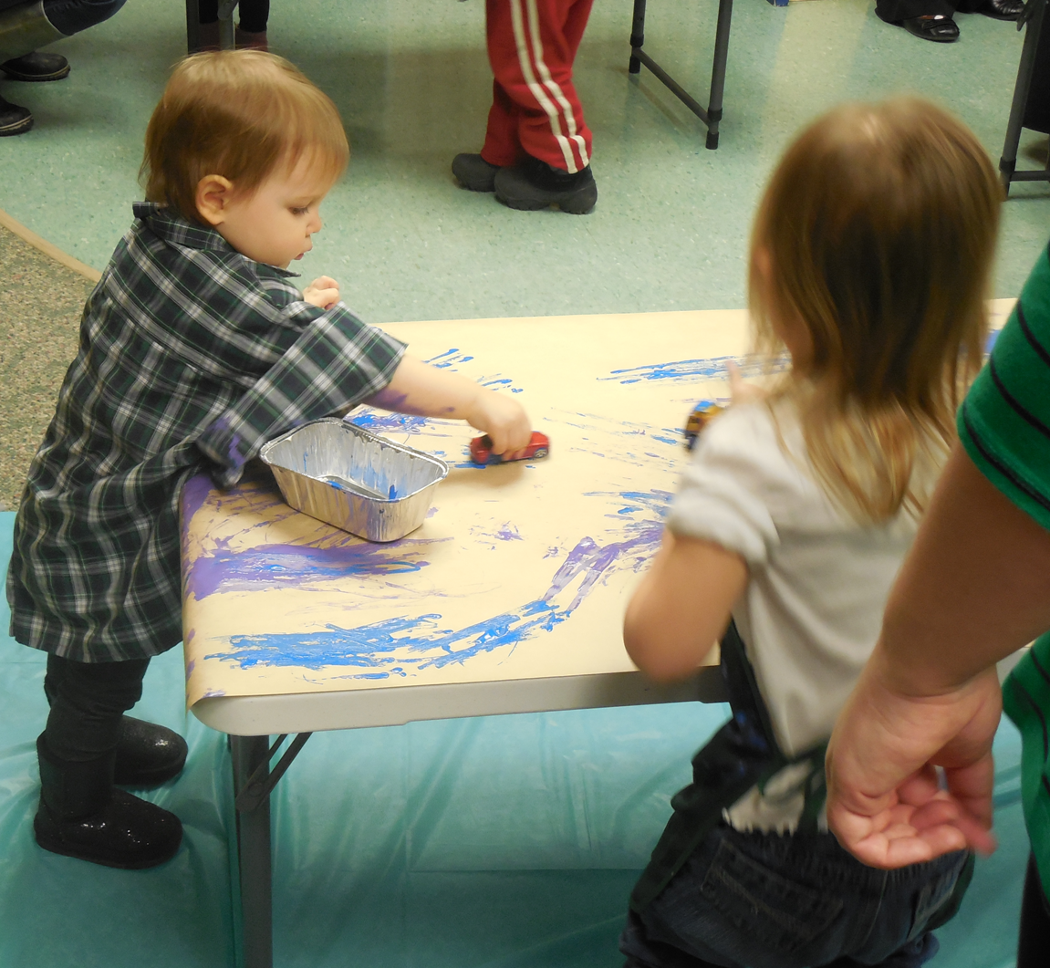
Programming for Toddlers Beyond Storytime
STEAM

Slide 39
Optimal Parent/Caregiver Messages
Is your child not enjoying a book? Stop reading it! It’s better to have 5 minutes of good reading time, rather than 5 minutes of forcing a child to finish a book.
A child who can identify shapes has an easier time with letter recognition.
Freeze songs are a great way to start practicing self control and bodily awareness.
One way to encourage a love of reading in your child is to let them see you reading.

Slide 40
Great Resources for Serving Babies & Toddlers

Slide 41
Policy & Research Groups
Zero to Three
Erikson Institute
American Academy of Pediatrics
Centers for Disease Control & Prevention
*this info is on your handout

Slide 42
Professional Resources
Association for Library Service to Children
Colorado Libraries for Early Literacy
Every Child Ready to Read, 2nd Edition
National Association for the Education of Young Children
Supercharged Storytimes
Your state library
*this info is on your handout

Slide 43
Blogs
Jbrary - Lindsey Krabbenhoft & Dana Horrocks
Mel’s Desk - Melissa Depper
Miss Meg’s Storytime- Meg Scheibel
Reading with Red - Brooke Newberry
Read, Sing, Play - Kendra Jones
Storytime Katie - Katie Salo
*this info is on your handout

Slide 44
What are your questions?

Slide 45
Thank you!
Brooke Newberry | brooke@lacrosselibrary.org | readingwithred.blogspot.com
Amy Koester | amy.e.koester@gmail.com | showmelibrarian.blogspot.com

