Slide 1
Welcome to today’s Infopeople Webinar!
Infopeople is dedicated to bringing you the best in practical library training and improving information access for the public by improving the skills of library workers. Infopeople, a grant project of the Califa Group, is supported in part by the Institute of Museum and Library Services under the provisions of the Library Services and Technology Act administered in California by the State Librarian. This material is covered by Creative Commons 4.0 Non-commercial Share Alike license. Any use of this material should credit the funding source.

Slide 2
TEEN SUICIDE PREVENTION
Cheryl Eskin, MFT and Michelle Carlson, MSCPH

Slide 3
Mental Health Statistics in the U.S.
21% of youth 13-18 live with a mental health condition
90% who die by suicide had an underlying mental illness
Average delay between onset of symptoms and intervention is 10 years
HOW CAN WE HELP?
Know the signs & start the conversation!
Notes:
We are all aware that suicide is a problem. We are here to help you better understand suicide and what can be done about it.

Slide 4
Real stories of hope and help…
Ginger, 16
Notes:
Teen testimonial – Make sure story includes coping, resilience, and recovery – include what helped him/her to educate the audience on what they can do to help

Slide 5
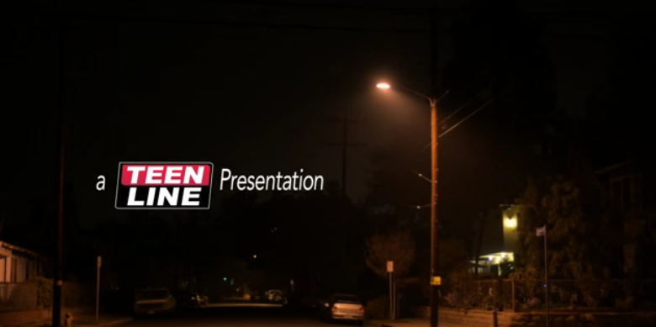
https://youtu.be/ErA_nfjITA4

Slide 6
Myth or Fact?
Suicide usually occurs with no warning signs.
MYTH!
Notes:
Most people show one or more warning signs, so it is important to know the signs and take them seriously especially if a behavior is new or has increased and if it seems related to a painful event, loss, or change.

Slide 7
Myth or Fact?
People who take their own life are weak and just looking for “attention.”
MYTH!
Notes:
4) More than 90% of people who take their own life have at least one and often more than one treatable mental illness such as depression, anxiety, and/or alcohol and substance abuse. With better recognition and treatment many suicides can be prevented. Differentiate b/t asking for attention to get help and “attention seeking” as a negatively perceived behavior***
It is ok to break a friend’s trust and share your concerns with an adult if you think your friend might be thinking about harming him or herself.

Slide 8
Myth or Fact?
Asking someone if they are thinking about suicide will put the idea in their head.
MYTH!
Notes:
2) When you fear someone you know is in crisis or depressed, asking them if they are thinking about suicide can actually help. By giving a person an opportunity to open up and share their troubles you can help alleviate their pain and find solutions. (We can use this question as a segway to have them turn to the person next to them and practice asking)
If a person talks about ending his or her life you should take him or her seriously and connect him or her to help.

Slide 9
Suicide Specific Information
Not everyone who thinks about suicide makes an attempt
17 % of high school students report seriously considering suicide
Suicide is the 2nd leading cause of death among 10-24 year olds
Notes:
Risk Factors – suicide is never connected to one absolute reason or cause
“What are things that could put a person at greater risk of suicide?”
Drugs & alcohol-Impaired impulse control- as related to being a teenager or being under the influence of drugs or alcohol
Lack of inhibition- not really caring what’s right or wrong
Access to guns- 6x more likely to die by suicide
Previous suicide attempts- if they have attempted before they are at greater risk
Suicide in family- mental illness
Abuse & bullying- if someone is experiencing abuse at home or being bullied at school
LGBTQ+ - family rejection, bullying, violence
Statements
Talking about wanting to die or to kill oneself
Talking about feeling hopeless or having no reason to live
Talking about feeling trapped or in unbearable pain
Talking about being a burden to others
Appearance
Changes from “baseline”
disheveled, no longer caring, big baggy clothes in summer weather
Behavior
Increasing the use of alcohol or drugs
Showing rage or talking about seeking revenge
Displaying extreme mood swings
Change in sleeping/eating habits
Acting anxious or agitated; behaving recklessly
Sleeping too little or too much
Looking for a way to kill oneself, such as searching online or buying a gun
Withdrawing or feeling isolated A
Writings and Drawings about death/suicide
Self Harm Vs. Suicide
Discuss the difference between harming self as maladaptive coping or hurting self with intention to die.
Drop in grades
Giving away possessions- danger in this as being a “will” for young people and a really big “red flag”
Talk, writing, and/or drawing about death- transition in to pictures drawn by teen in the 70’s
Giving away possessions
Feelings/Affect
Expand beyond depression to agitation, anxiety, expansiveness (mania, bi-polorarity), 1&2, Hypomania, dysthmia
Behaviors
Acting anxious or agitated; behaving recklessly
Sleeping too little or too much
Looking for a way to kill oneself, such as searching online or buying a gun
Withdrawing or feeling isolated
Writings and Drawings about death/suicide

Slide 10
Risk Factors for Suicide
Previous suicide attempts
Recent loss
Access to guns
Suicide and/or mental illness in family
Abuse & bullying
Stress resulting from prejudice/discrimination – LGBTQ+
Stigma around mental illness & asking for help
Alcohol or drug abuse
Notes:
Risk Factors – suicide is never connected to one absolute reason or cause
“What are things that could put a person at greater risk of suicide?”
Drugs & alcohol-Impaired impulse control- as related to being a teenager or being under the influence of drugs or alcohol
Lack of inhibition- not really caring what’s right or wrong
Access to guns- 6x more likely to die by suicide
Previous suicide attempts- if they have attempted before they are at greater risk
Suicide in family- mental illness
Abuse & bullying- if someone is experiencing abuse at home or being bullied at school
LGBTQ+ - family rejection, bullying, violence
Statements
Talking about wanting to die or to kill oneself
Talking about feeling hopeless or having no reason to live
Talking about feeling trapped or in unbearable pain
Talking about being a burden to others
Appearance
Changes from “baseline”
disheveled, no longer caring, big baggy clothes in summer weather
Behavior
Increasing the use of alcohol or drugs
Showing rage or talking about seeking revenge
Displaying extreme mood swings
Change in sleeping/eating habits
Acting anxious or agitated; behaving recklessly
Sleeping too little or too much
Looking for a way to kill oneself, such as searching online or buying a gun
Withdrawing or feeling isolated A
Writings and Drawings about death/suicide
Self Harm Vs. Suicide
Discuss the difference between harming self as maladaptive coping or hurting self with intention to die.
Drop in grades
Giving away possessions- danger in this as being a “will” for young people and a really big “red flag”
Talk, writing, and/or drawing about death- transition in to pictures drawn by teen in the 70’s
Giving away possessions
Feelings/Affect
Expand beyond depression to agitation, anxiety, expansiveness (mania, bi-polorarity), 1&2, Hypomania, dysthmia
Behaviors
Acting anxious or agitated; behaving recklessly
Sleeping too little or too much
Looking for a way to kill oneself, such as searching online or buying a gun
Withdrawing or feeling isolated
Writings and Drawings about death/suicide

Slide 11
Stressors
A Better Understanding
I can’t see
what’s on the other side!
Depression
Bullying
Identity
Family
Loss
BF/GF
Friends
School
Notes:
Introduce “Bob” as a teen that goes to the same school
Point to thick line at bottom of screen- that represents the future
Ask (along with prompt on pres)– “What do you look forward to?”
Then Ask (with prompt)- “What stresses you out?”
Then go into story as a way to help students gain a better understanding of suicide.
Story line for Depressed Stickperson– “Bob”
-Has been having a hard time concentrating at school. Really distracted and grades have been dropping
-On top of that, realized significant other was liking other people’s pictures on Instagram and felt no trust in the relationship—break up
-S.O.-mutual friends, drama within the friend circles
-Not getting along with family because of grades/behavior
-Grandmother died
-Ex posted embarrassing pictures on instagram and getting bullied at school
-Identity—Feelings of not really knowing who they are
-Depression- withdrawal, lonely, sad, painful
This can be told as a story for best effect. Make sure to point out how Bob is feeling throughout the process to give students a chance to empathize and really understand.
Point out that with stressors piled on makes it harder to look at the future because all “Bob” can see is the stressors right in front of him

Slide 12
Helpless
Pain
No way out
Hopeless
Alone
Tunnel vision
Notes:
Understanding the concept of tunnel vision
A person at risk isn’t thinking about all the great positive things, is only looking at the stressors piled up and feeling
-Hopeless
-Helpless
-Pain
-Alone
- And like there’s no way out

Slide 13
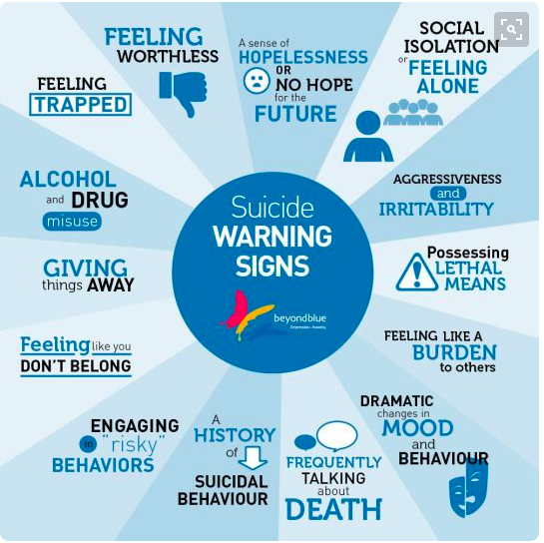
Notes:
Most people show one or more warning signs before an attempt
Make sure to say improved mood in someone who has been down

Slide 14
Buffers/Protective Factors
“Permission” to talk about feelings
Someone to talk to who will really LISTEN
Responsibility to the community
Connectedness – to individuals, family, community & social institutions
Problem solving skills – ability to adapt to change
Religion
Notes:
Suicide IS preventable! Example: Suicides on Golden Gate Bridge - the fact that a larger number of people have been talked out of ending their lives by police and security officers than have jumped from the bridge
Sharing real stories of reaching out for help and coping, particularly if you are a teen speaking to a peer
Standing up for people (peers, relatives, friends) living with a mental health challenge when being: harassed, bullied or excluded – especially important in online communities – social media

Slide 15
How Can You Help?
Ask!
Are you thinking of killing yourself?
I’m really concerned for your safety. Are you thinking of killing yourself?
When people are feeling extremely upset, they can have thoughts of suicide. Is this something you’ve been thinking about?
Notes:
Address the benefits of intervening early, before symptoms progress. It’s never too early to ask this question if you note some of the warning signs we discussed.
Tell them to take turns asking out loud before continuing to other ways of asking
Ask in a calm way – more likely to tell you the truth

Slide 16
What if they say YES?
ASSESS!
Do you have a plan?
Is it realistic and/or easily accessible?
Do you have a specific time frame?
Have you attempted before?
If they answer YES, call 911 or the PET team.
If they answer NO, professional help should be obtained ASAP.
Notes:
Research shows that suicide hotlines save lives!
It is ok to break a friend’s trust and share your concerns with an adult if you think your friend might be thinking about harming him or herself.

Slide 17
Do and Don’ts with Suicidal Teens
Don’t promise to keep their suicidal thoughts a secret.
No debates about the moral aspects of suicide.
Let the teen know in advance if you plan to involve others
Be comfortable with the word “suicide.”
Know how to assess for plans, means, lethality, etc.
Safety Plan - Involve collaterals as much as possible (including school, siblings, etc)

Slide 18
If they’re not suicidal, but you’re still concerned….
Talk and LISTEN to them.
Let them know you appreciate their sharing
Connect with parents (if appropriate)
Give them opportunities to shine
Provide resources
Take care of yourself

Slide 19
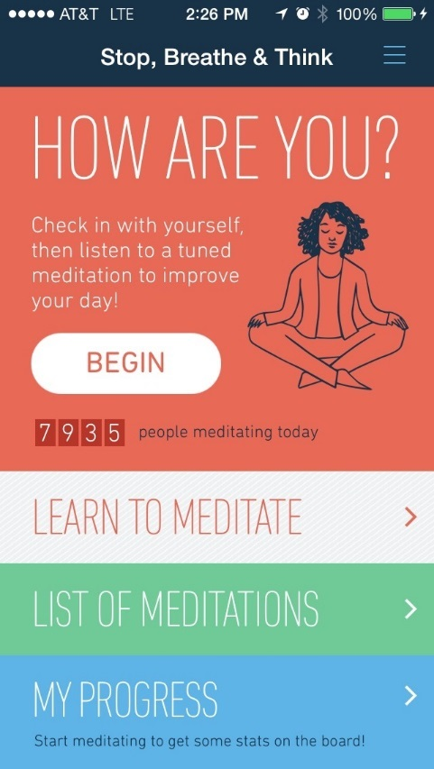
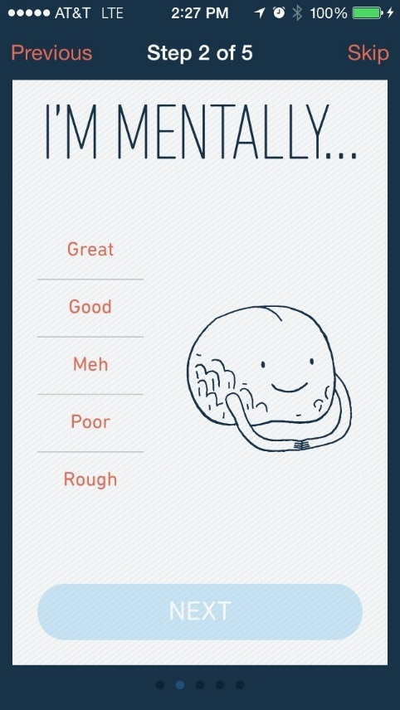
Resources
Stop, Breathe & Think
http://www.stopbreathethink.org/
Notes:
This is a wonderful app to help link a friend with more support. Can put 3 “friends” as their go-to people when they need more support. Also links them diretly to national suicide prevention lifeline or 911 if emergency.
Can help someone figure out their warning signs – when they are starting to feel that way… how to safely cope… distractions (favorite movie? Book? Music?)… identify their network of support (therapist? Family? Friends?) and how to keep safe. Free resource.

Slide 20
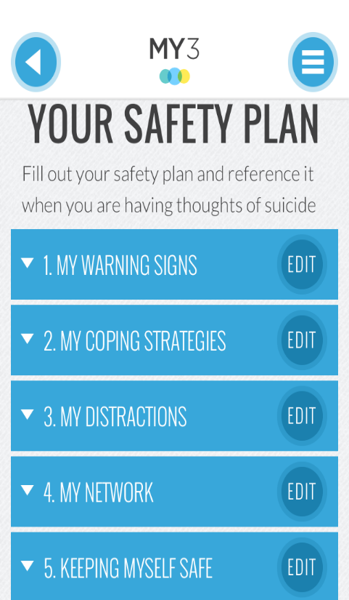
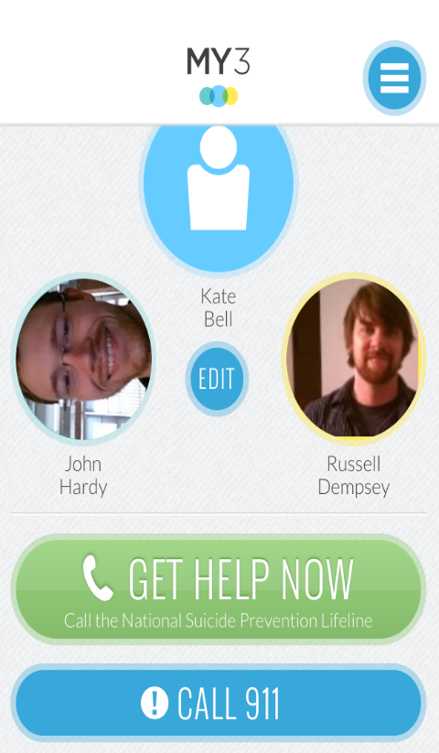
Resources
MY3 APP
http://www.my3app.org/
Notes:
This is a wonderful app to help link a friend with more support. Can put 3 “friends” as their go-to people when they need more support. Also links them diretly to national suicide prevention lifeline or 911 if emergency.
Can help someone figure out their warning signs – when they are starting to feel that way… how to safely cope… distractions (favorite movie? Book? Music?)… identify their network of support (therapist? Family? Friends?) and how to keep safe. Free resource.

Slide 21
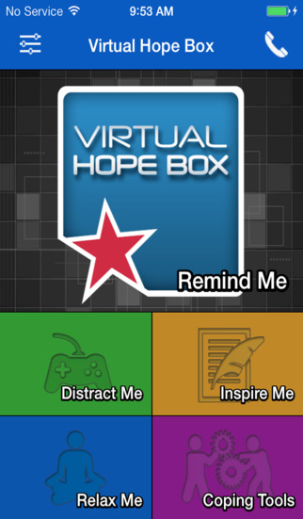
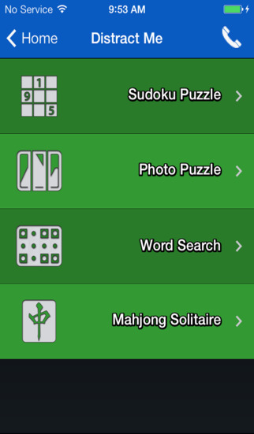
Resources
Virtual Hope Box in the app store
Notes:
This is a wonderful app to help link a friend with more support. Can put 3 “friends” as their go-to people when they need more support. Also links them diretly to national suicide prevention lifeline or 911 if emergency.
Can help someone figure out their warning signs – when they are starting to feel that way… how to safely cope… distractions (favorite movie? Book? Music?)… identify their network of support (therapist? Family? Friends?) and how to keep safe. Free resource.

Slide 22
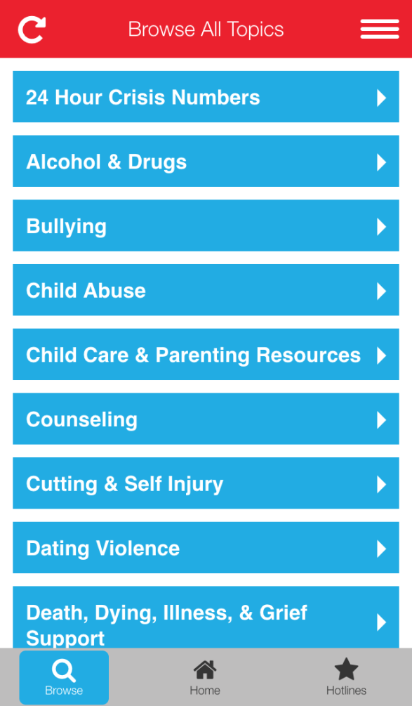
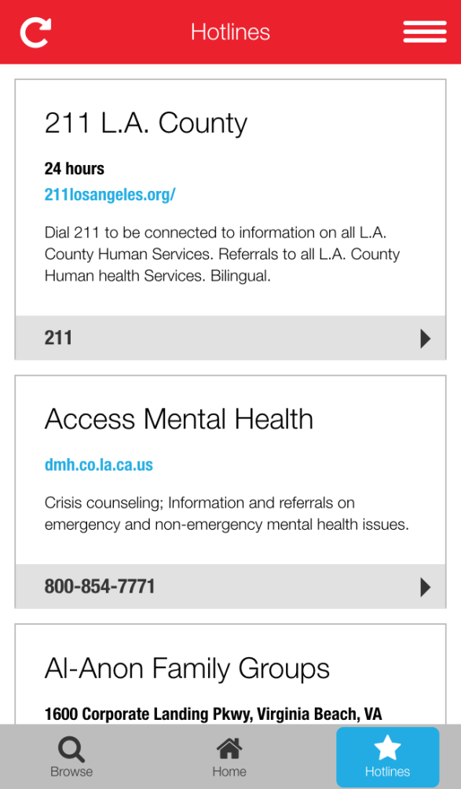
Resources
Search for Teen Line on any smart phone
http://www.TeenlineOnline.org/Downloads/
Notes:
TEEN LINE app – different resources for teens in SoCal.

Slide 23
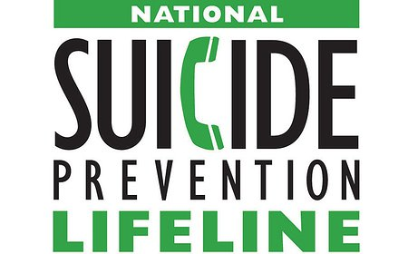
Resources
1-800-273-8255 24/7
SuicidePreventionLifeline.org
Know the Signs
SuicideIsPreventable.org
LGBTQ
1-866-488-7386 24/7
TheTrevorProject.org
310-855-4673 or
Text “TEEN” to 839863
TeenlineOnline.org
Notes:
Programs or services Teen Line provides to help with teens who may be suicidal – hotline, message boards and parent support website – Should we read recent emailed testimonial from teen who contacted hotline and said “You saved my life”?

Slide 24
Any questions?:
Please contact Cheryl Eskin, Program Director, at 310-423-1604 or cheryl@teenlineonline.org
or
Michelle Carlson, Executive Director, at 310-423-1084 or michelle@teenlineonline.org
THANK YOU FOR YOUR TIME!

